Slide 1
Introduction to the Arts
Spring 2021
Printmaking Project
Instructor: Art Moses
Nathan Ayala
Taylor Borla
Audrianna Cope
Isabella De Gregorio
Taylor Flosser
Katelyn Jones
Benjamin Laxton
Catherine McKittrick
Austin Roy
Mason Scott
Cassidy Sweeney
Chandler Williams

Slide 2
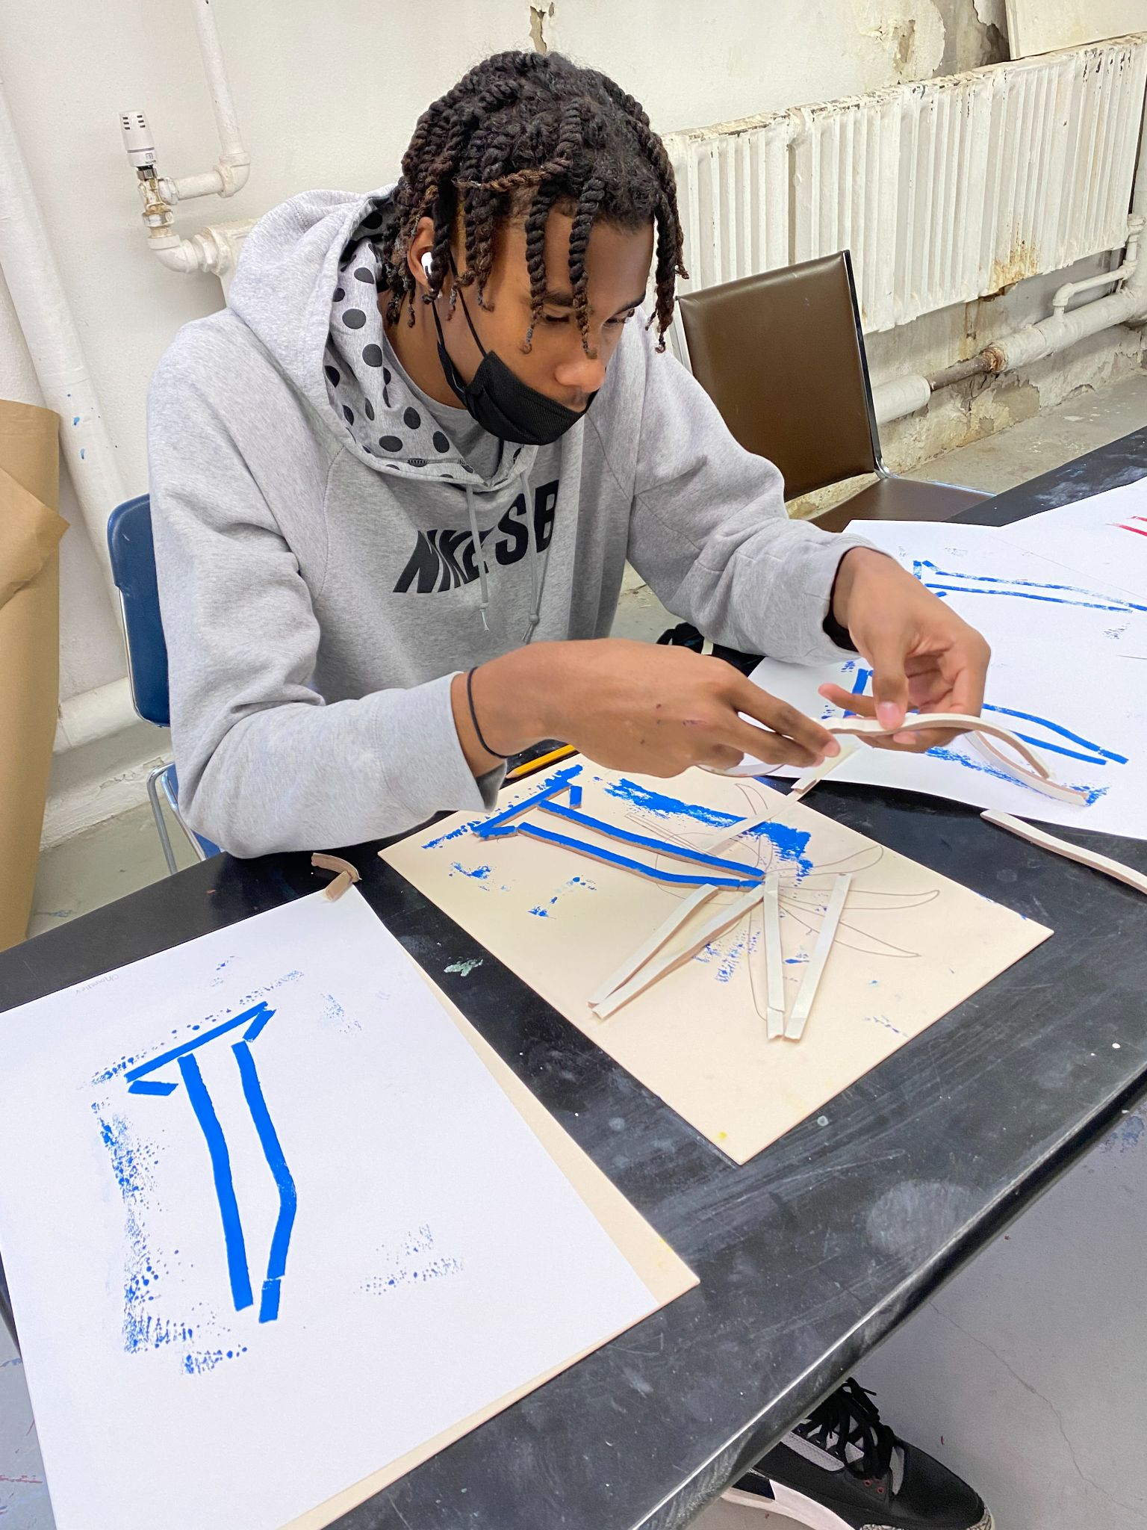
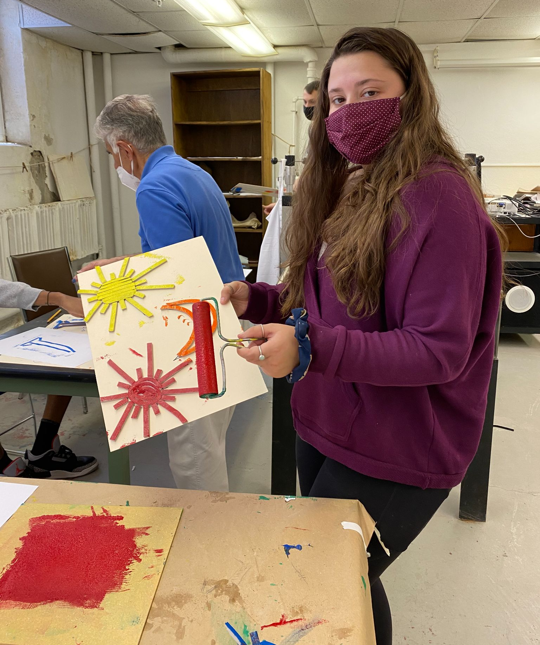
Printmaking Projects
As one of many topics covered in this course, students are introduced to basic printmaking techniques.
The first printmaking exercise is a one color block print using ten inch square stripped plasterboard cured with a coat of shellac, dried and then printed on paper. The student is reminded that lettering must be reversed on the tile so that letters are printed in the correct order. The design must include a theme and lettering.
These photos were taken on the day of the second exercise which includes a three color registered print with reverse lettering .
______________________________
Photo credits to Isabella DeGregorio ‘22.

Slide 3
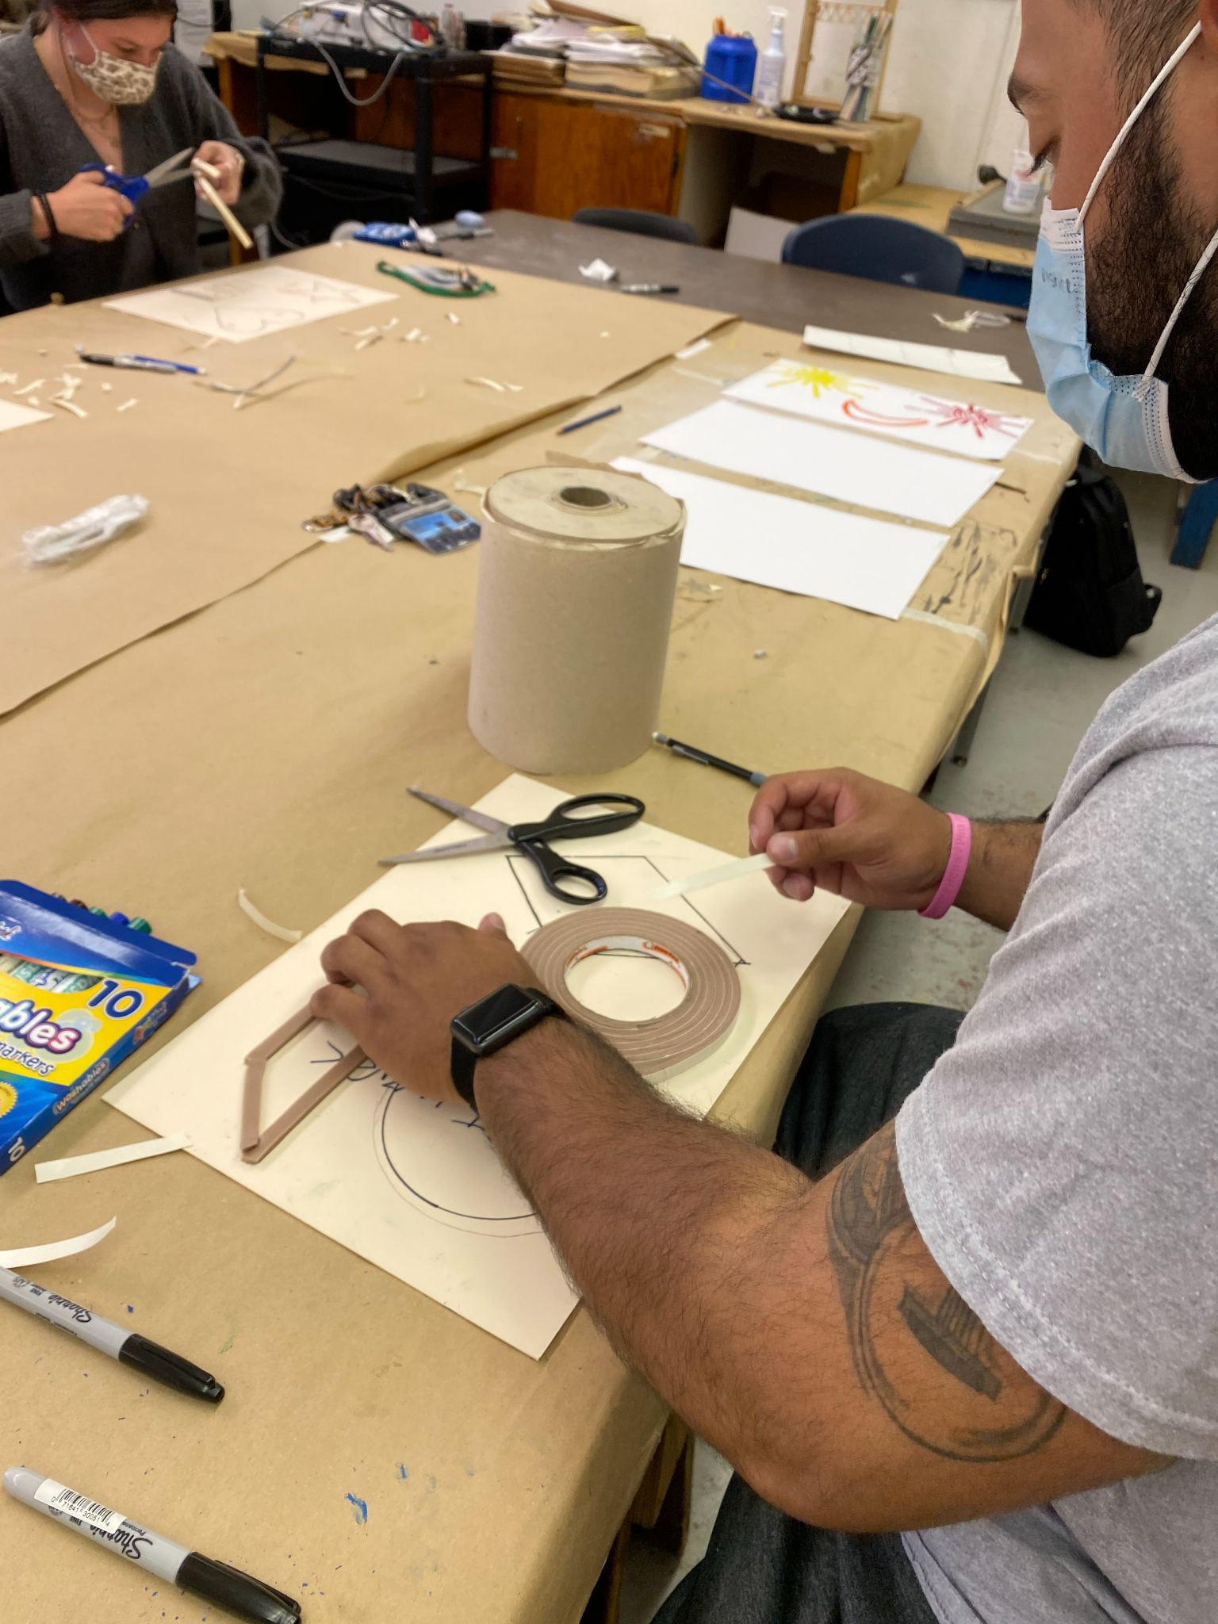
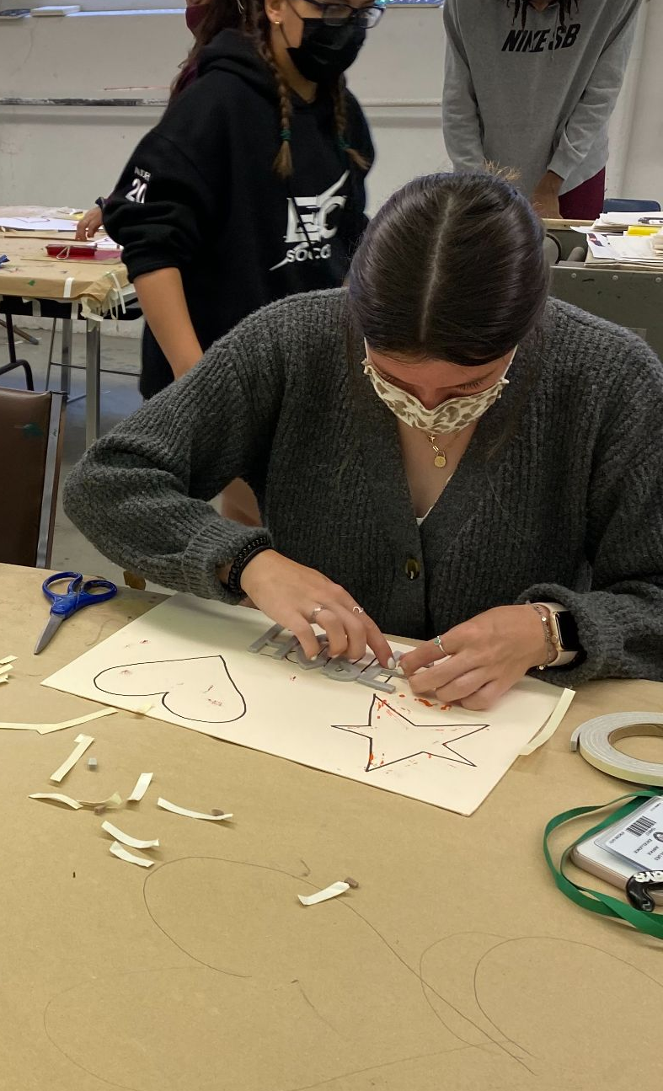
The student uses pressure sensitive weather stripping on a rigid board to develop a theme and title.

Slide 4
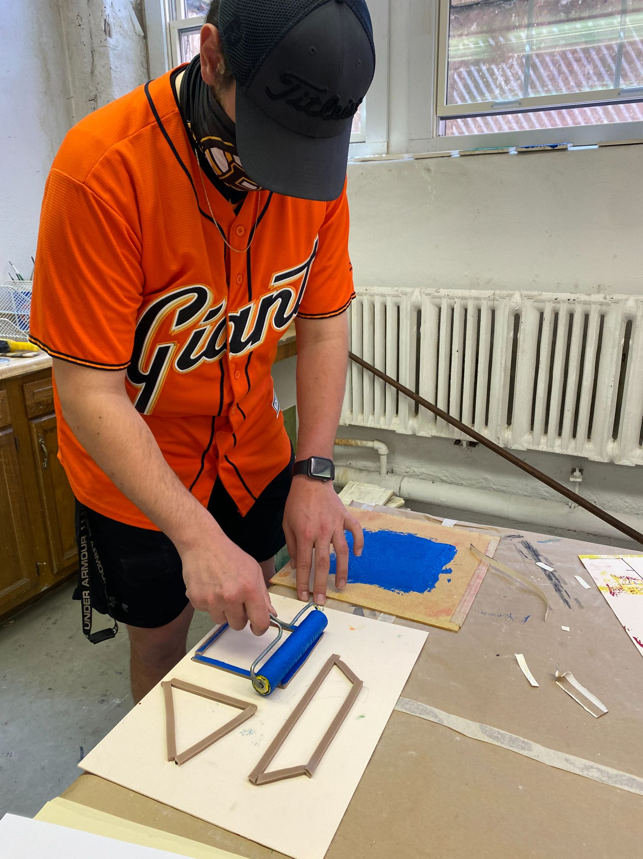
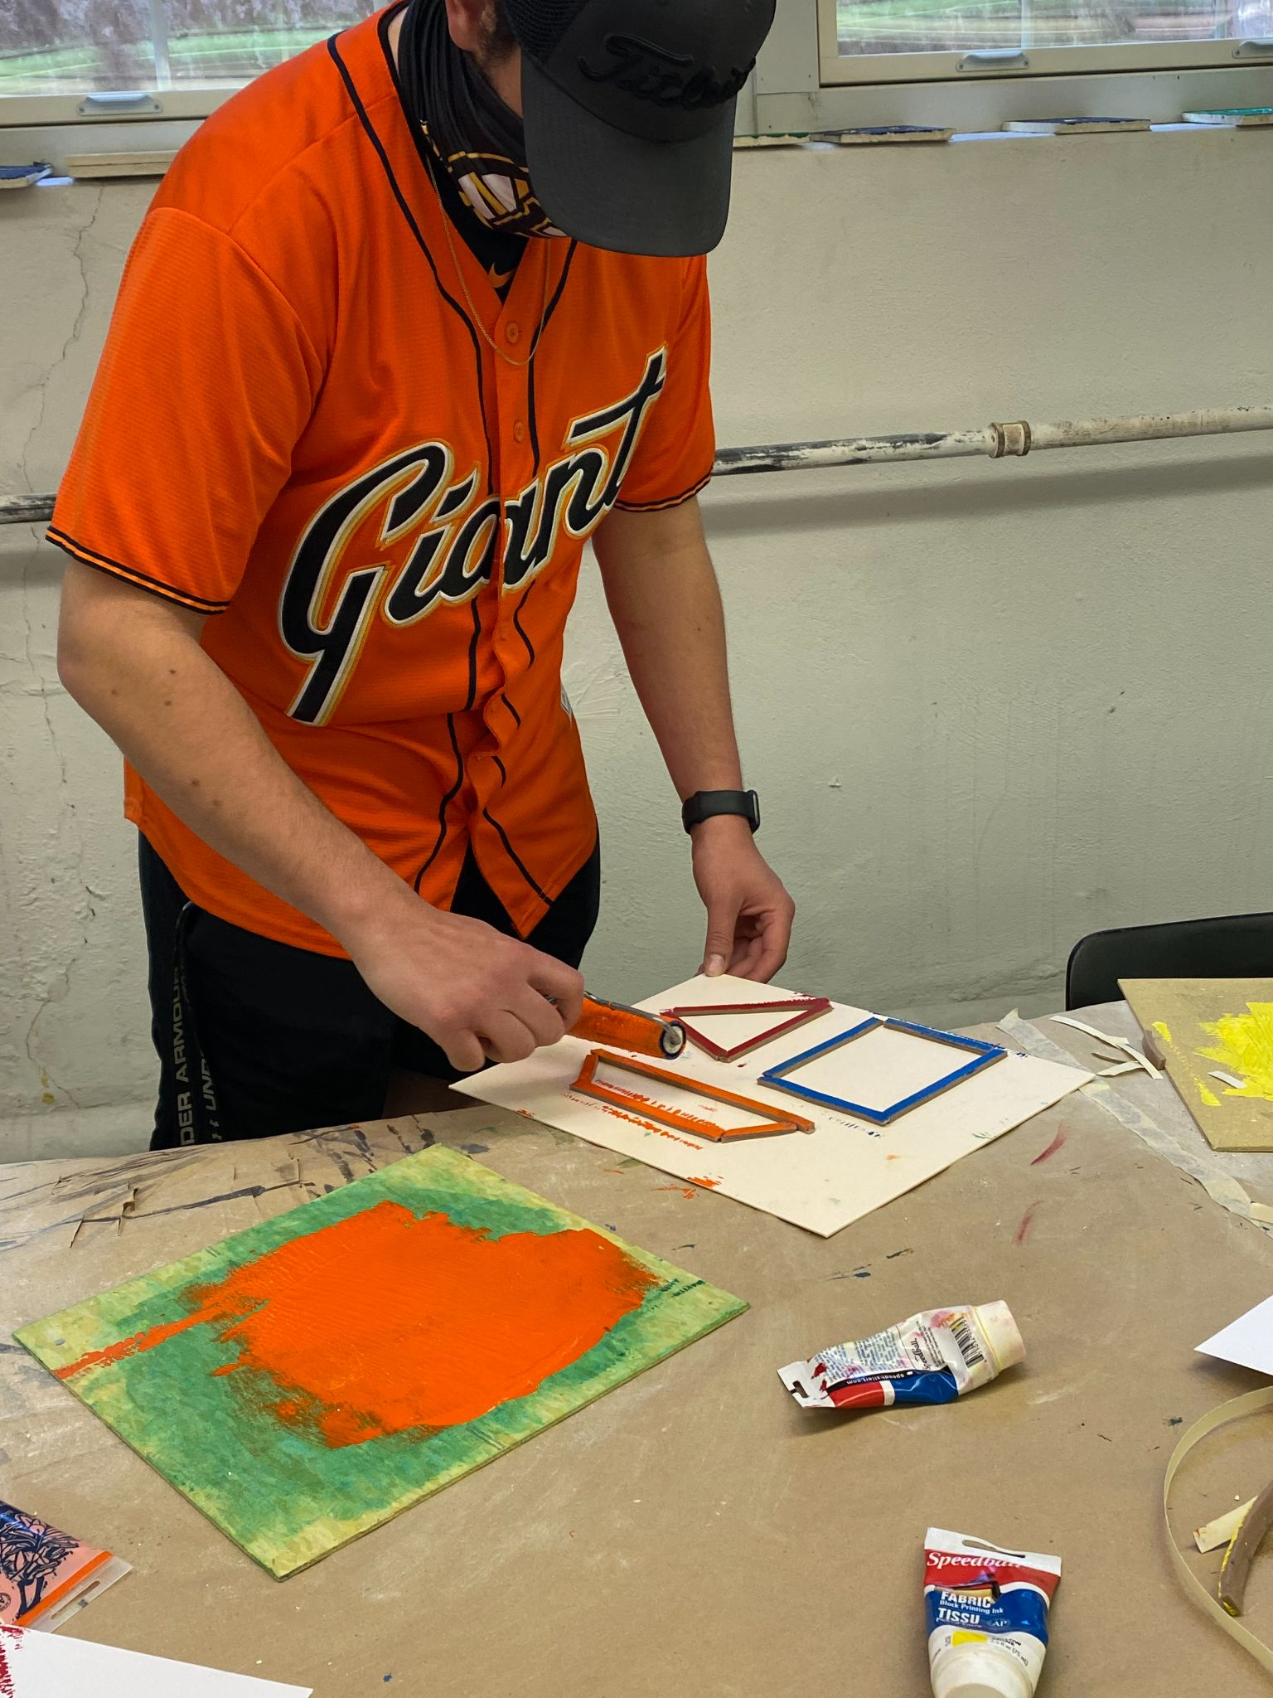
There are three separate pattern applications to the rigid board. As each color is inked and applied to three separate pieces of paper (three prints for the three colors ) the weatherstripping is removed and the next "color" of weatherstripping is applied.

Slide 5
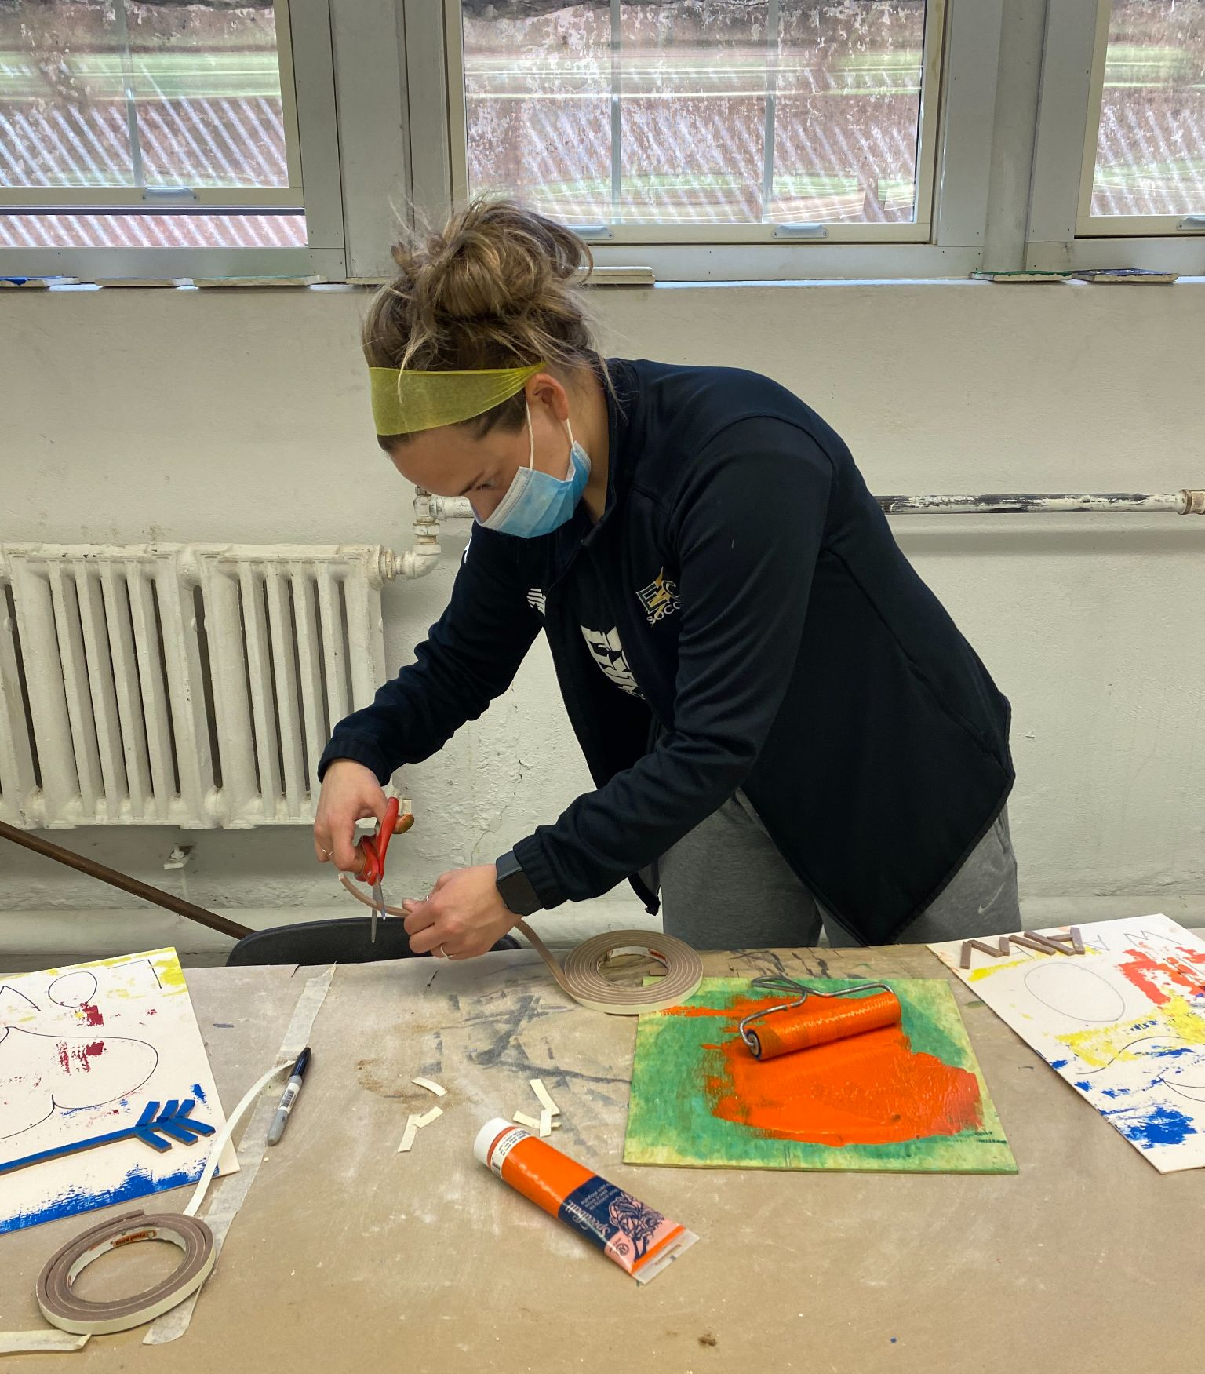
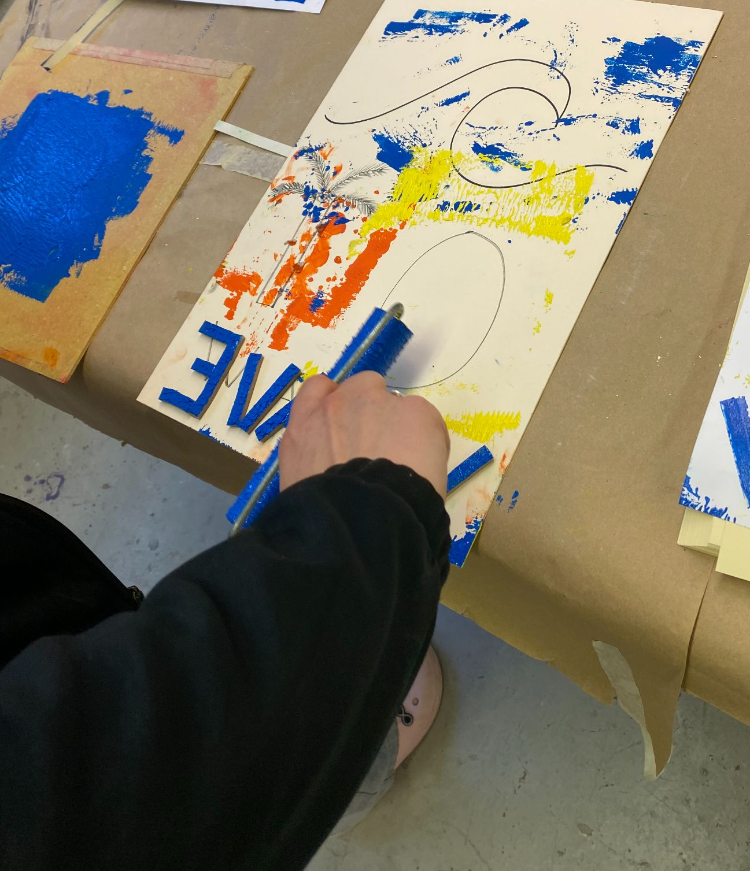
Note this picture below with the reverse lettering on the student's work board .
The student then realizes the complexity of multi-color printed pictures and black and white newspapers . Registration is the control of application and clarity.

Slide 6
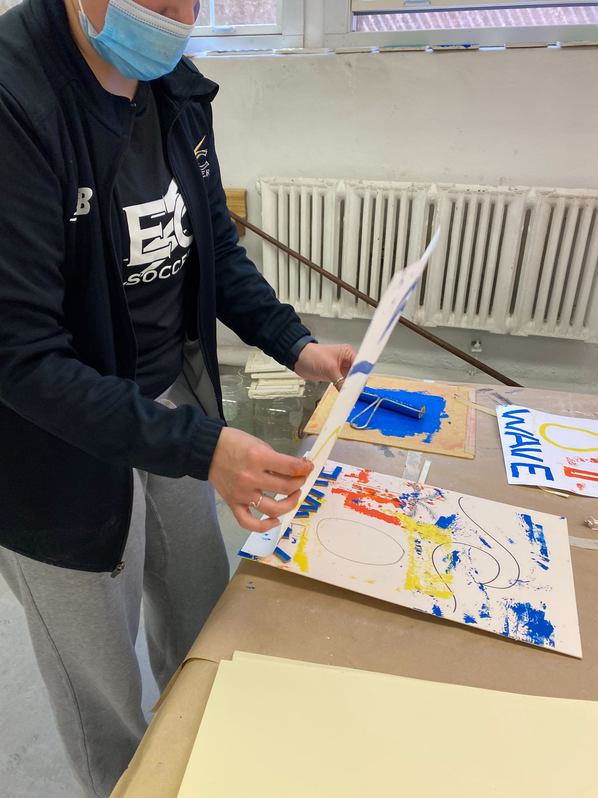
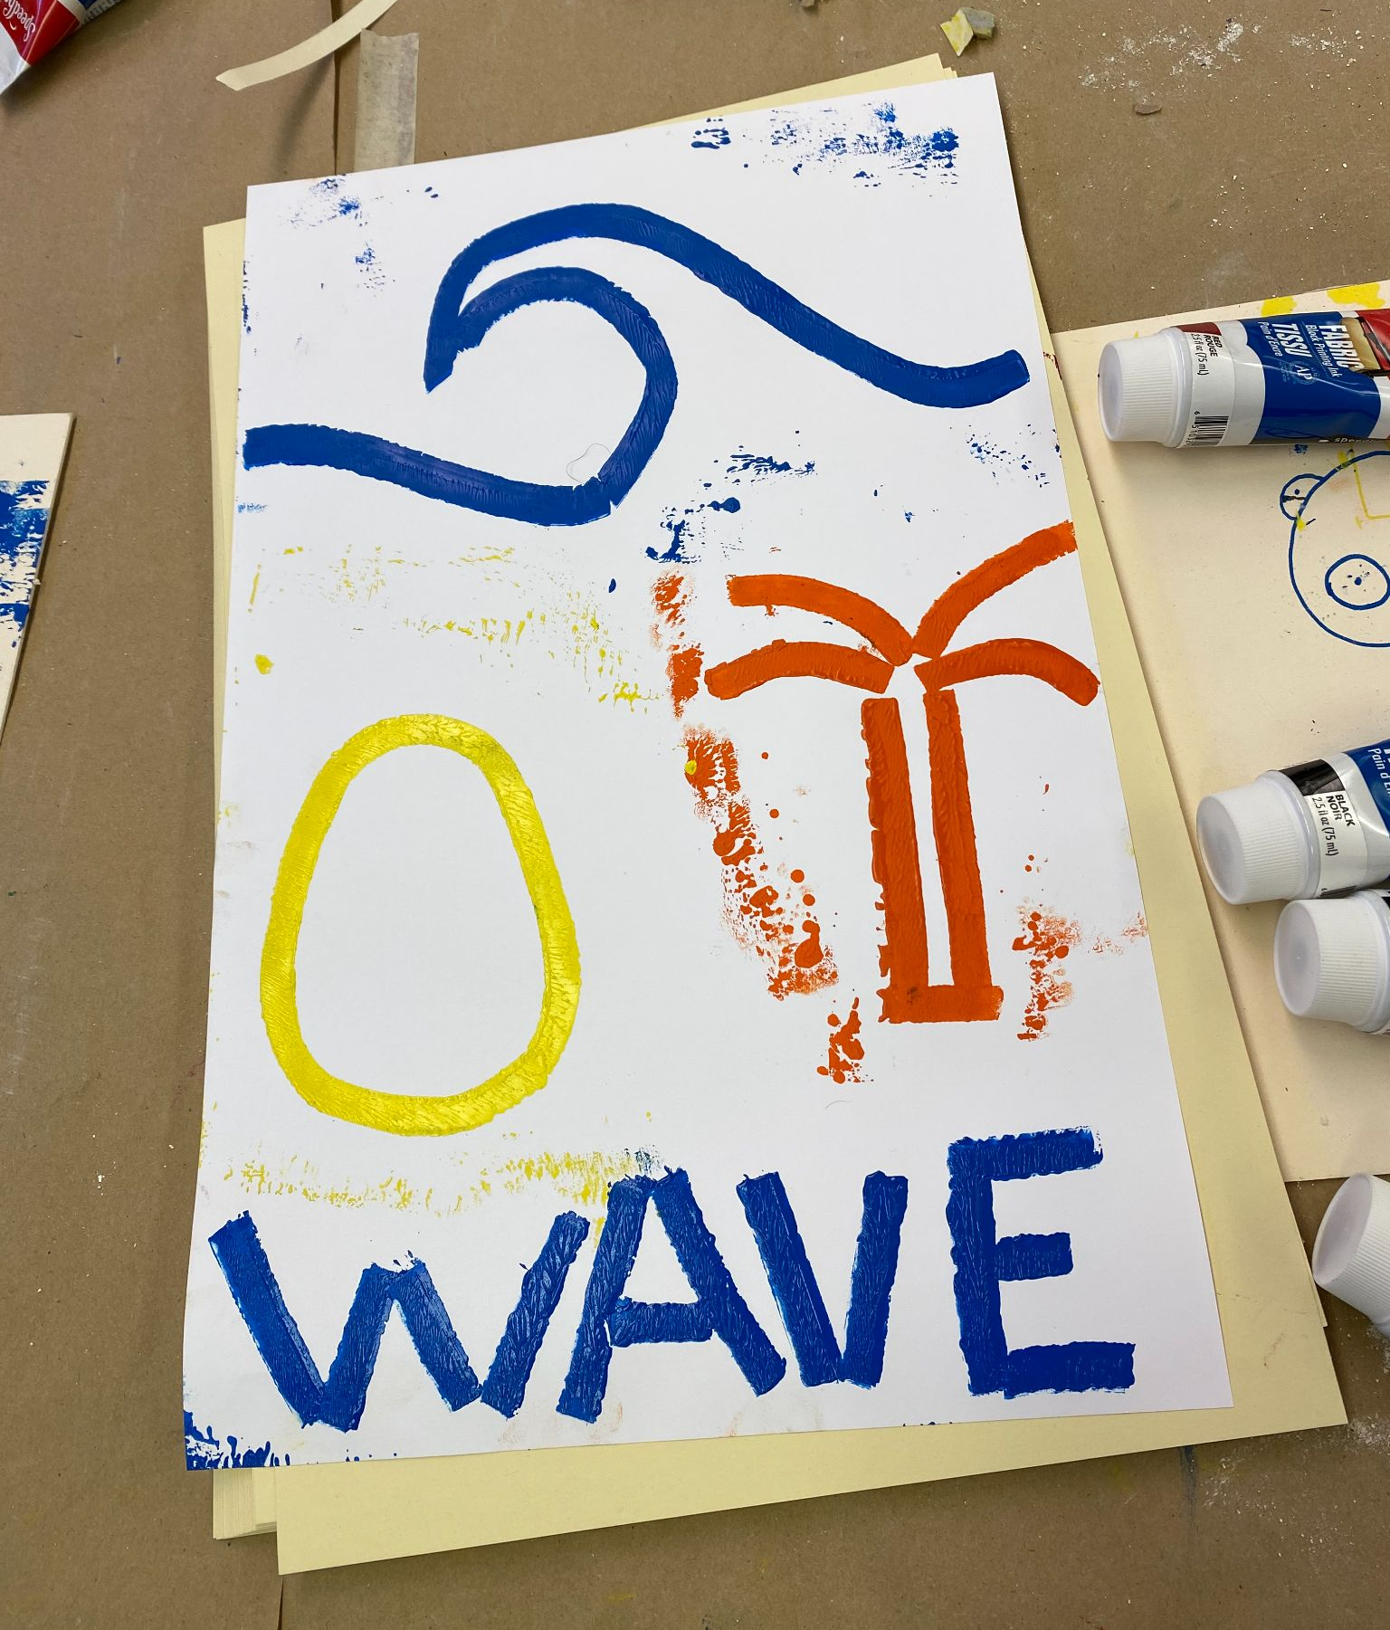
The students had fun with the projects. There were a few classroom chuckles when the student forgot to reverse initial lettering on the hard board.

Slide 7
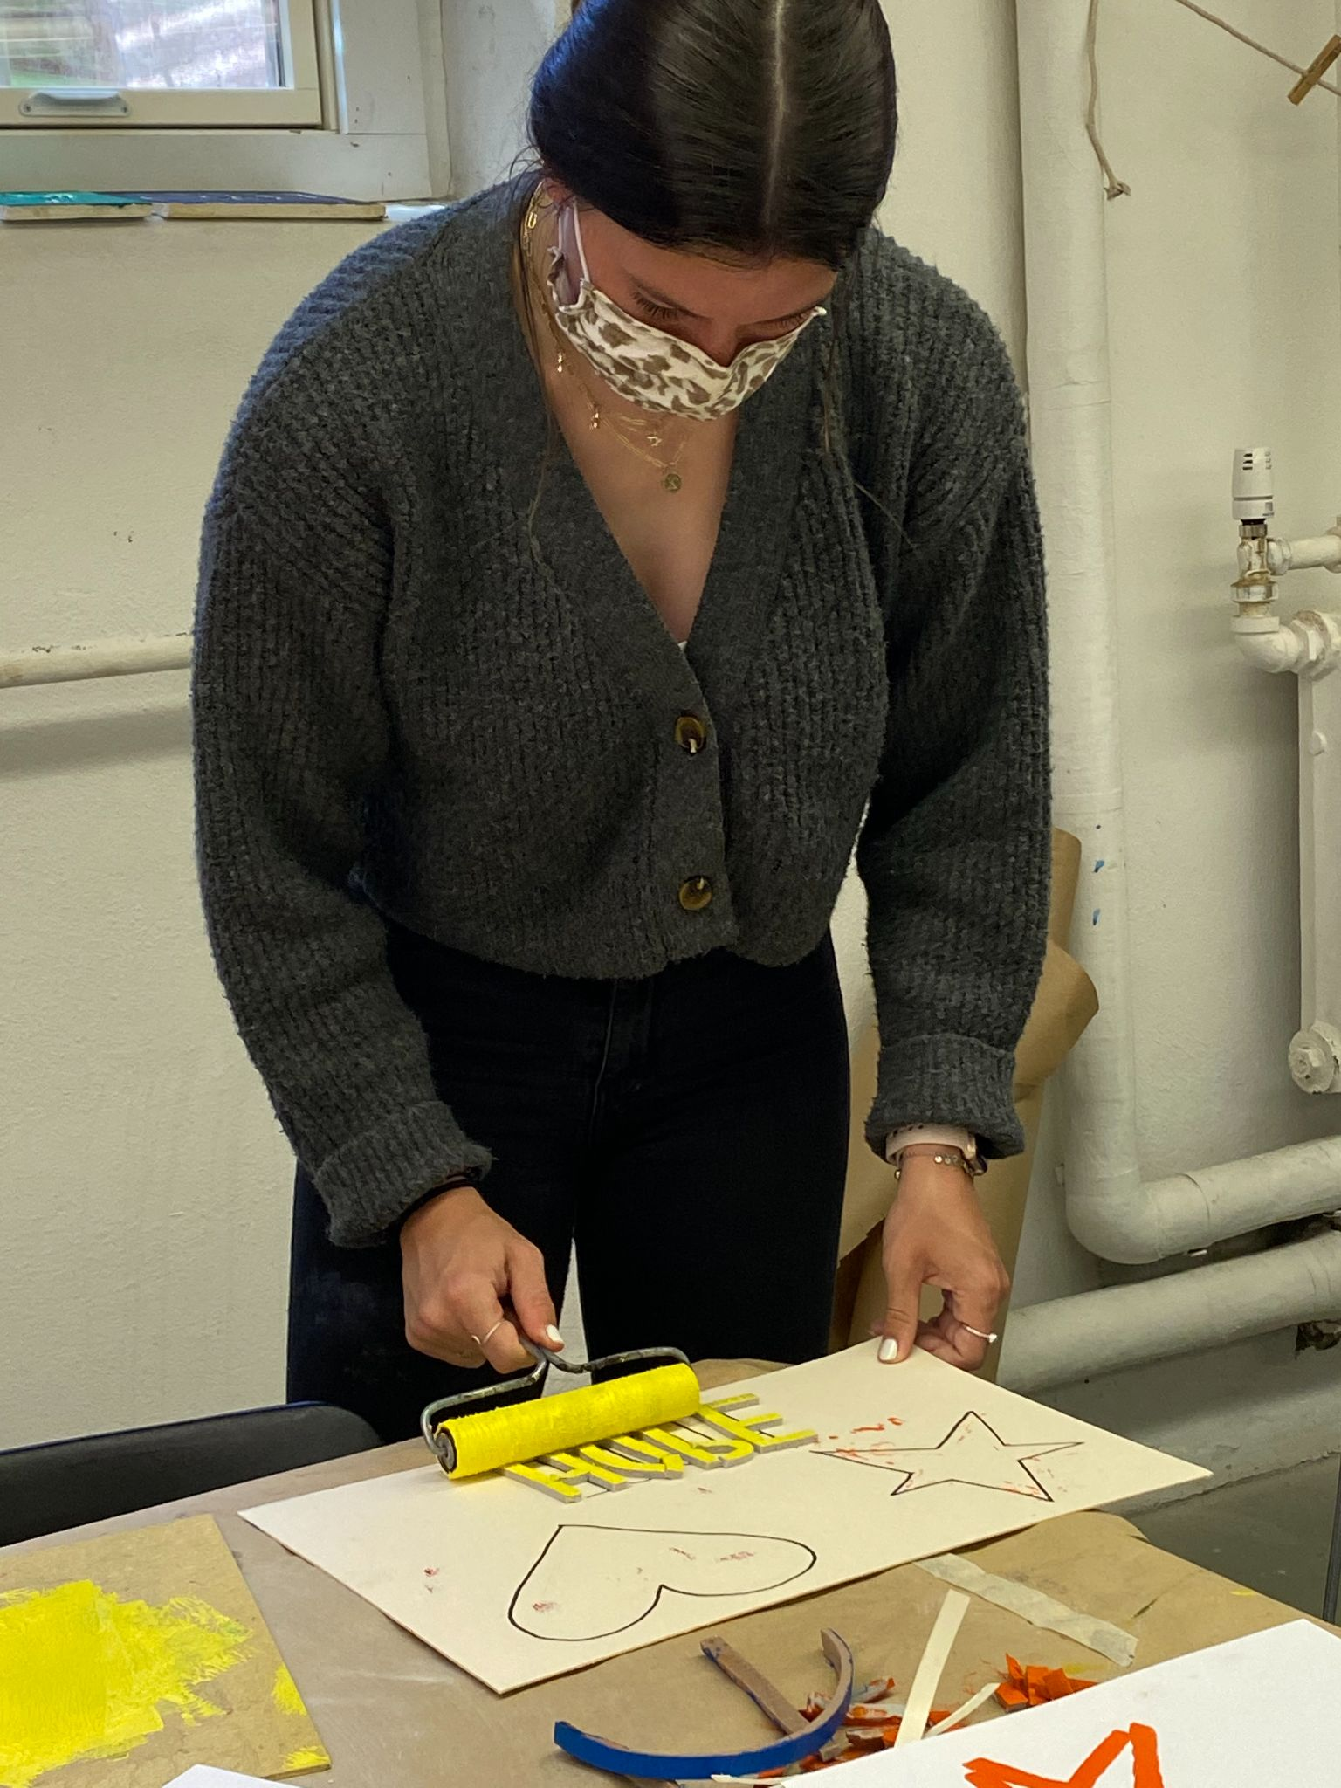
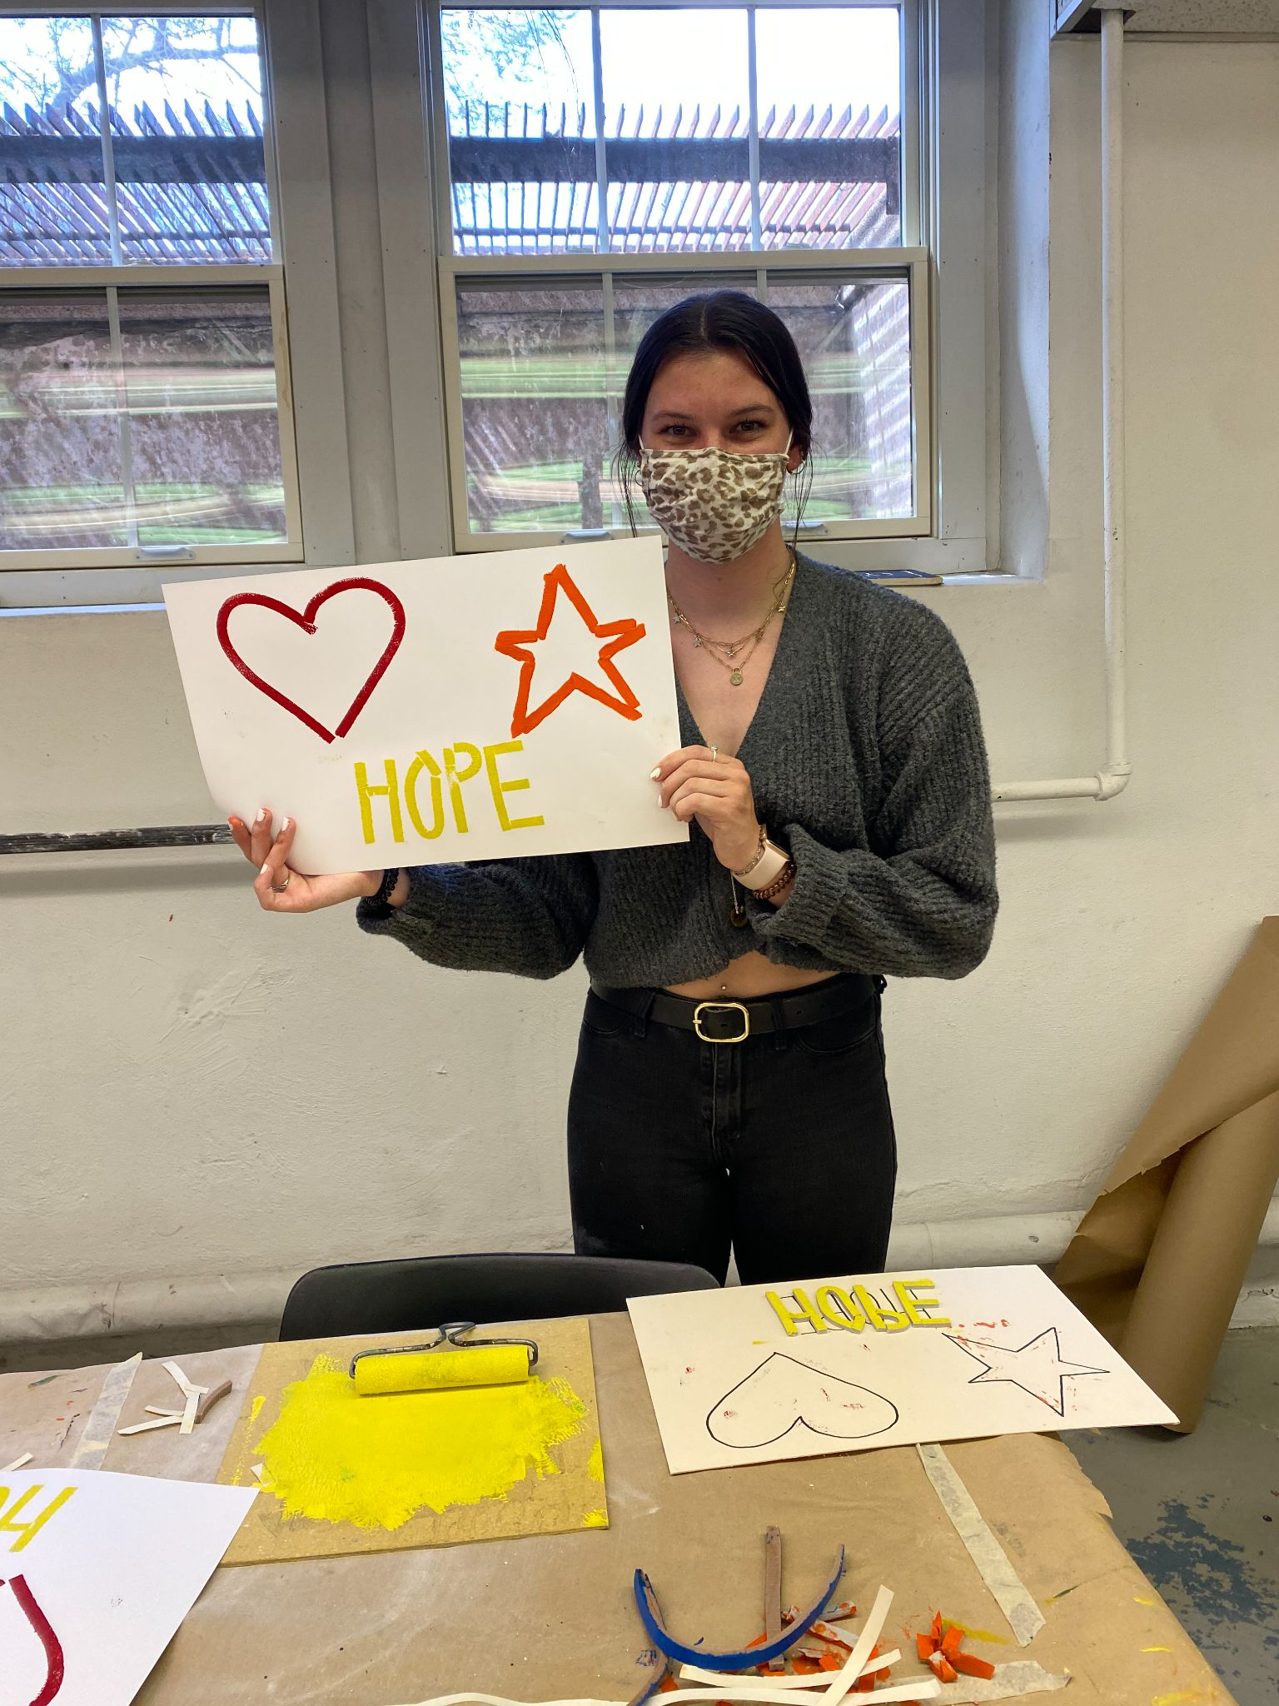
Another successful three color print!
No backwards letters here!

Slide 8
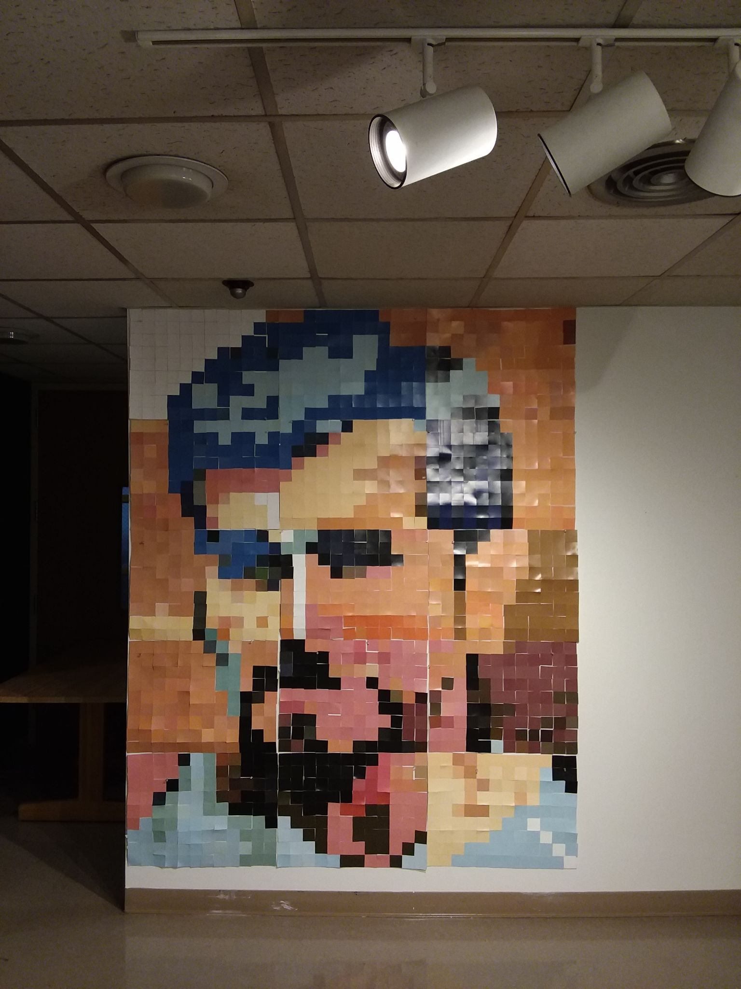
Bonus Photo!!
Moses Mosaic
An Introduction to the Arts
group project made up of
1620 square color chips.
Finished piece is approximately
7’ tall and 6’ wide.
Have a great summer everyone!

