Slide 1
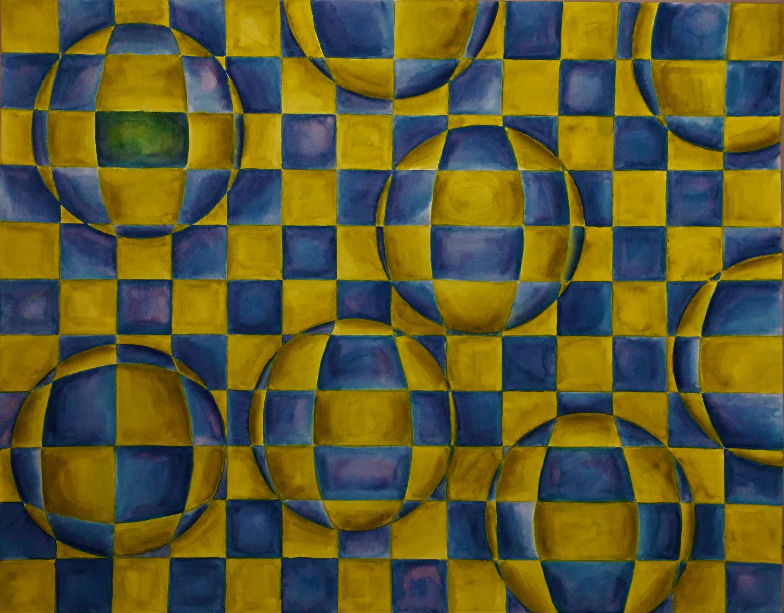
Exploring Color - Spring 2021
Class Exhibition
Instructor: Brian Kiernan
Rachel D’avella
Emily Gay
Santino Giordano
Luiza Guberow
Amanda Hall
Erik Ho
David Ivanov
Aleksandra Kagan
Kianna Lozada Pagan
Alliha Malcolm
Mathew Marchand
Flavia Marques
Joseph Nwanebi
Lauren Pope
Jenna Richards
Aliza Riemer
Amanda Strout
China Torres
Whitney Zapotitla
Madison Zigmont

Slide 2
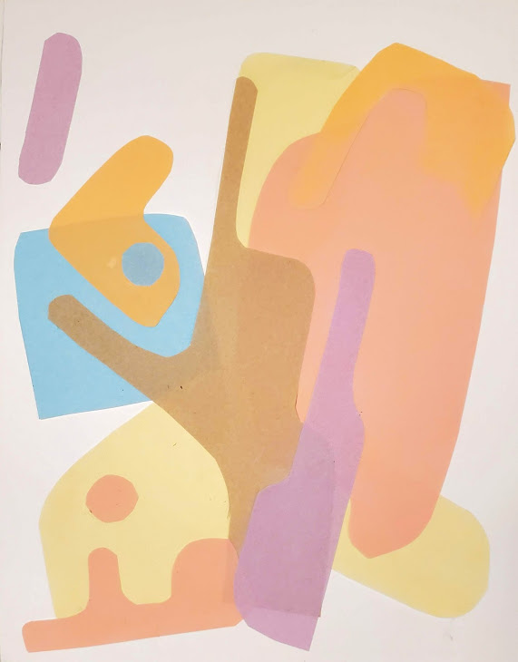
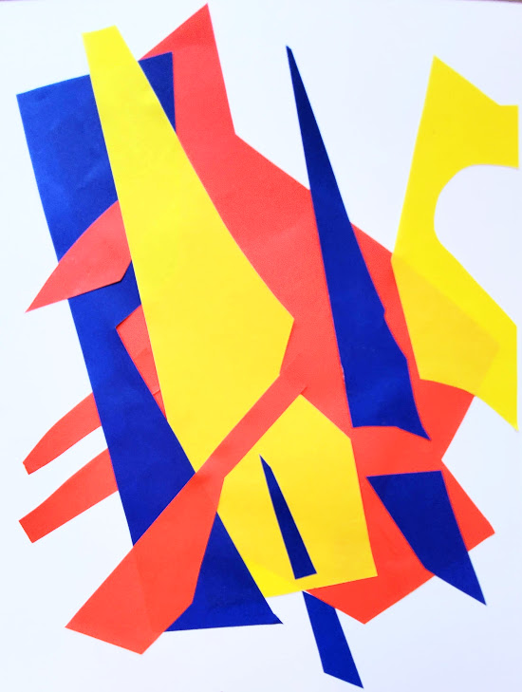
THE PROPERTIES OF COLOR: Hue, value, intensity

Slide 3
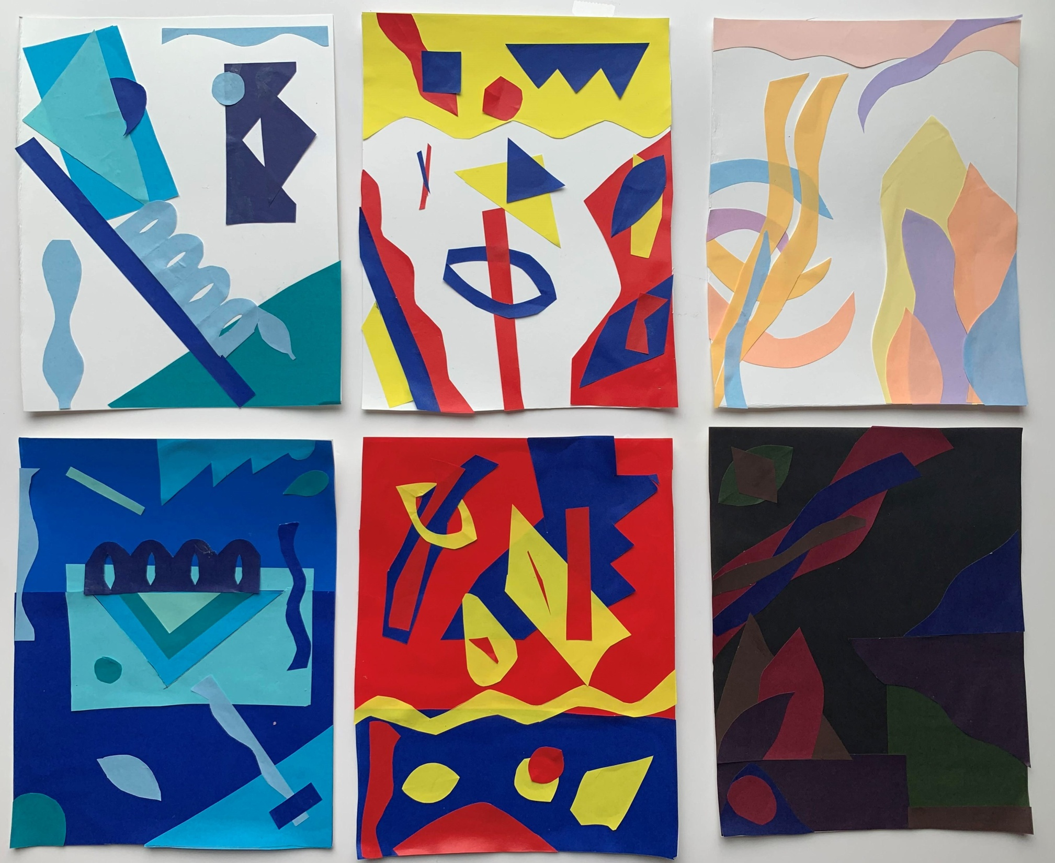

Slide 4
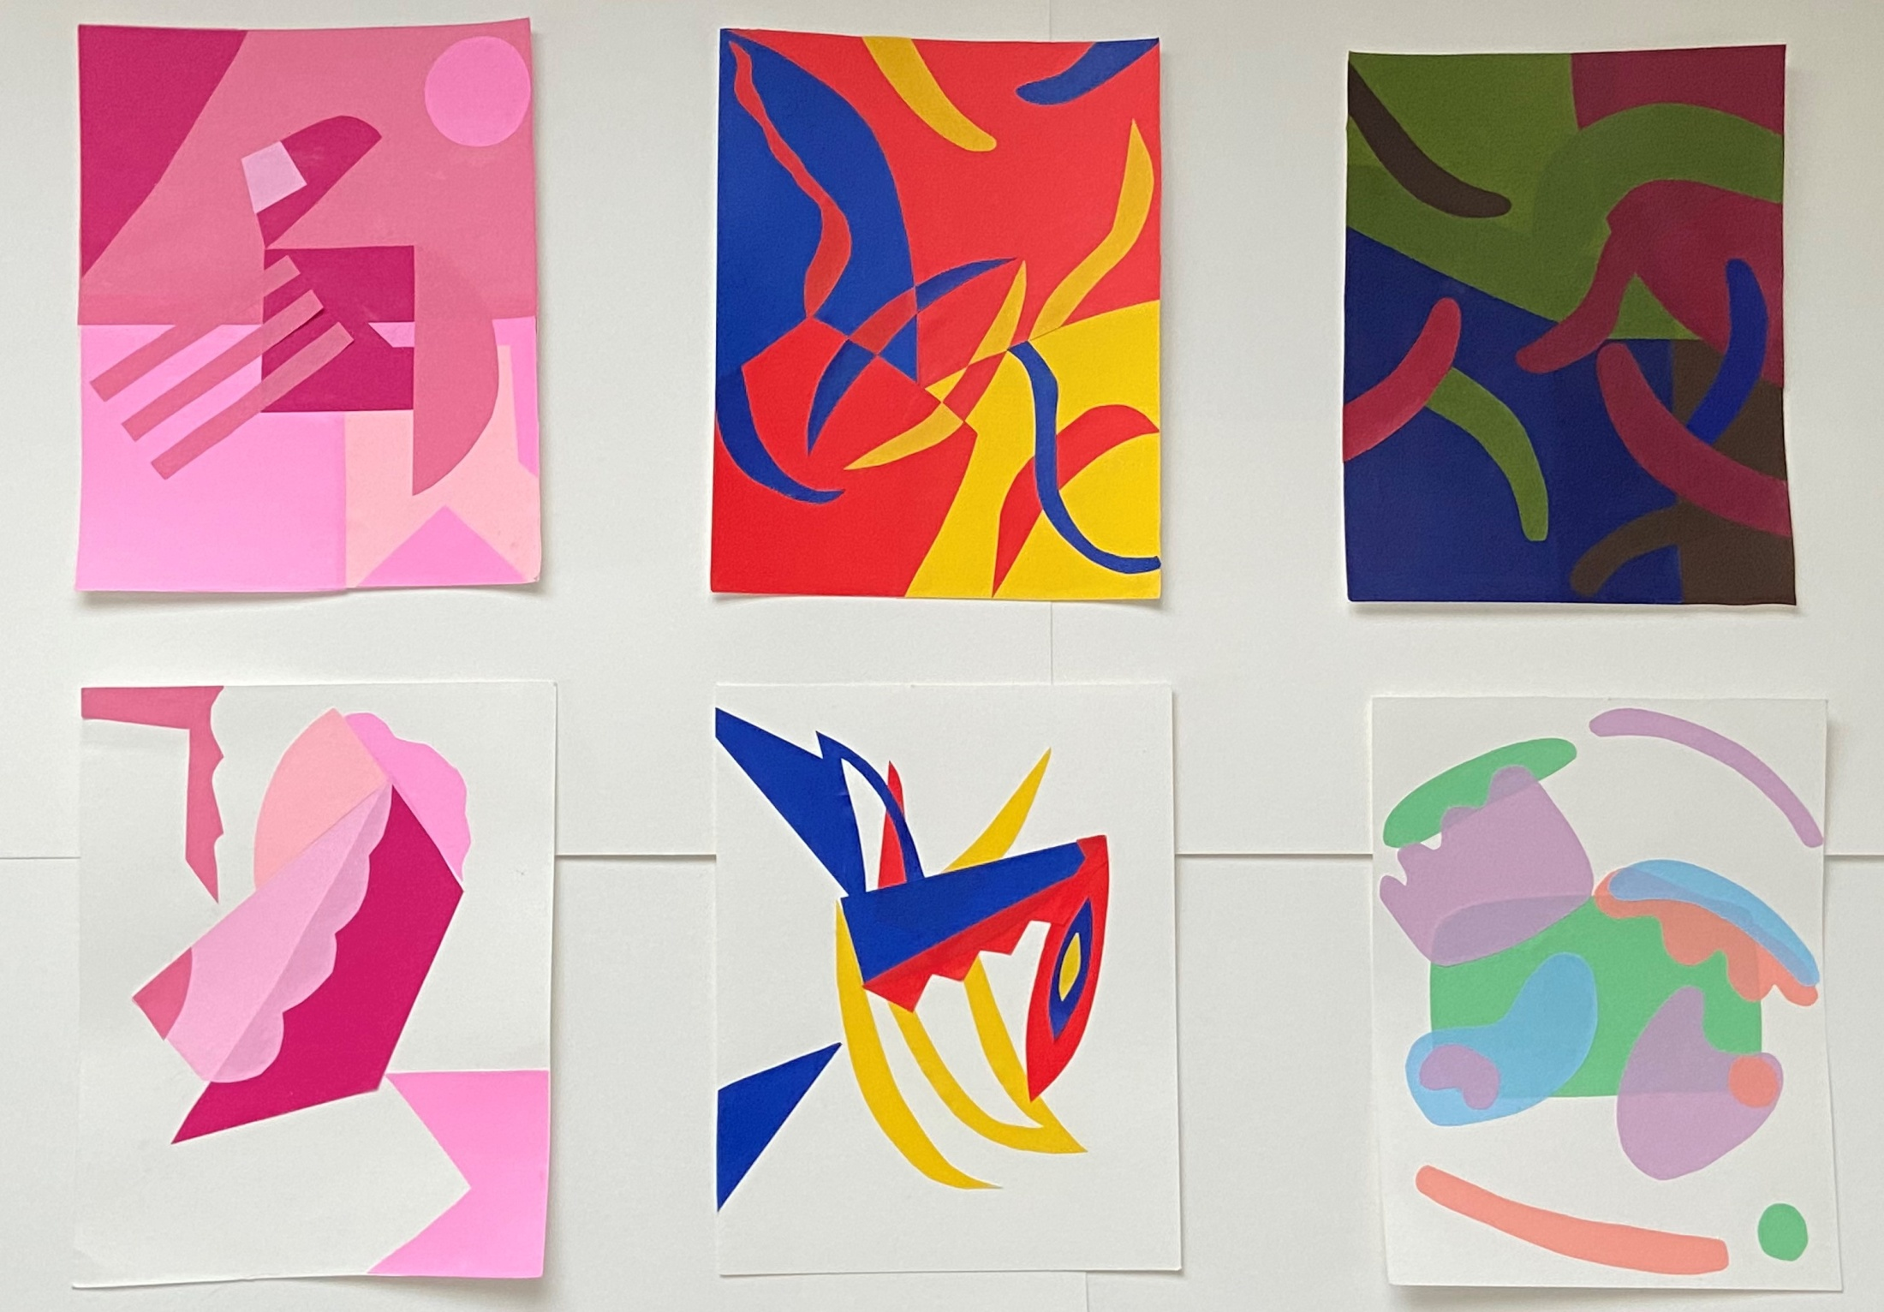

Slide 5
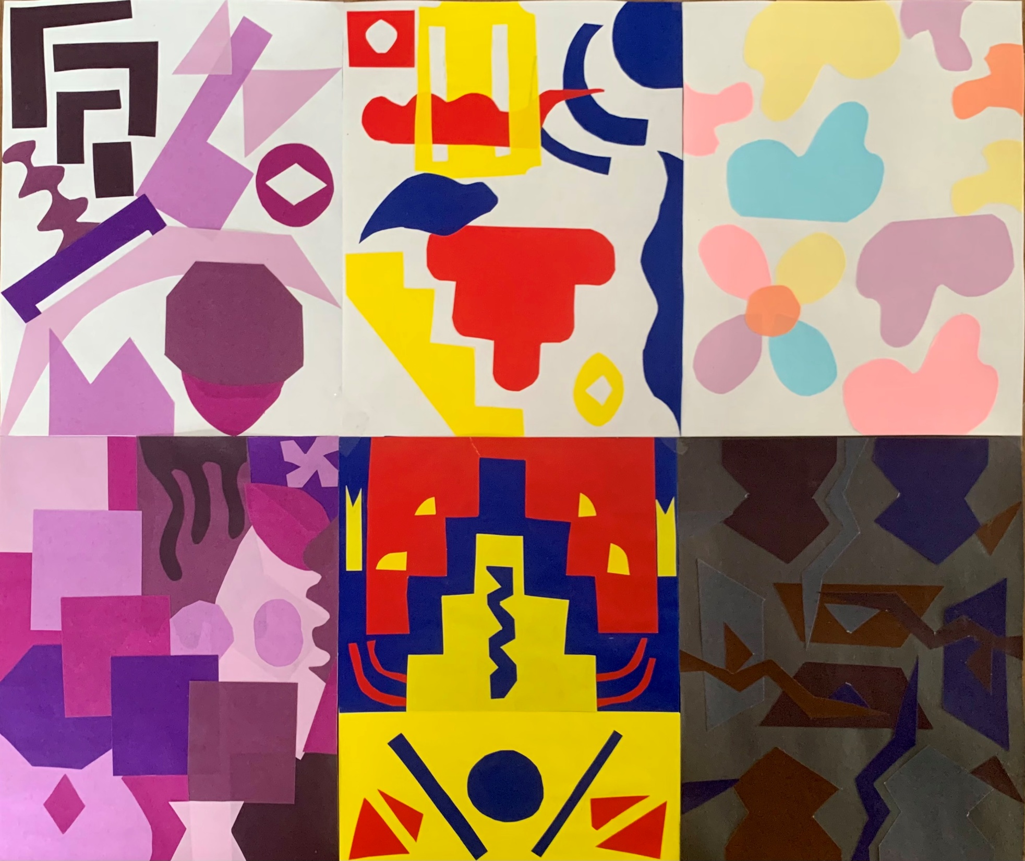

Slide 6
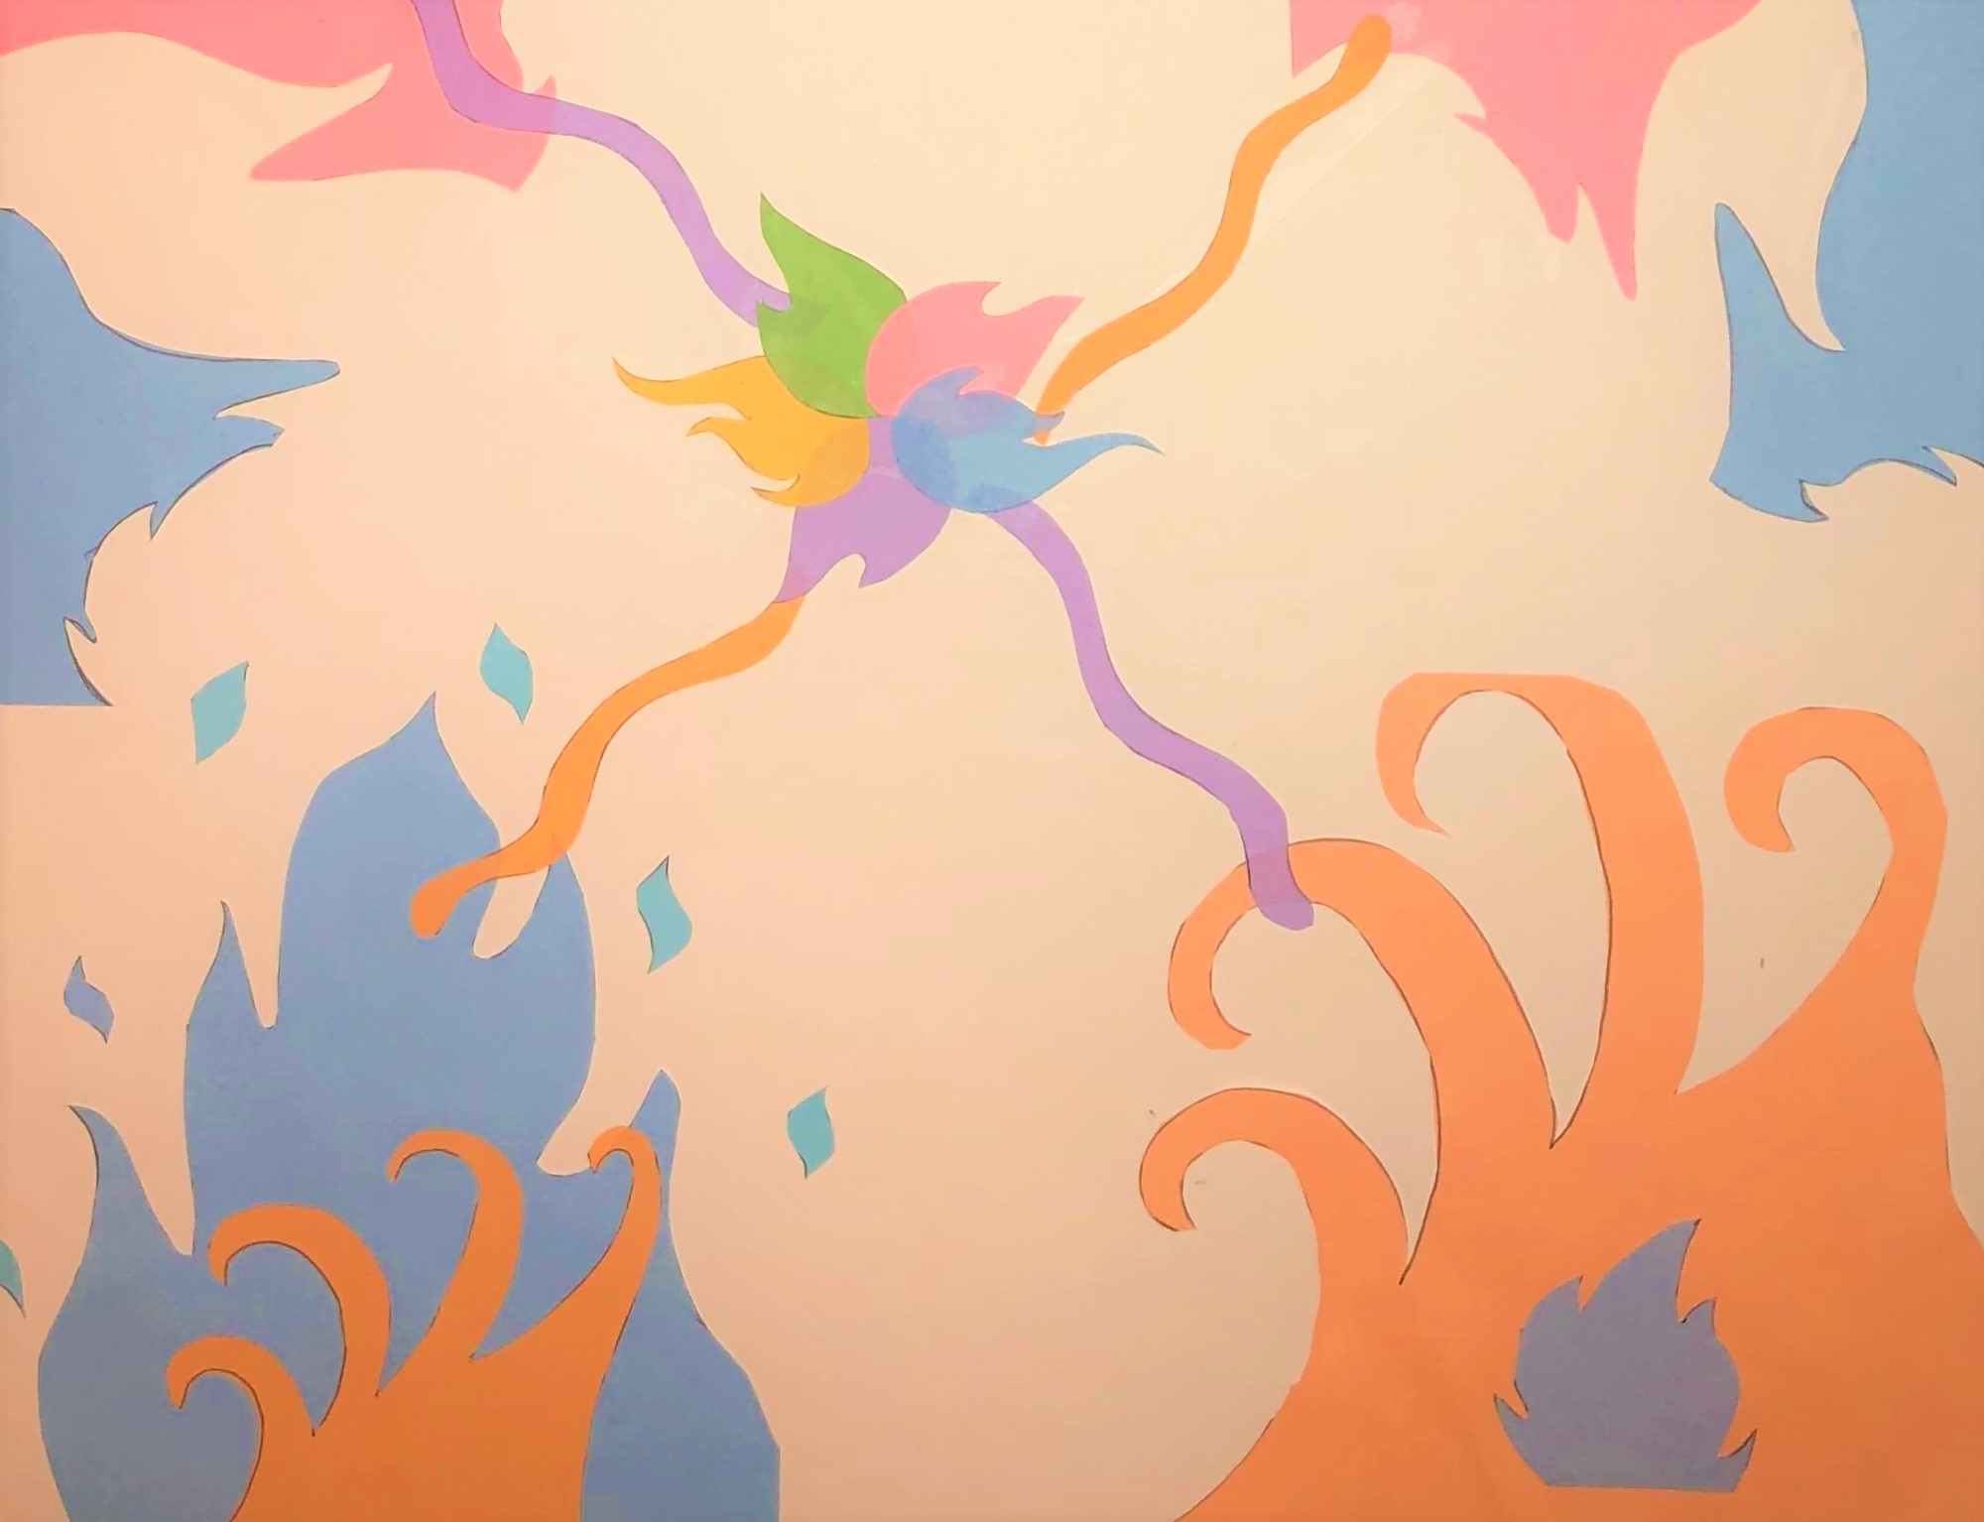

Slide 7
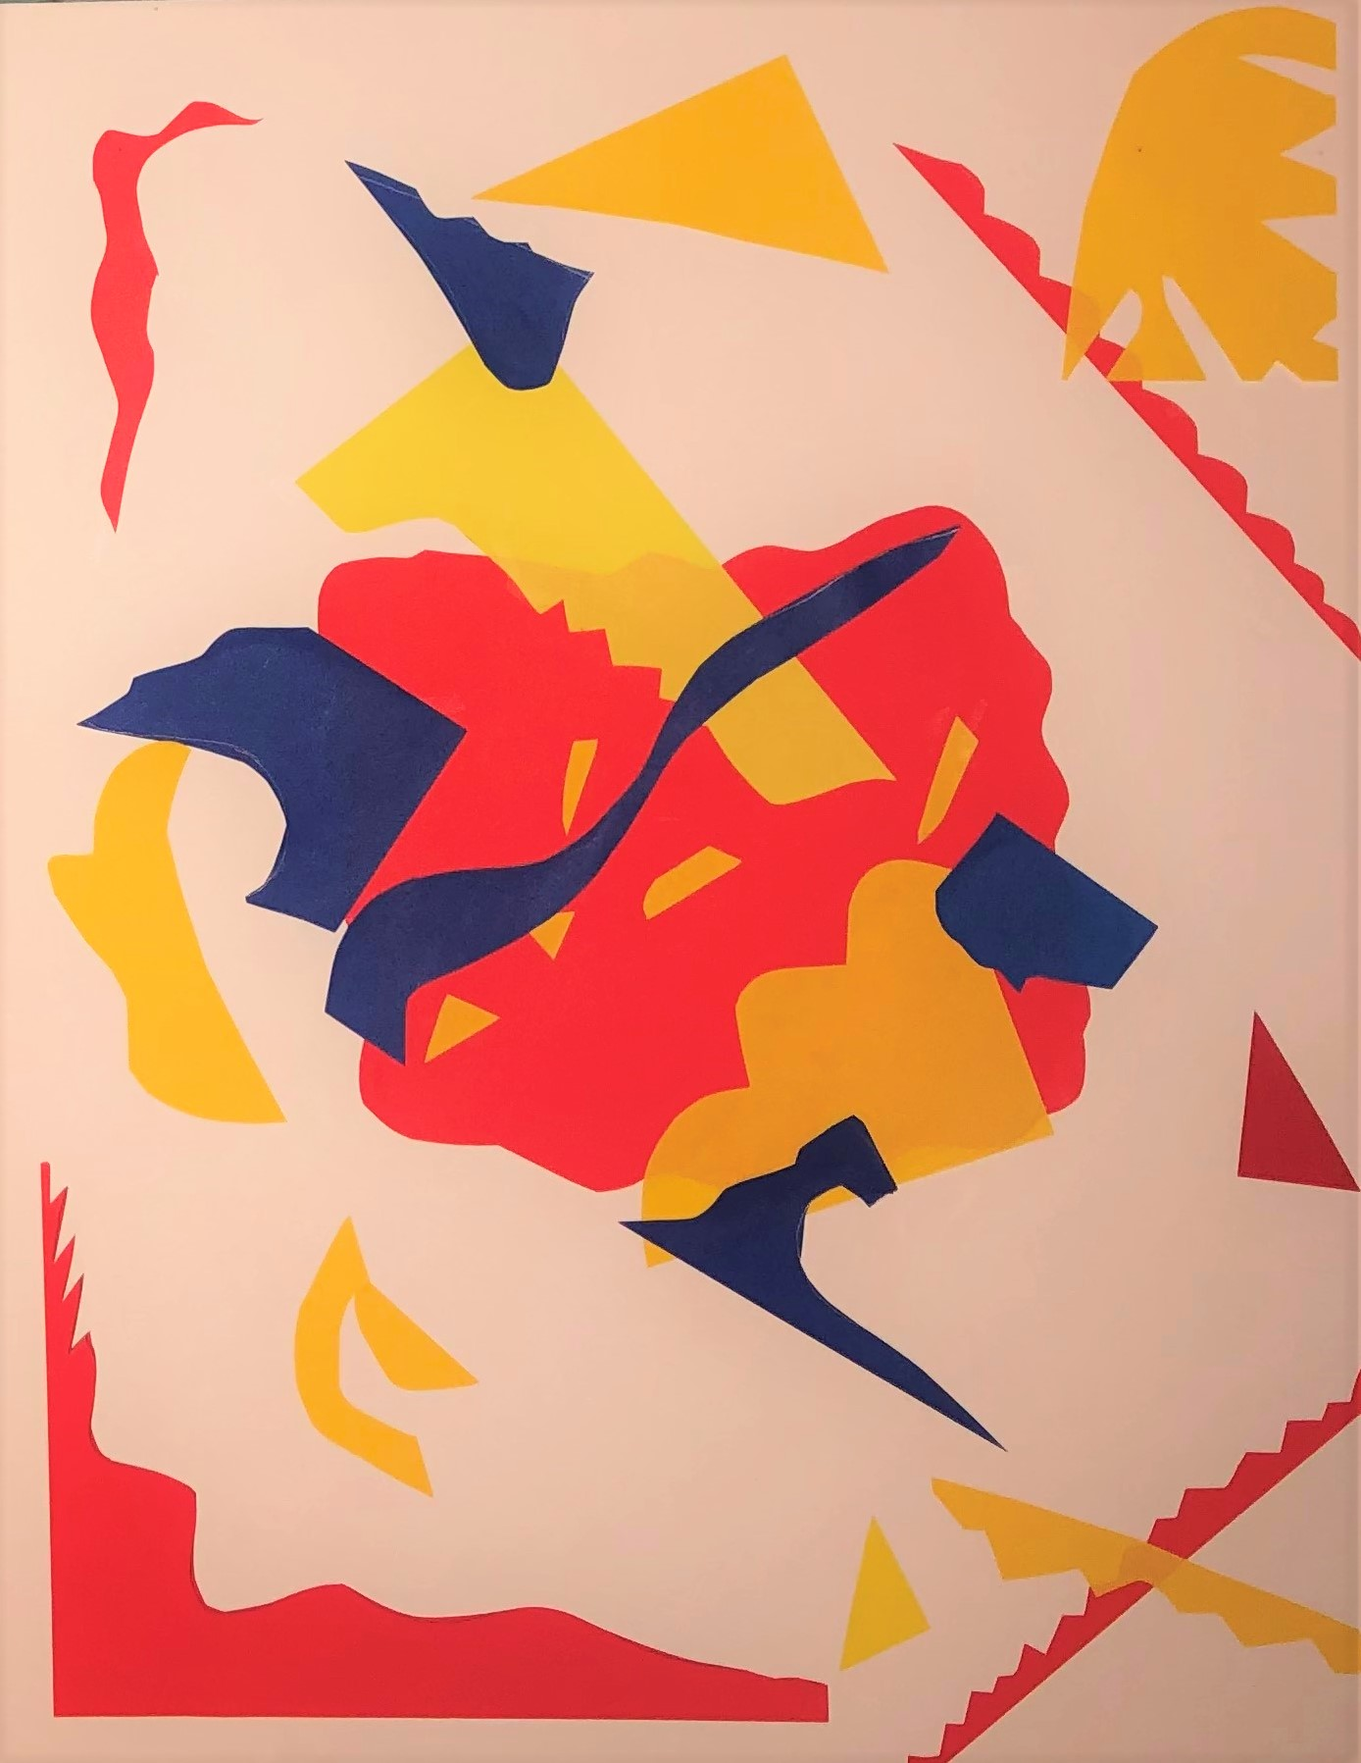

Slide 8
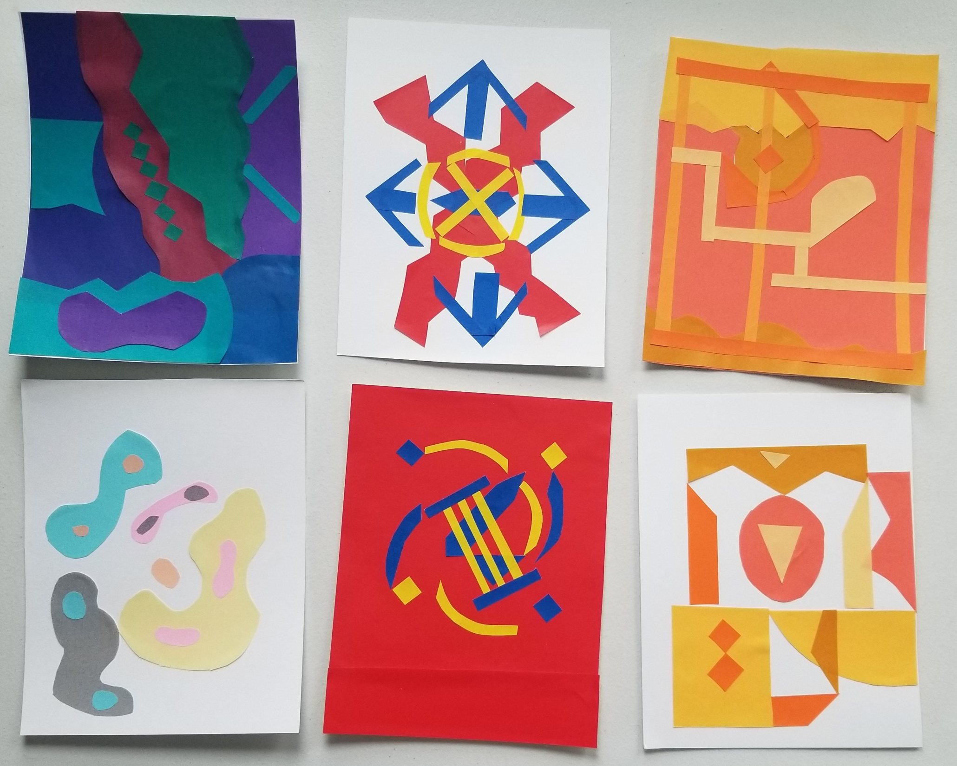

Slide 9
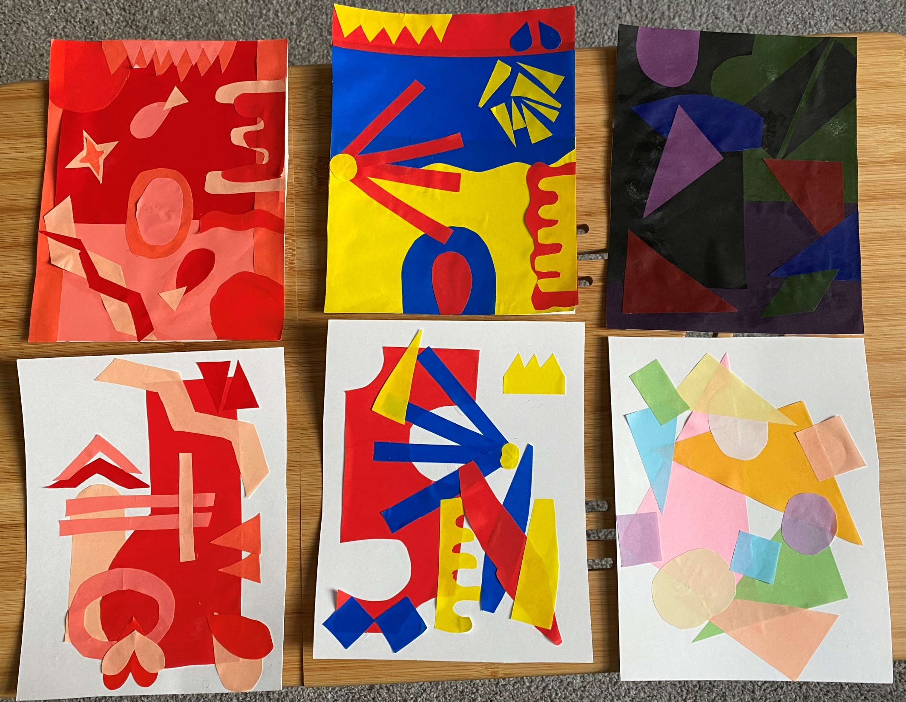

Slide 10
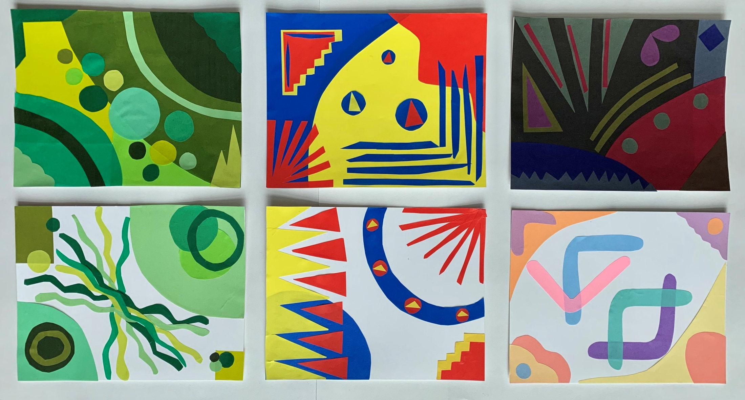

Slide 11
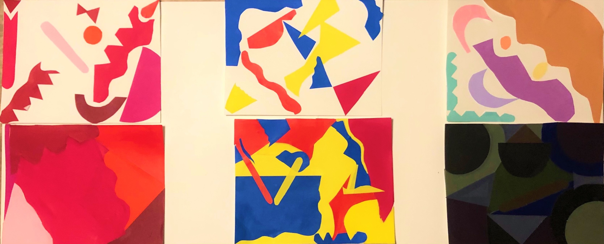

Slide 12
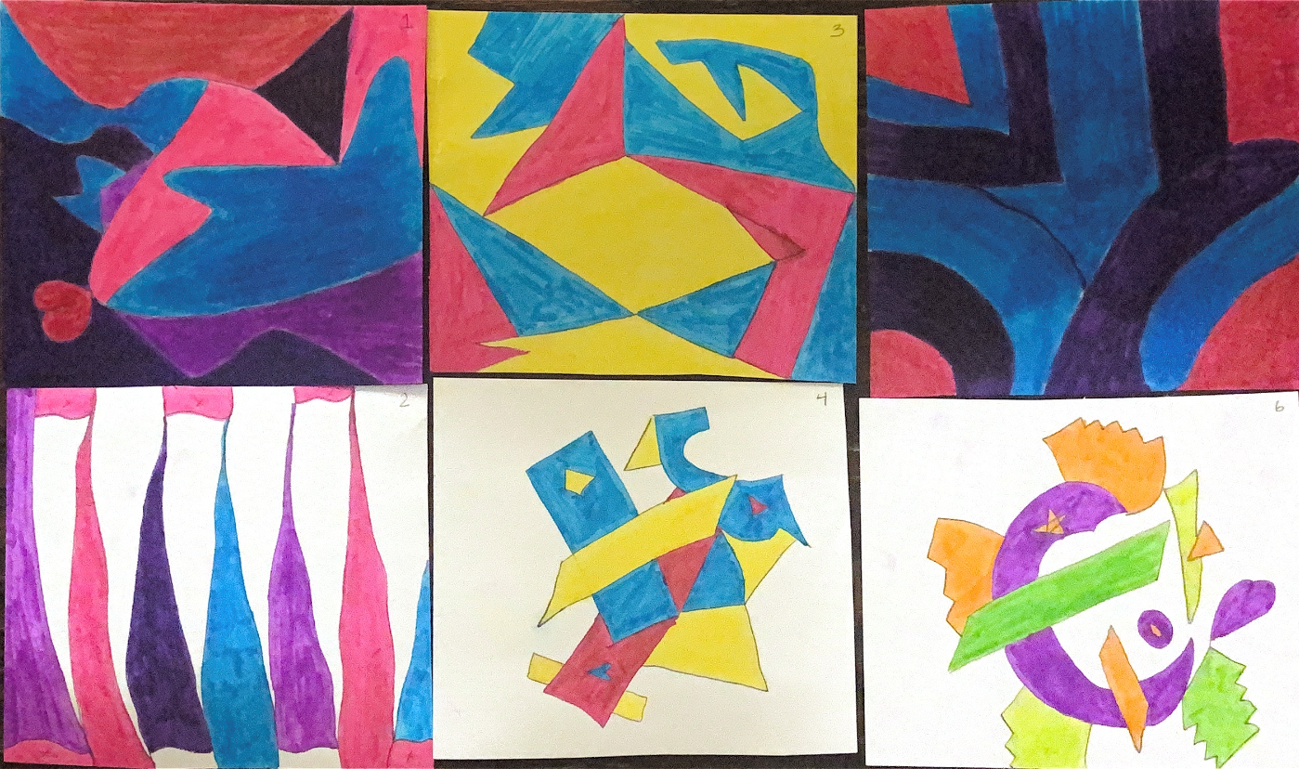

Slide 13
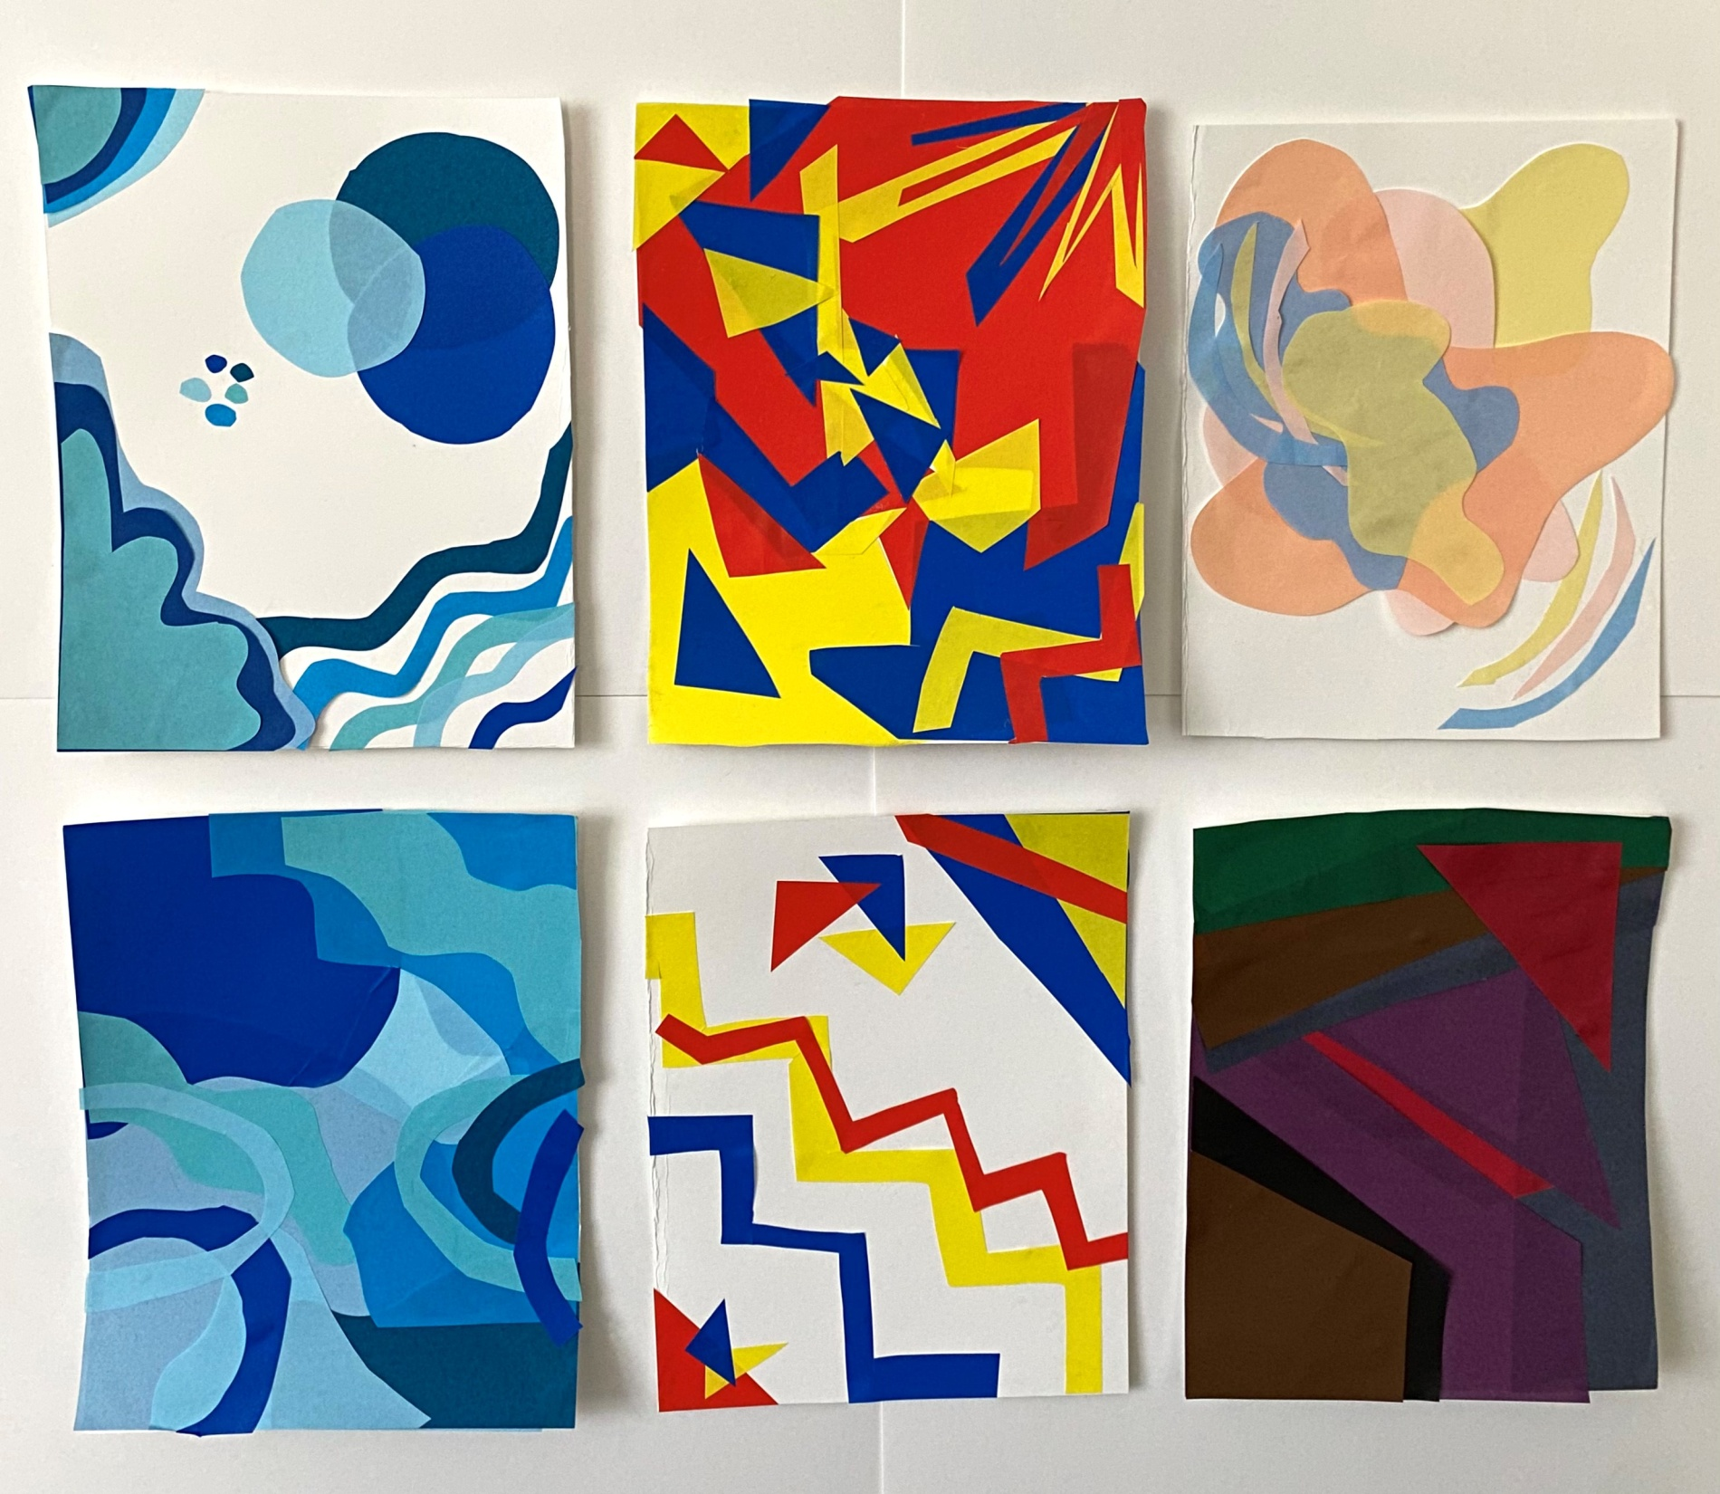

Slide 14
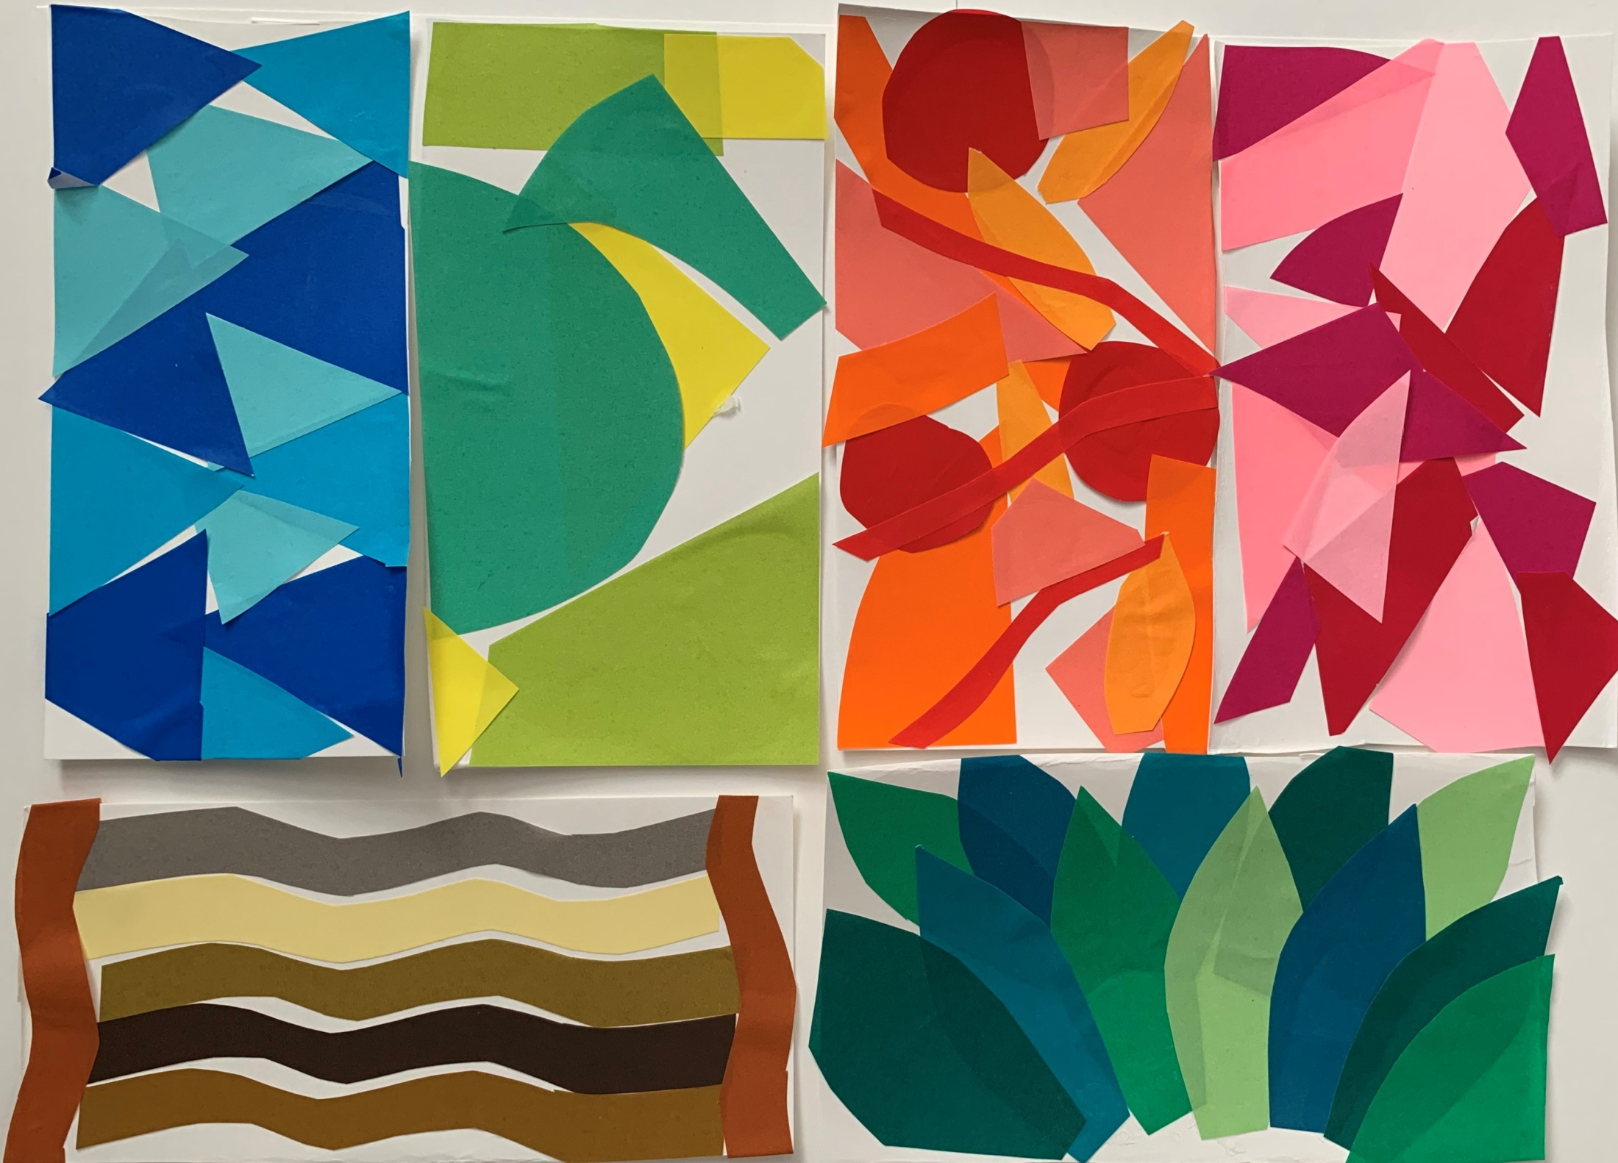

Slide 15
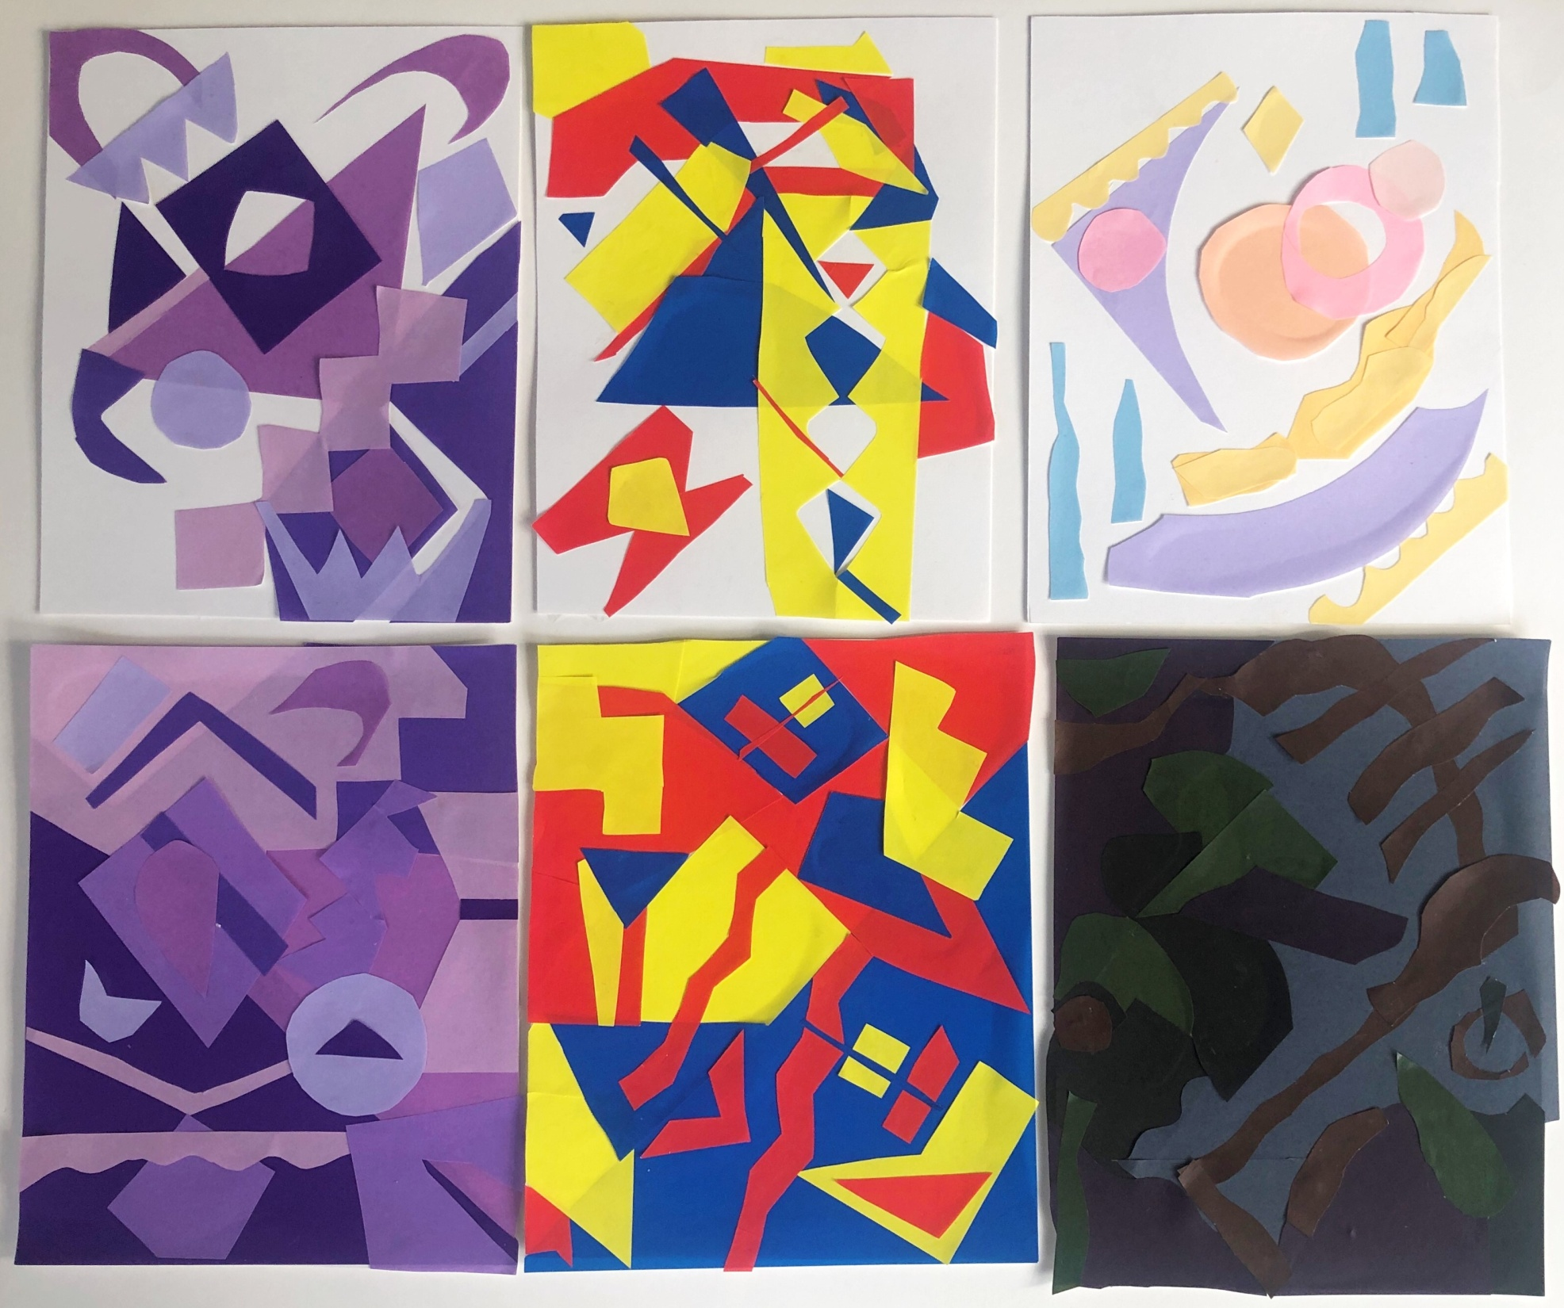

Slide 16
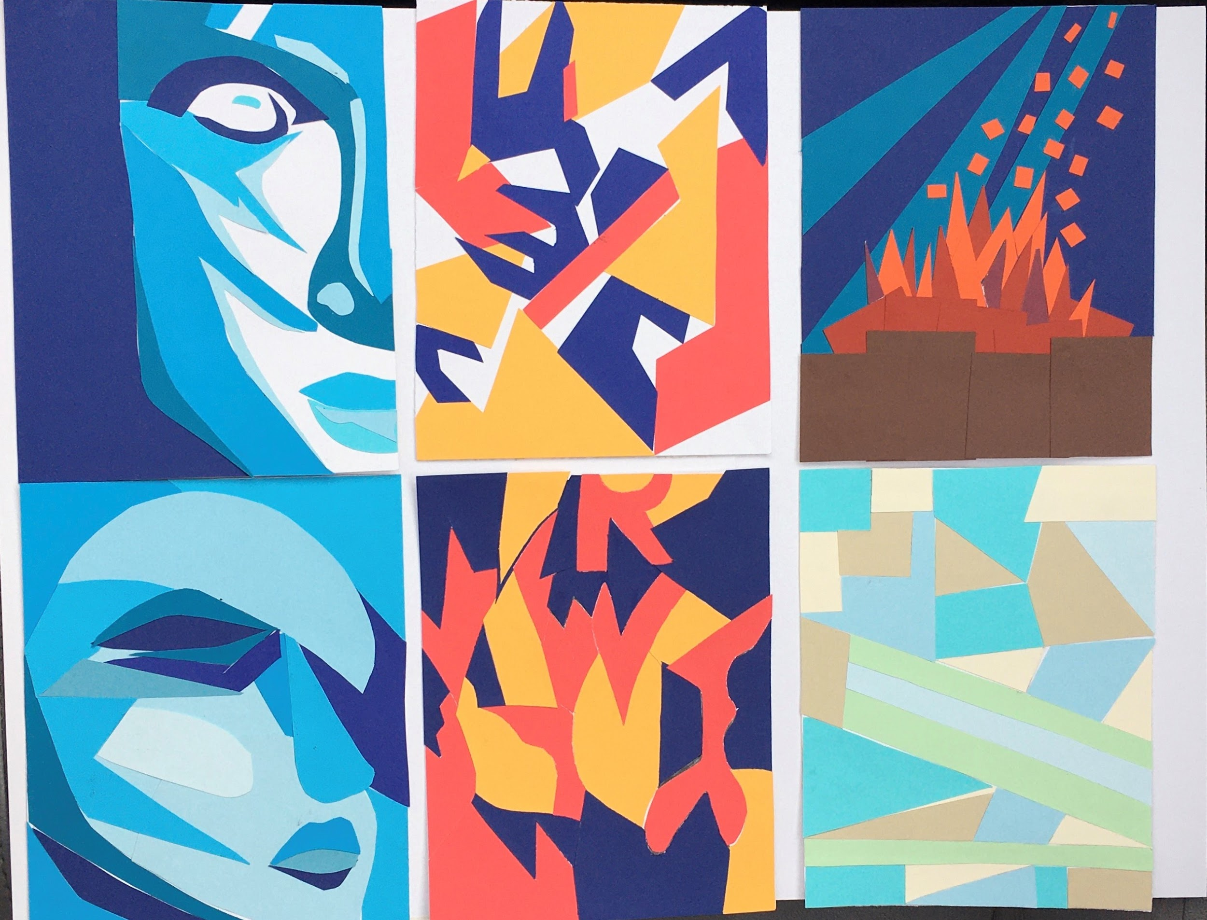

Slide 17
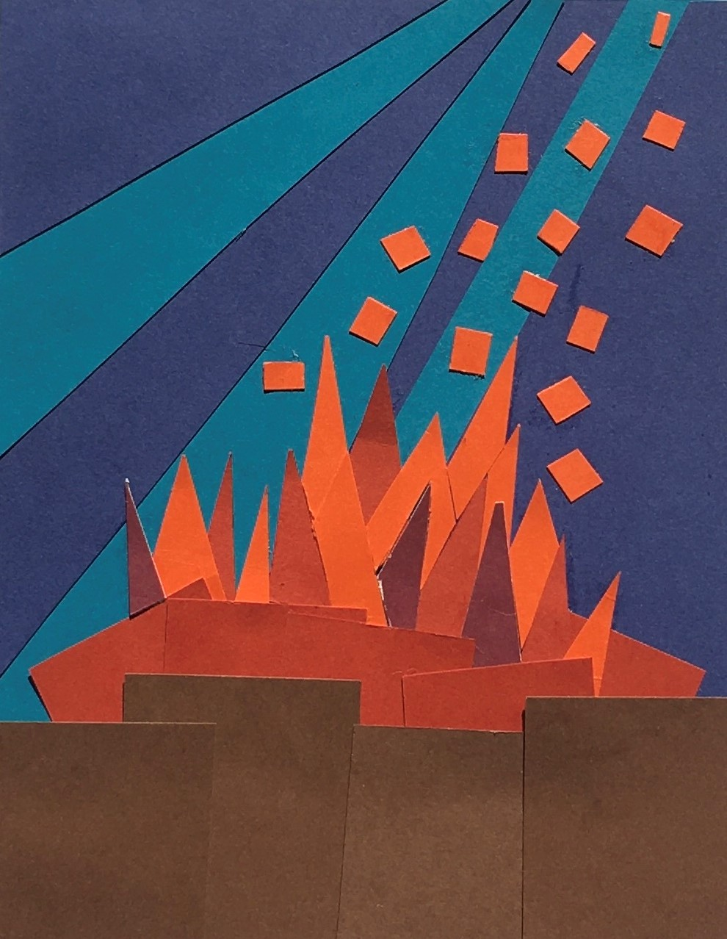

Slide 18
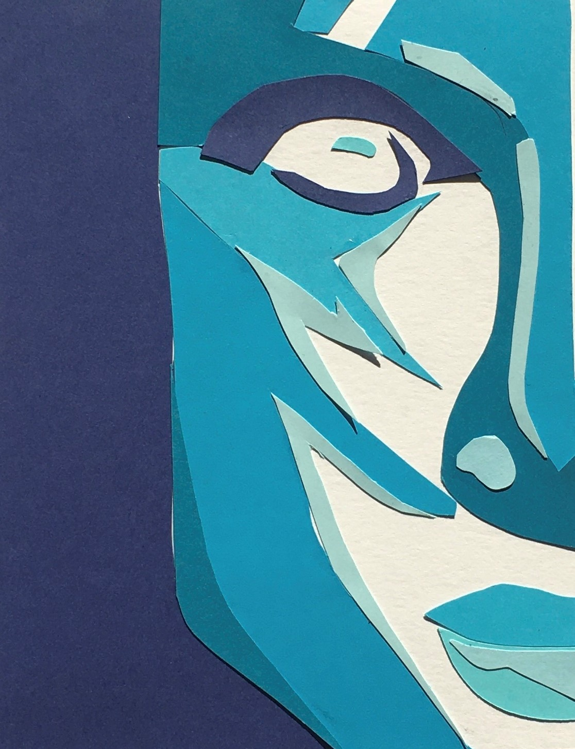

Slide 19
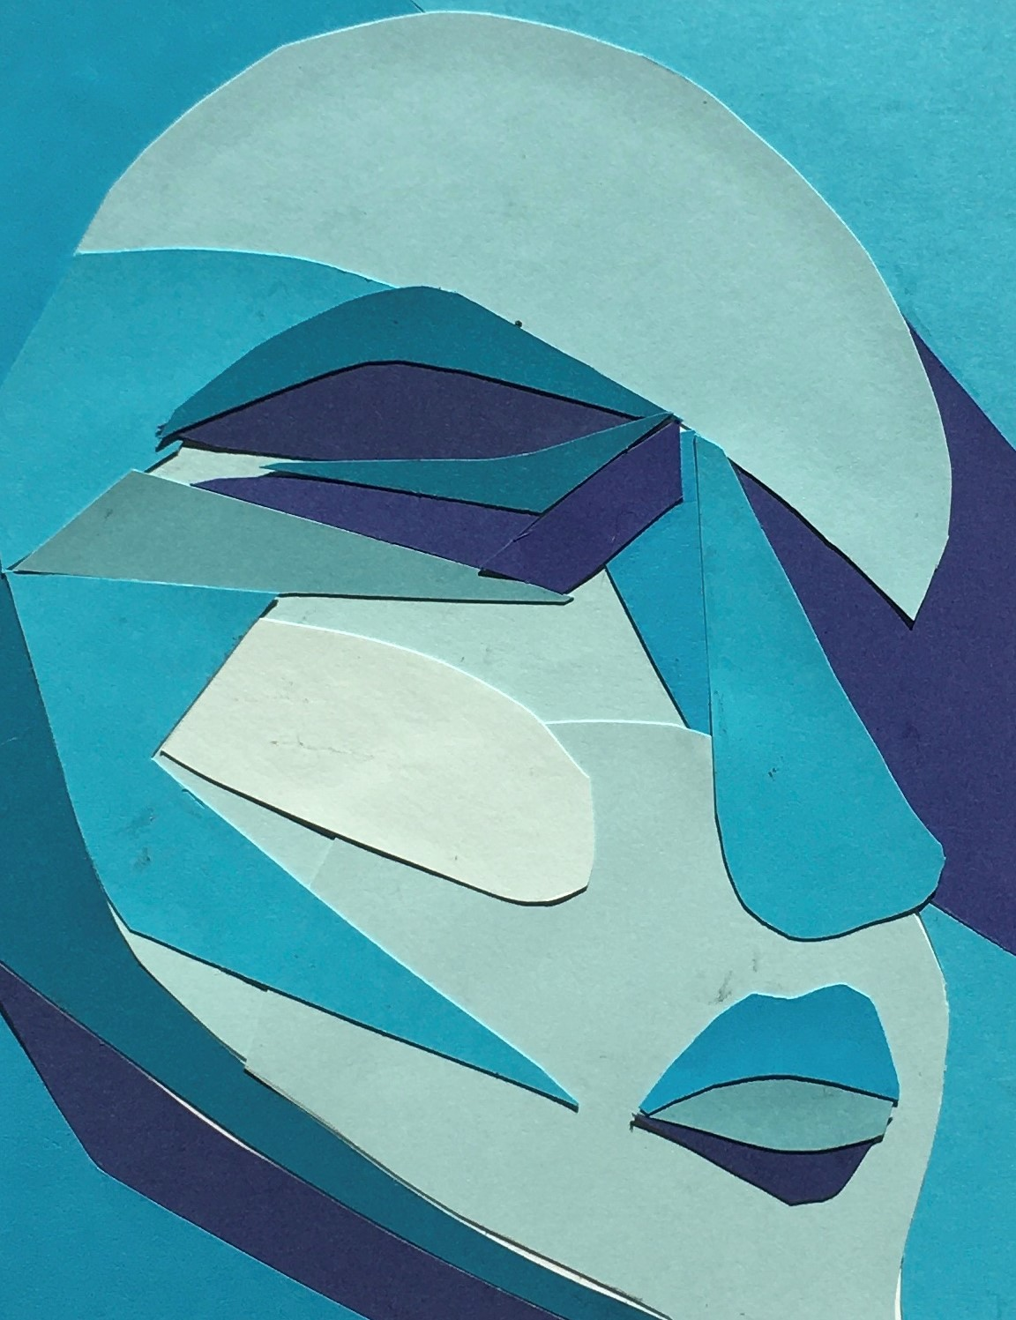

Slide 20
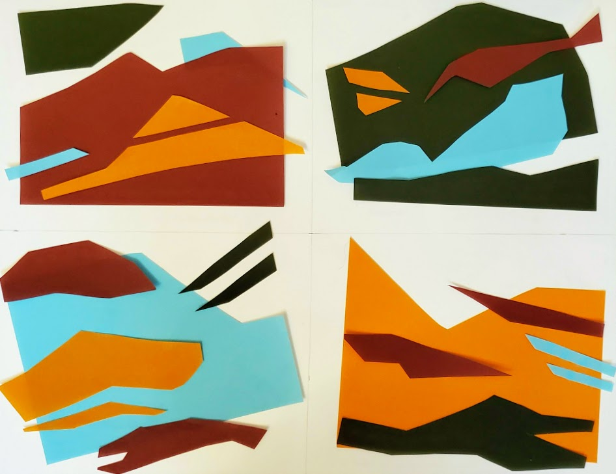
COLOR INTERACTION

Slide 21
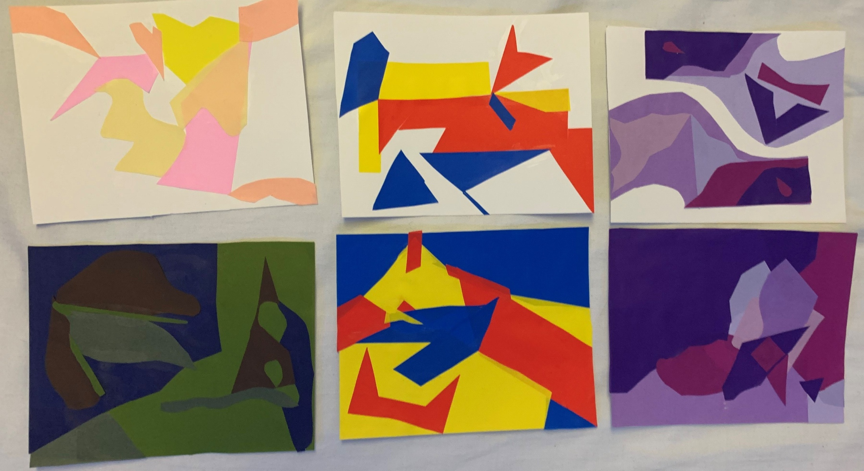

Slide 22
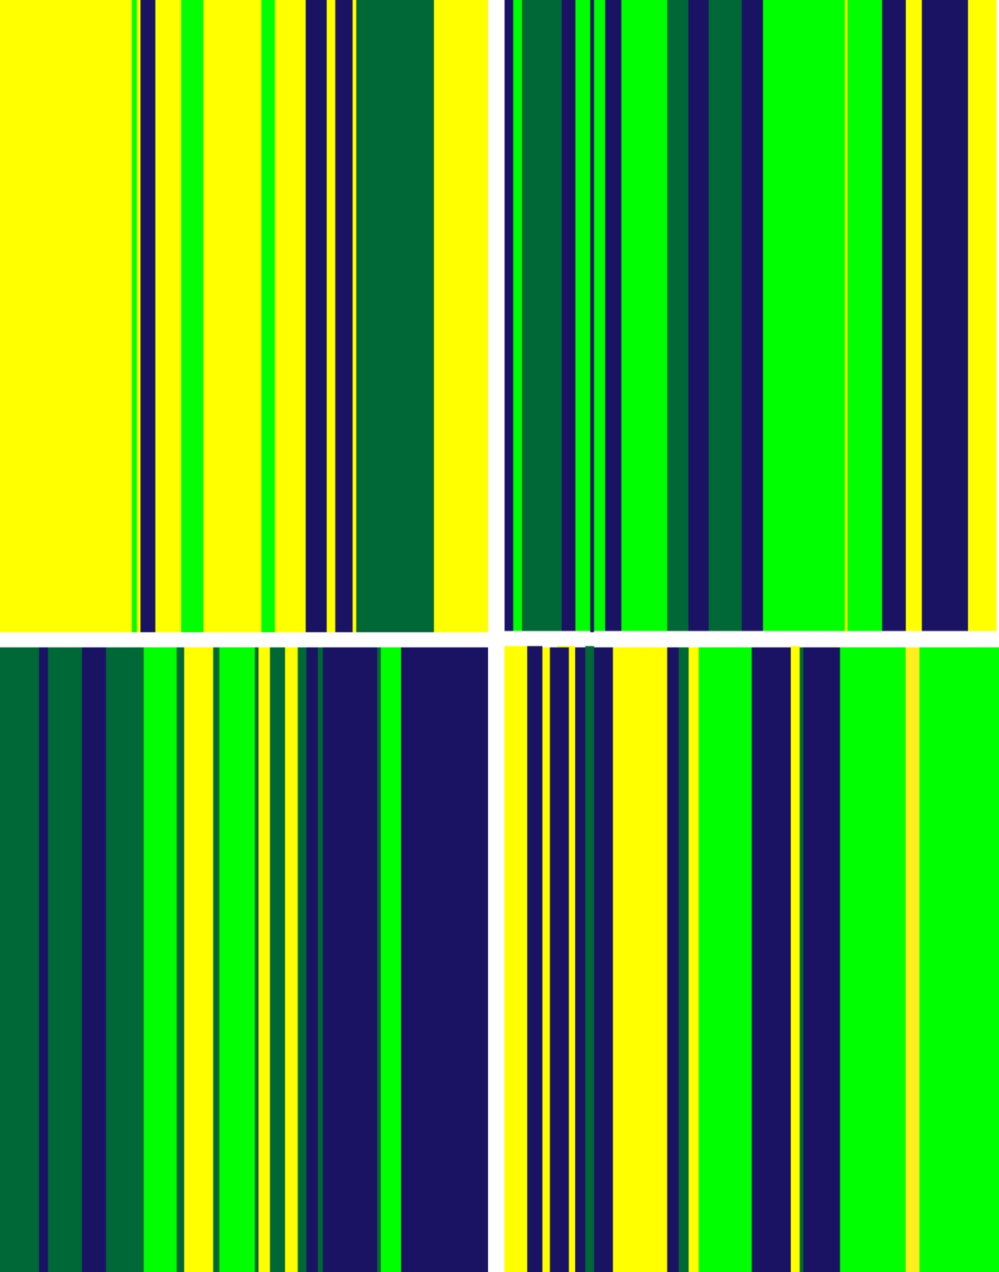

Slide 23
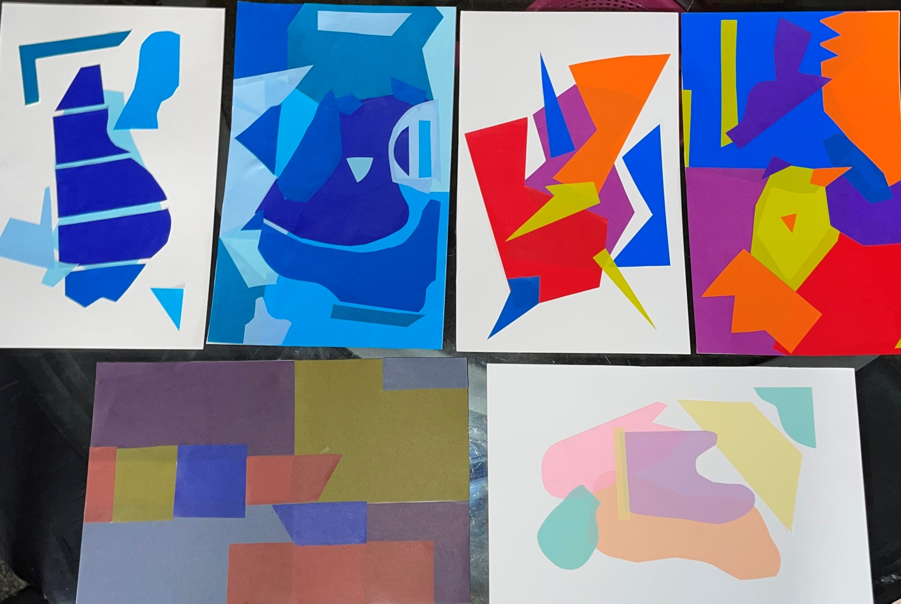

Slide 24
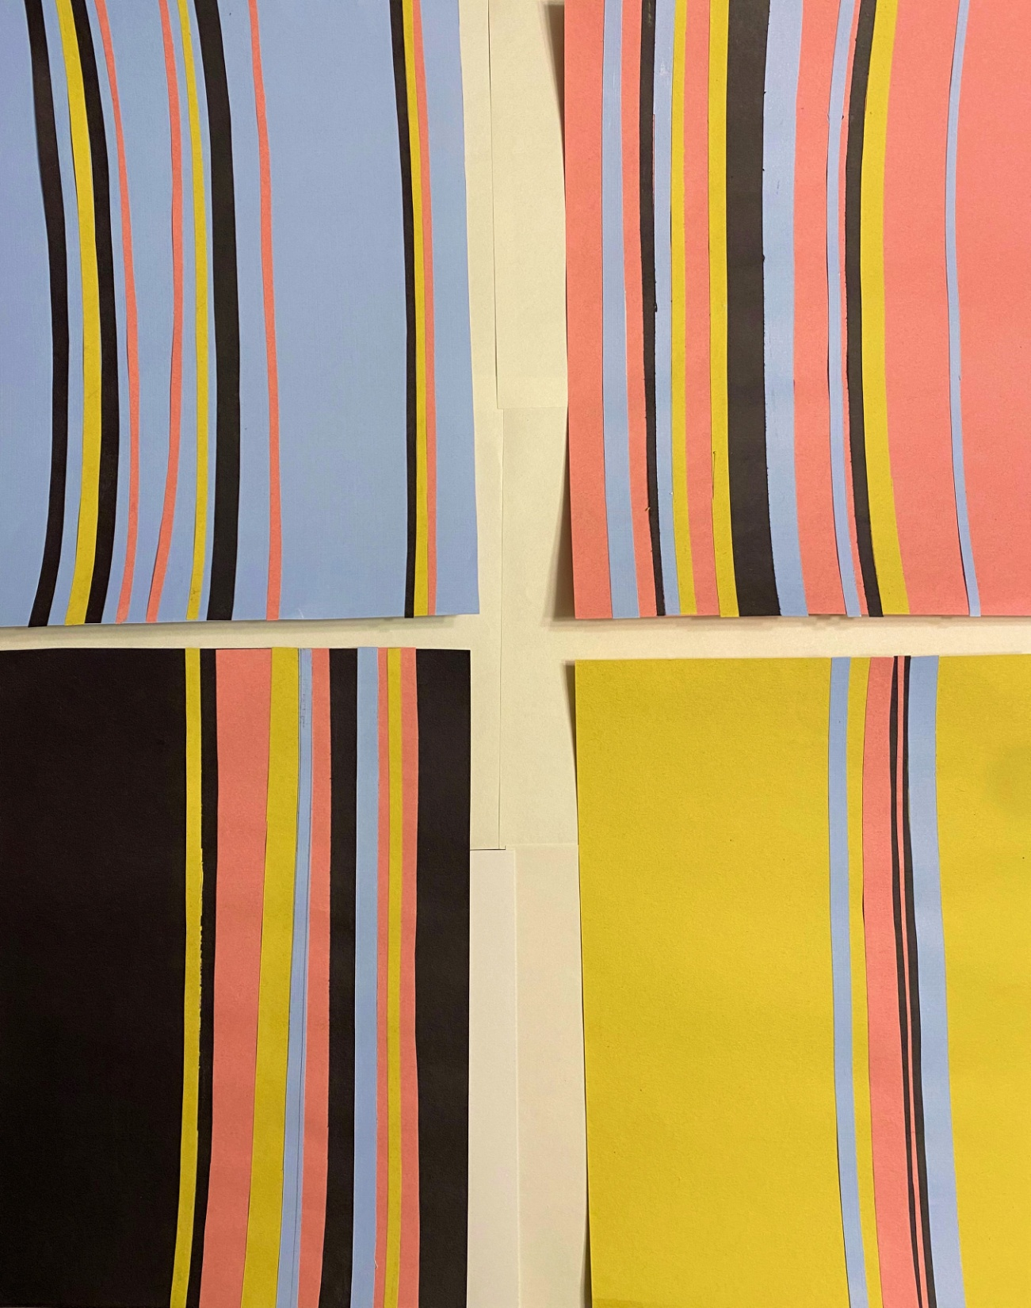

Slide 25
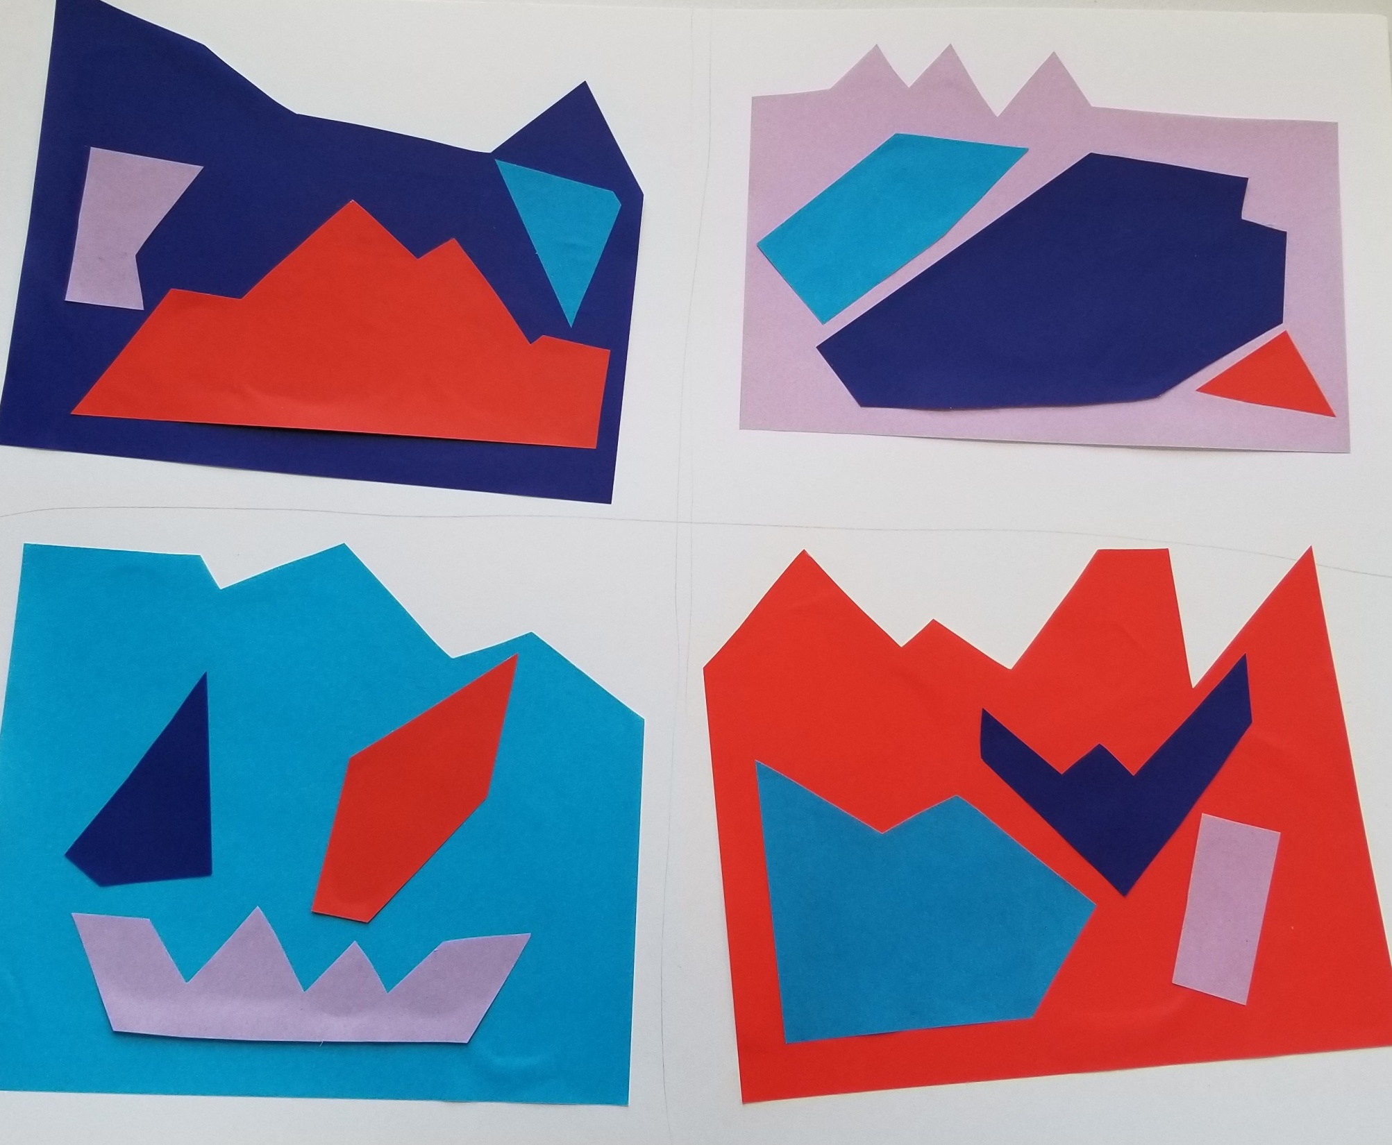

Slide 26
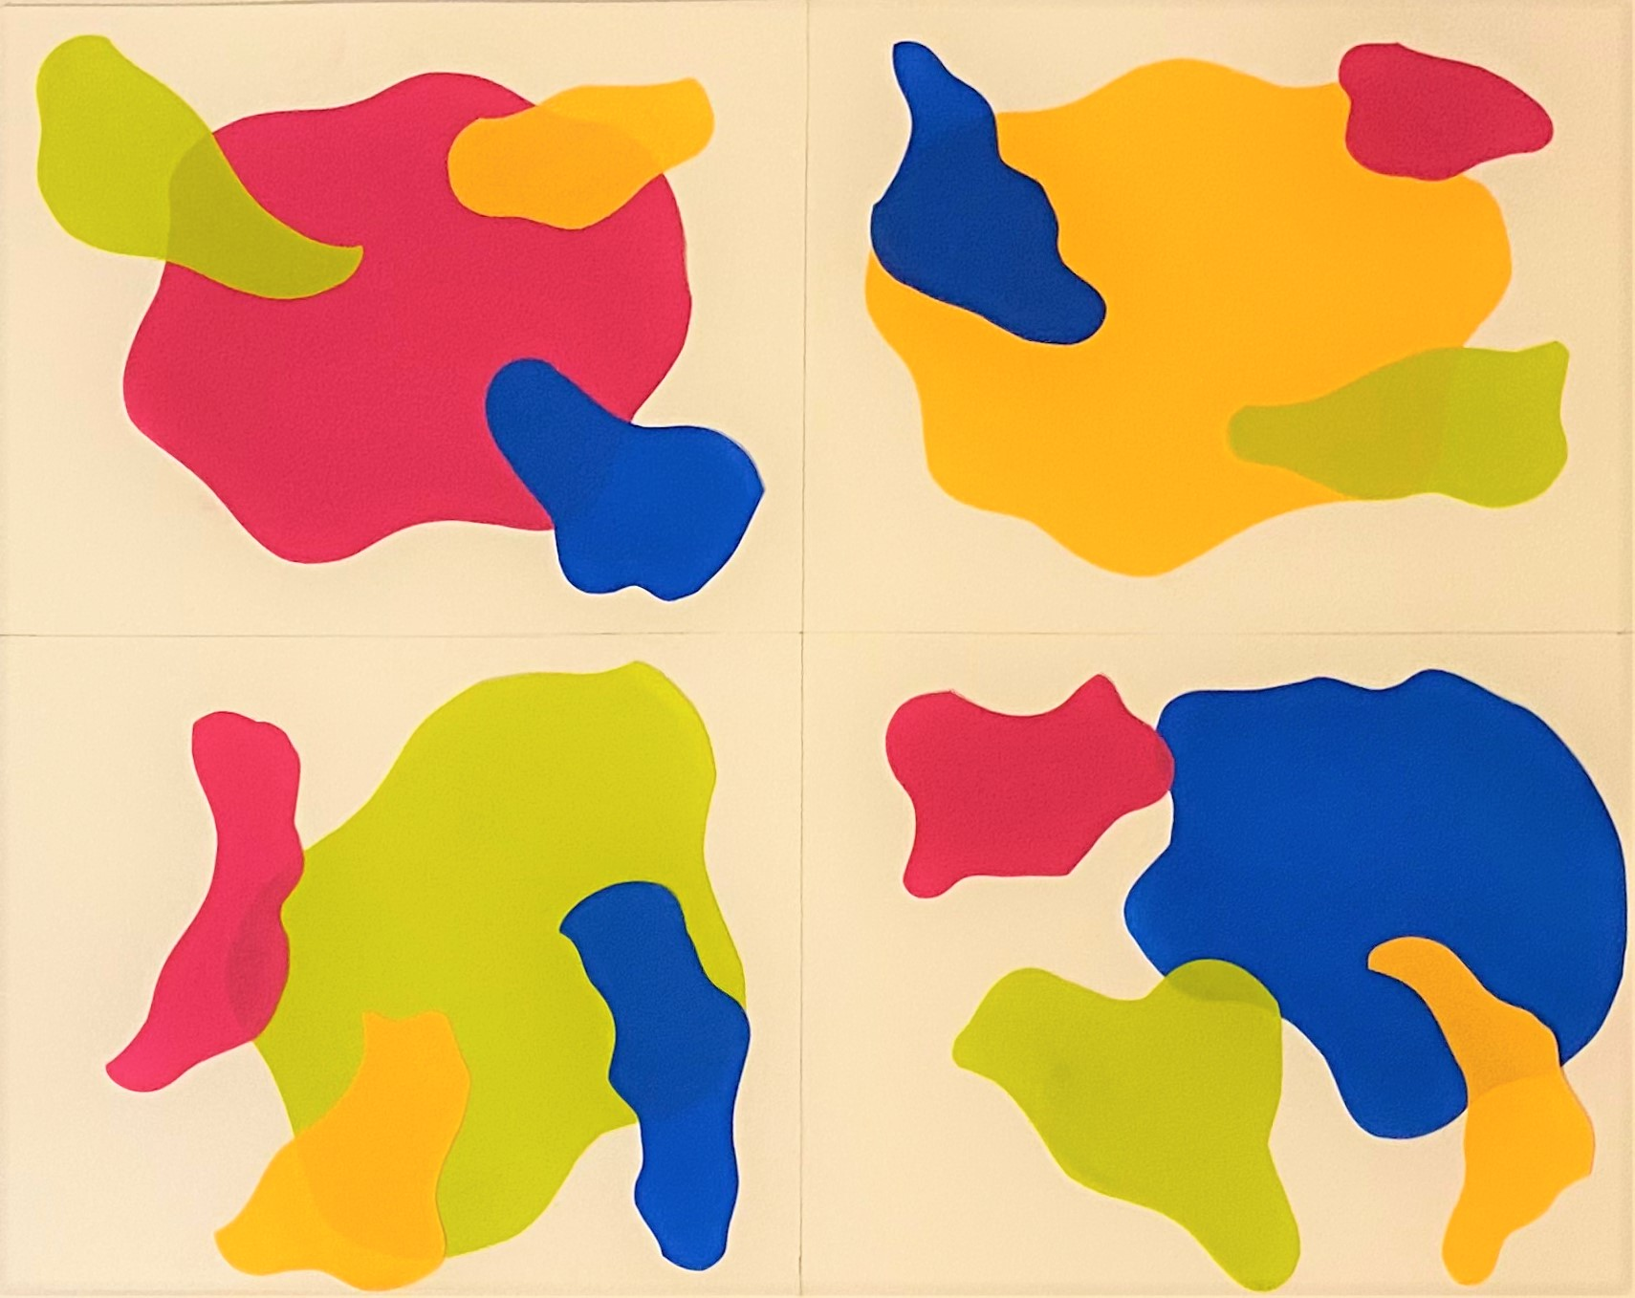

Slide 27
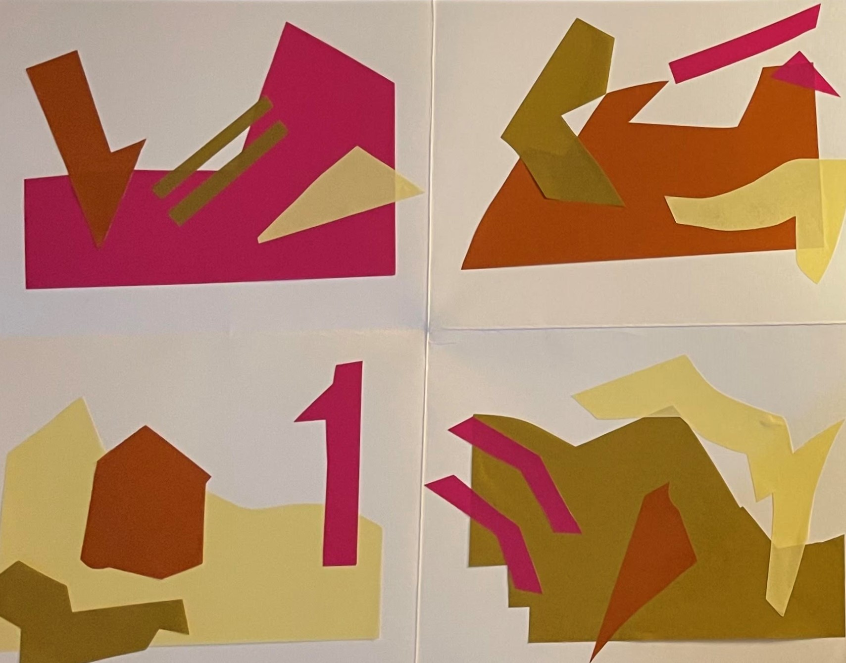

Slide 28
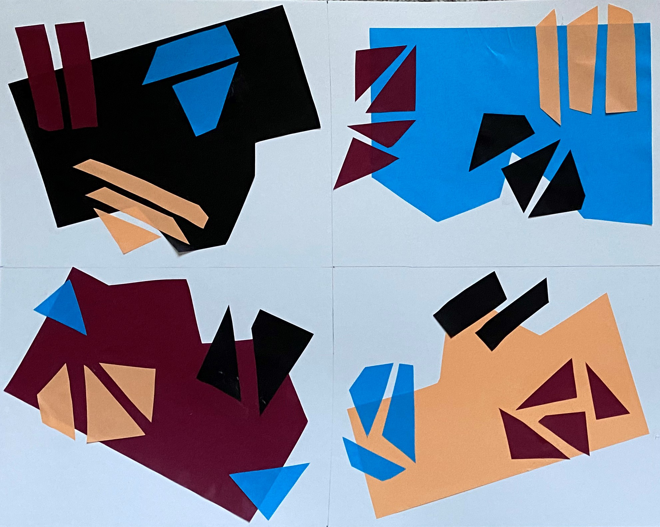

Slide 29
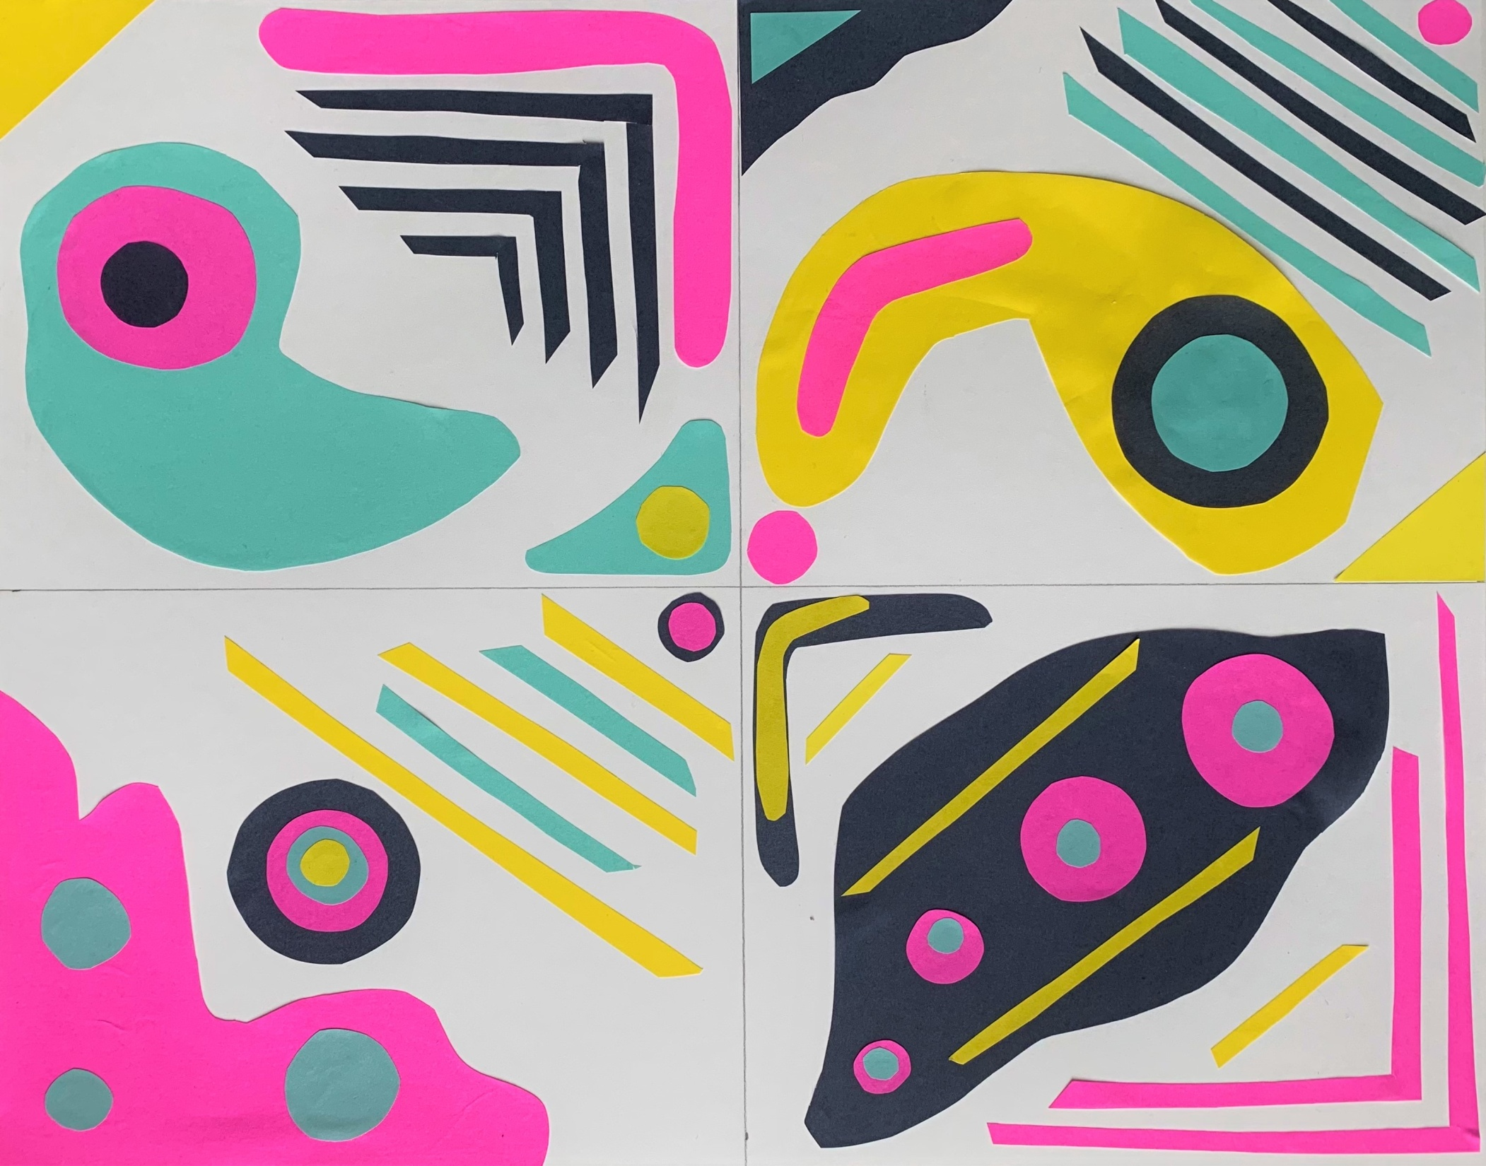

Slide 30
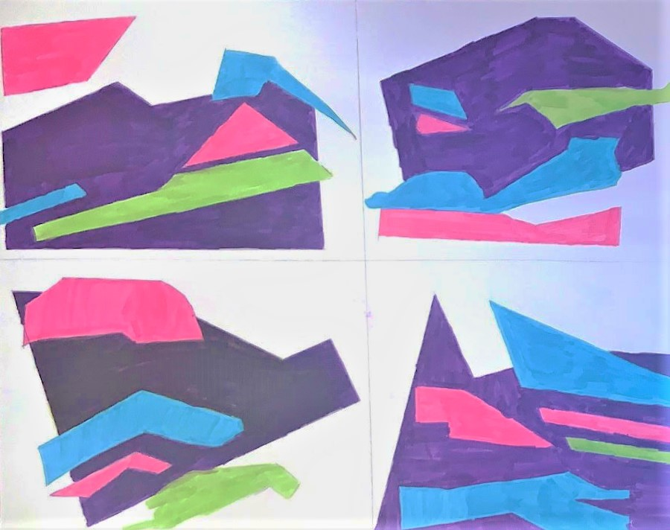

Slide 31
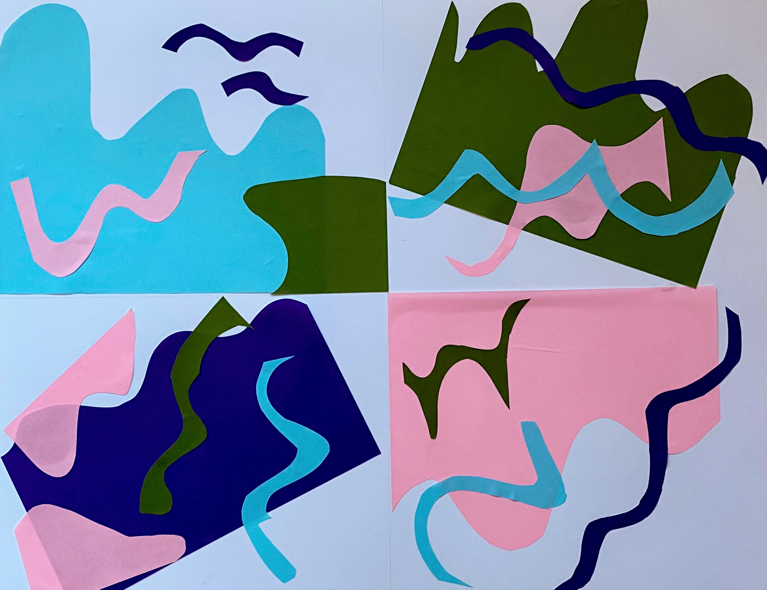

Slide 32
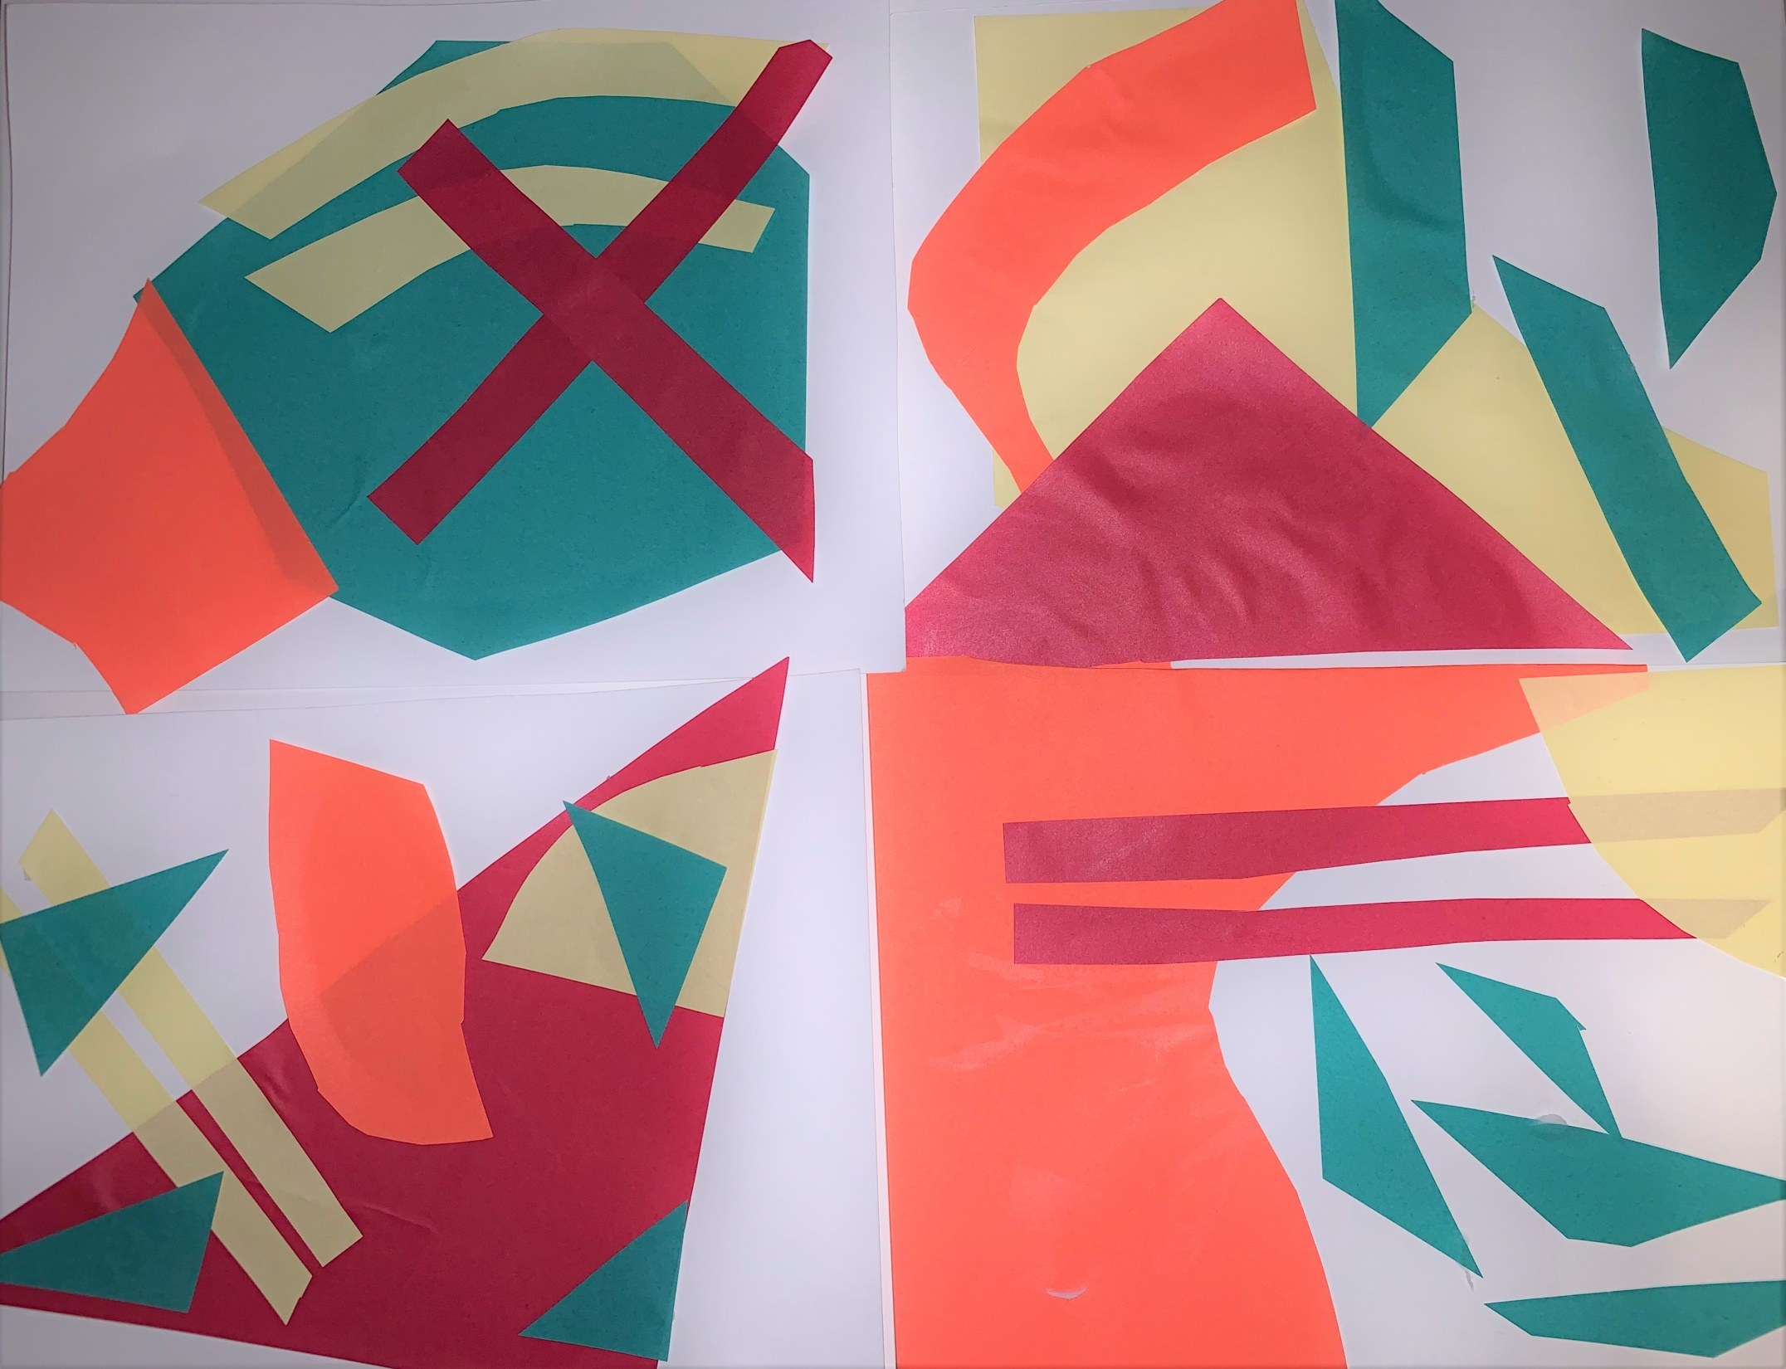

Slide 33
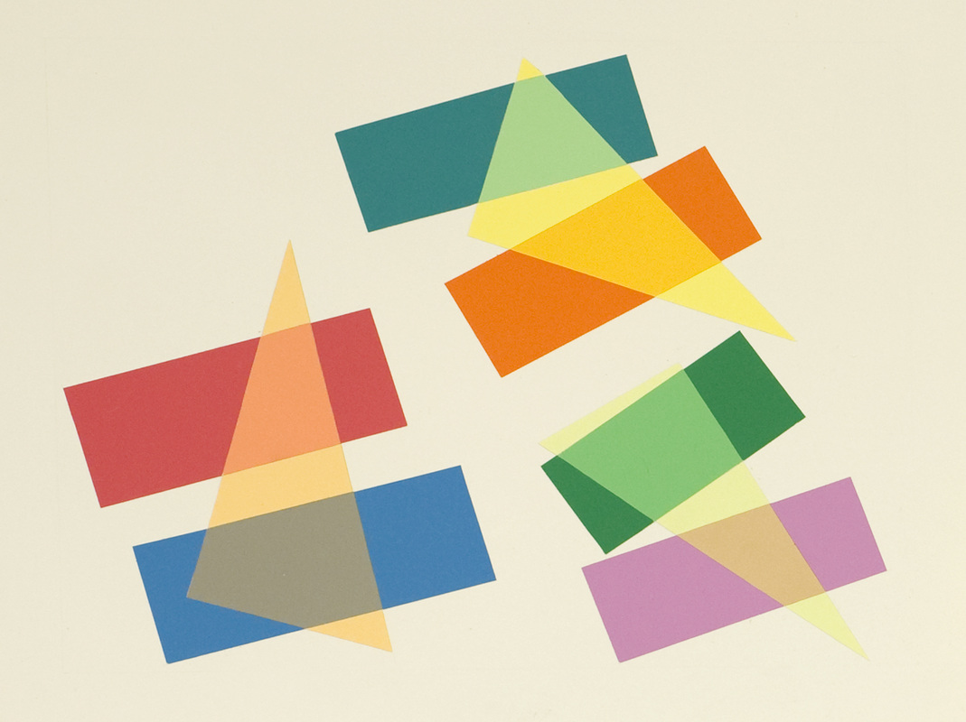
SIMULATED TRANSPARENCY

Slide 34
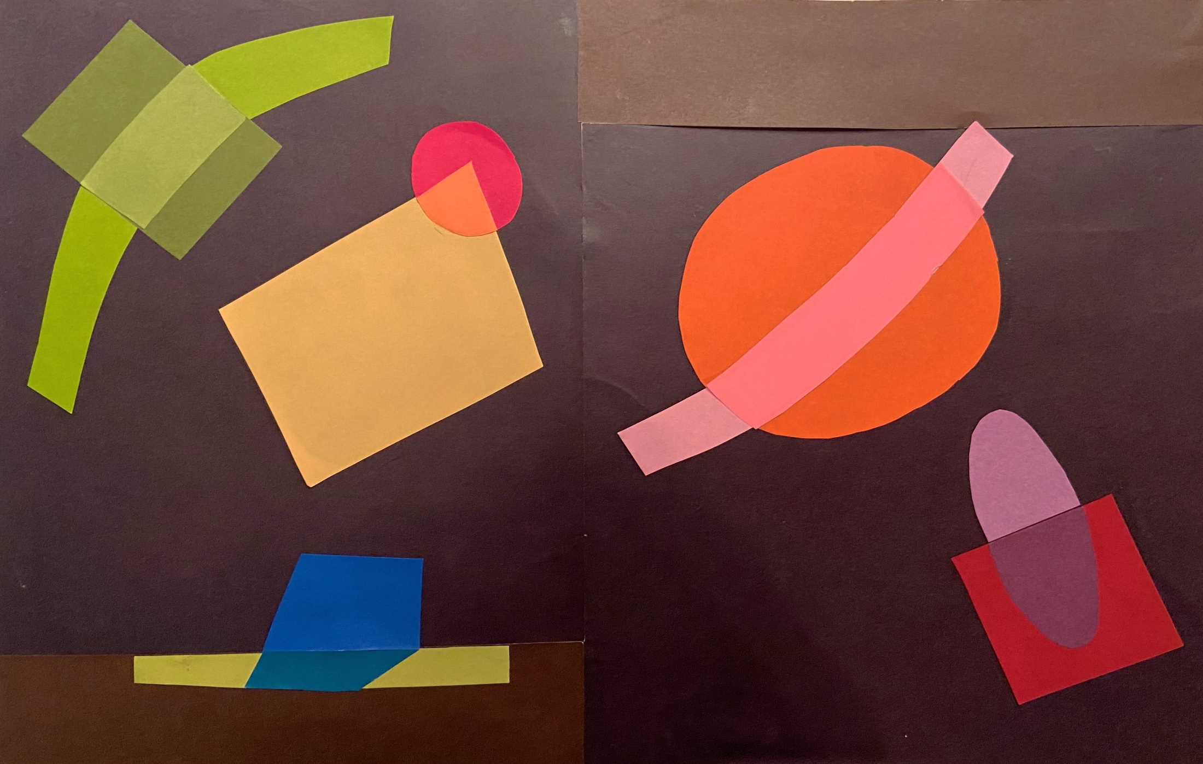

Slide 35
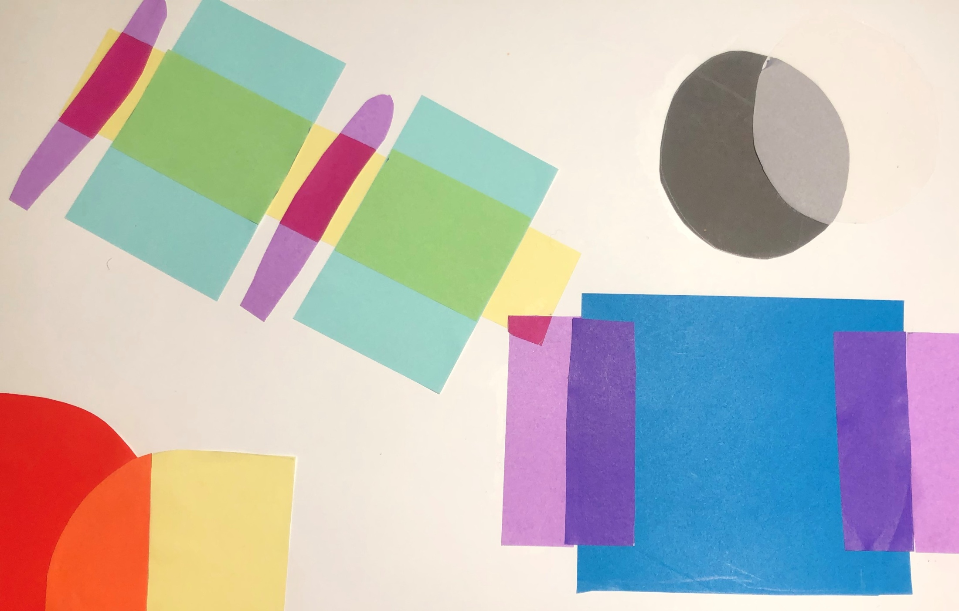

Slide 36
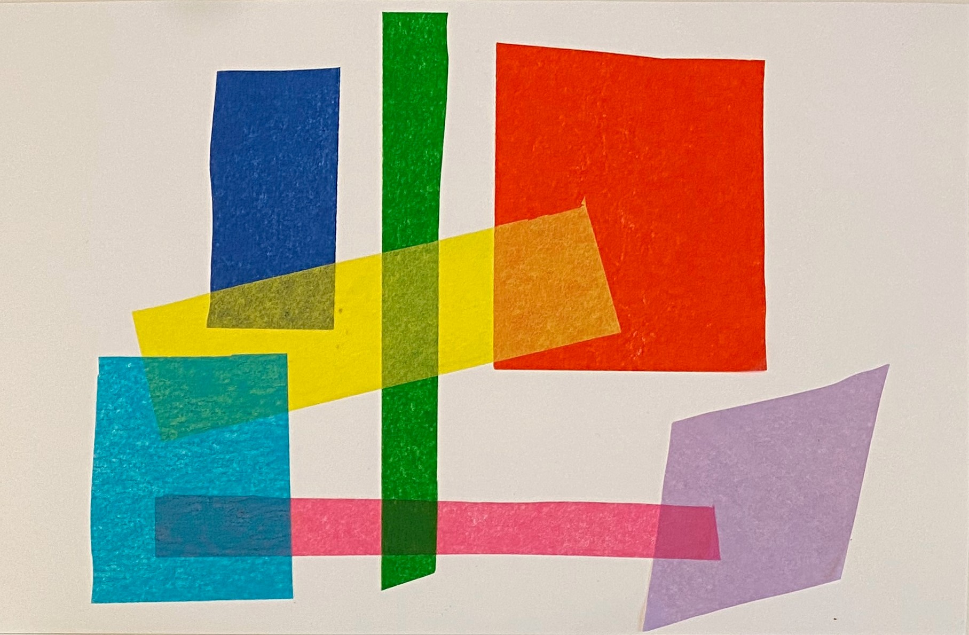

Slide 37
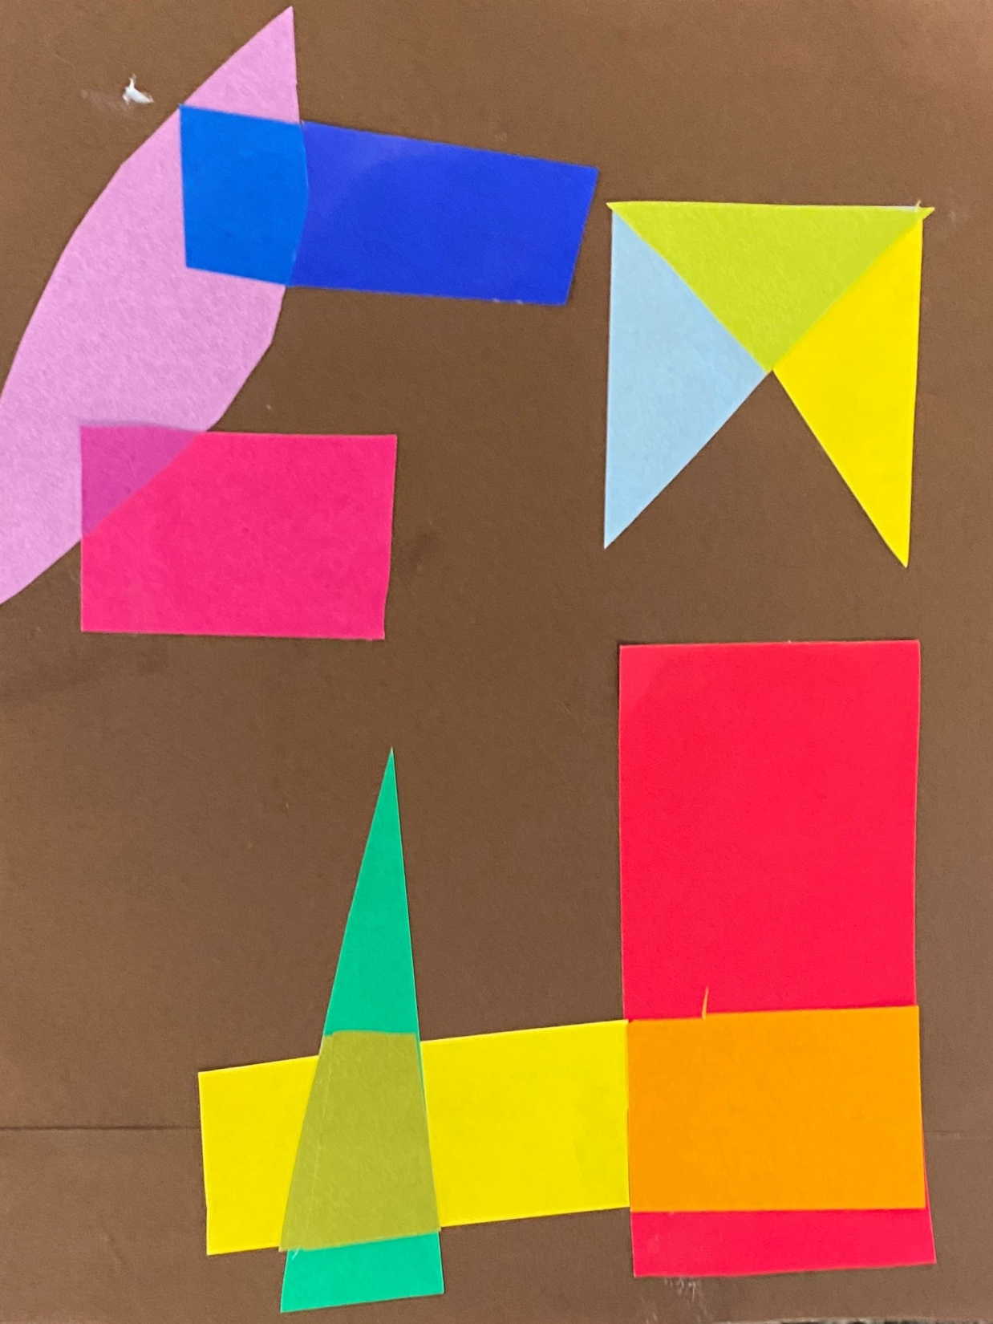

Slide 38
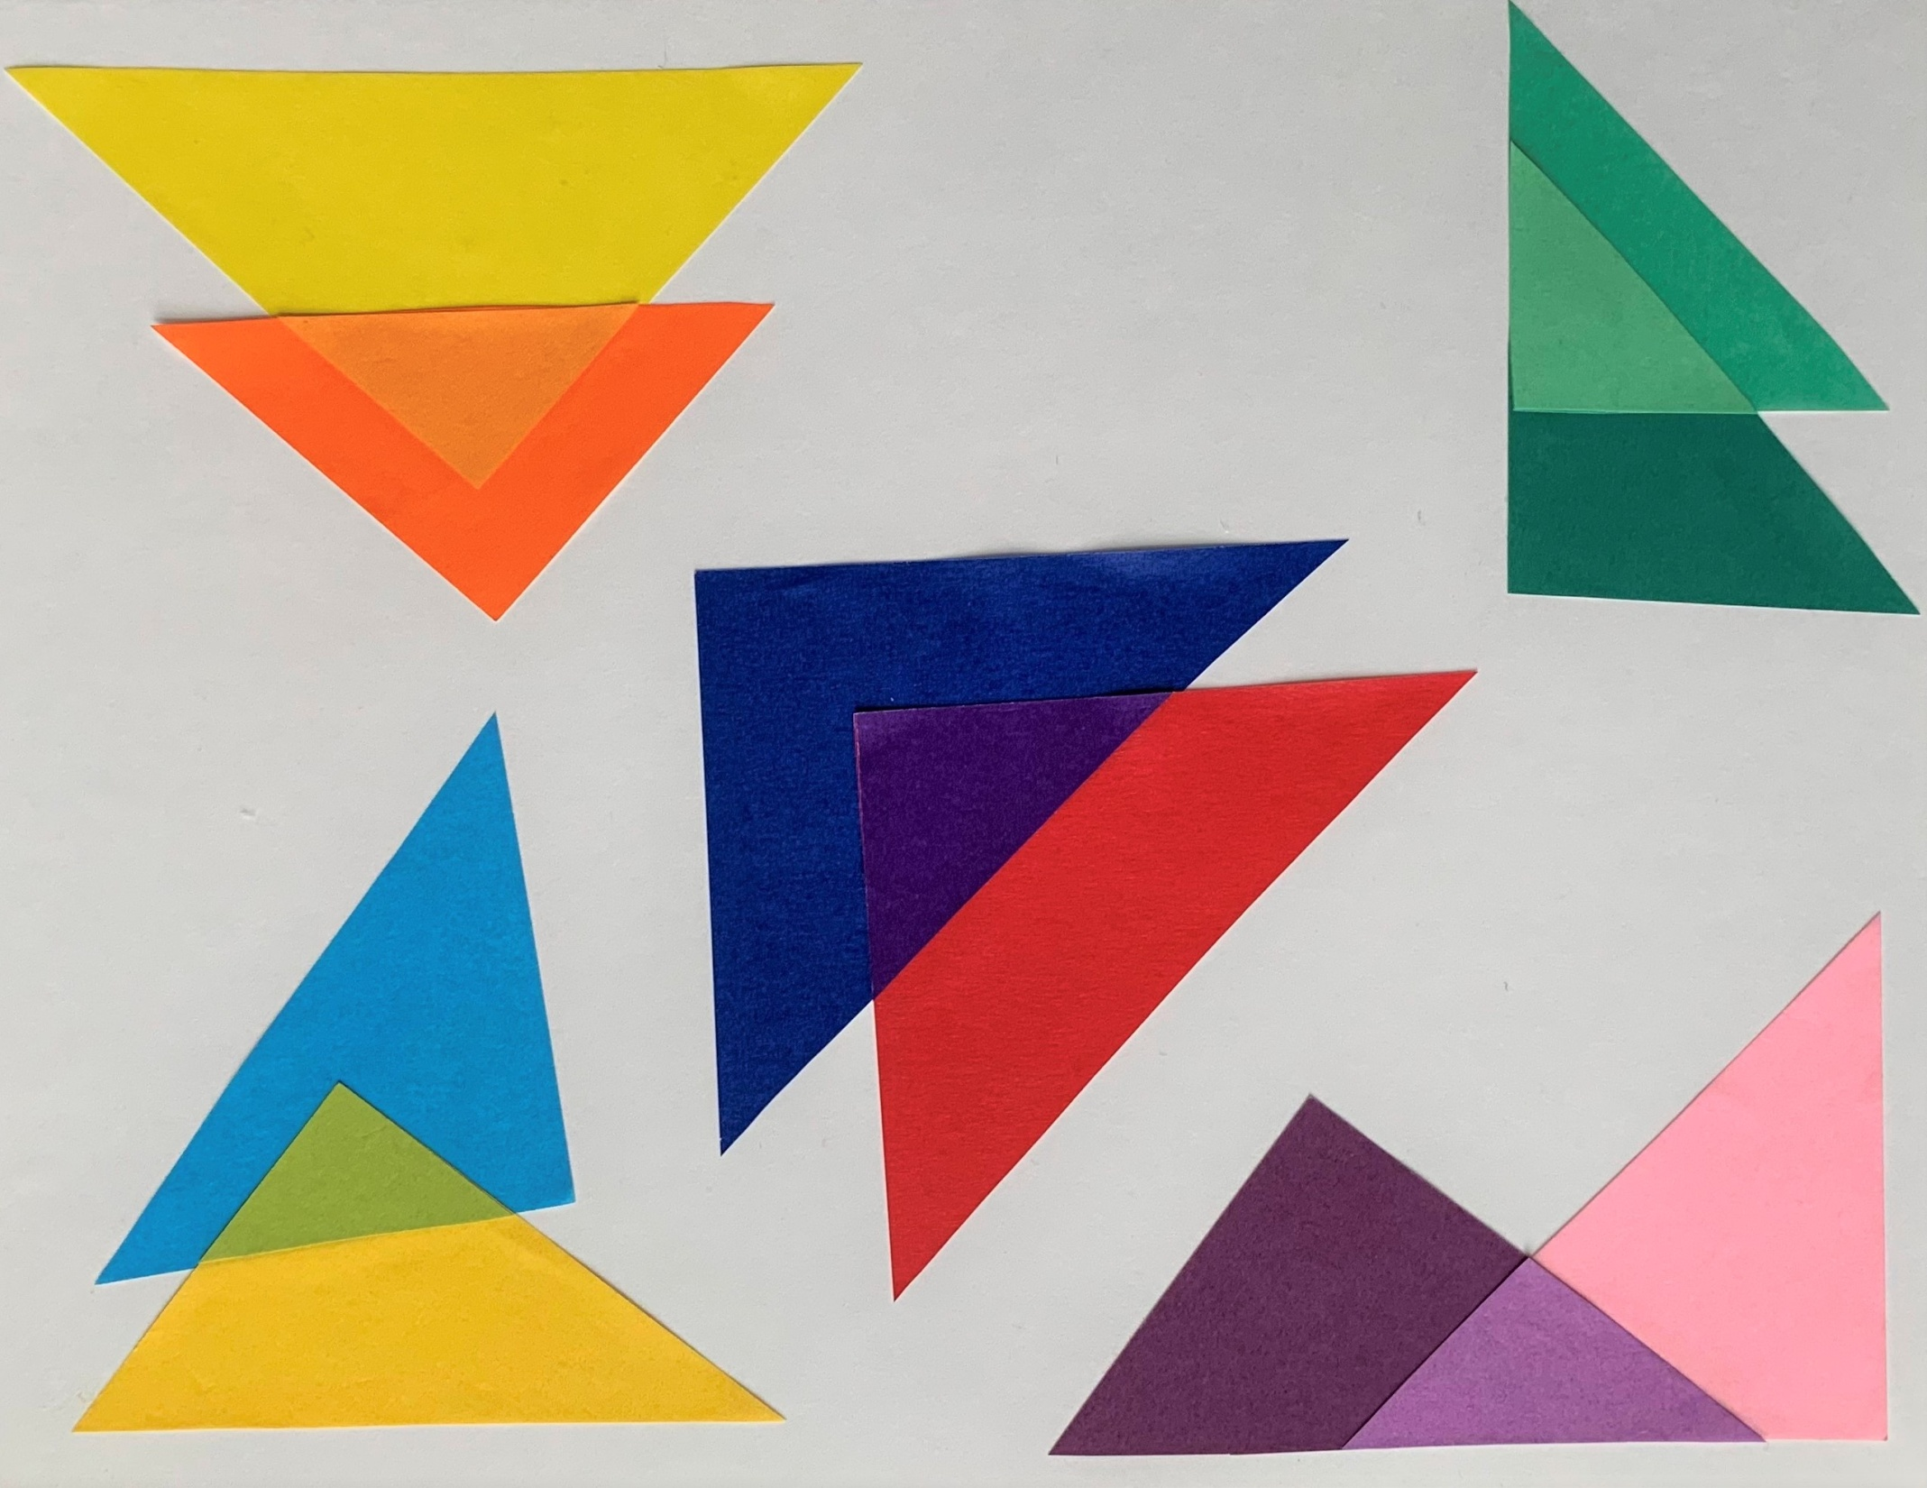

Slide 39
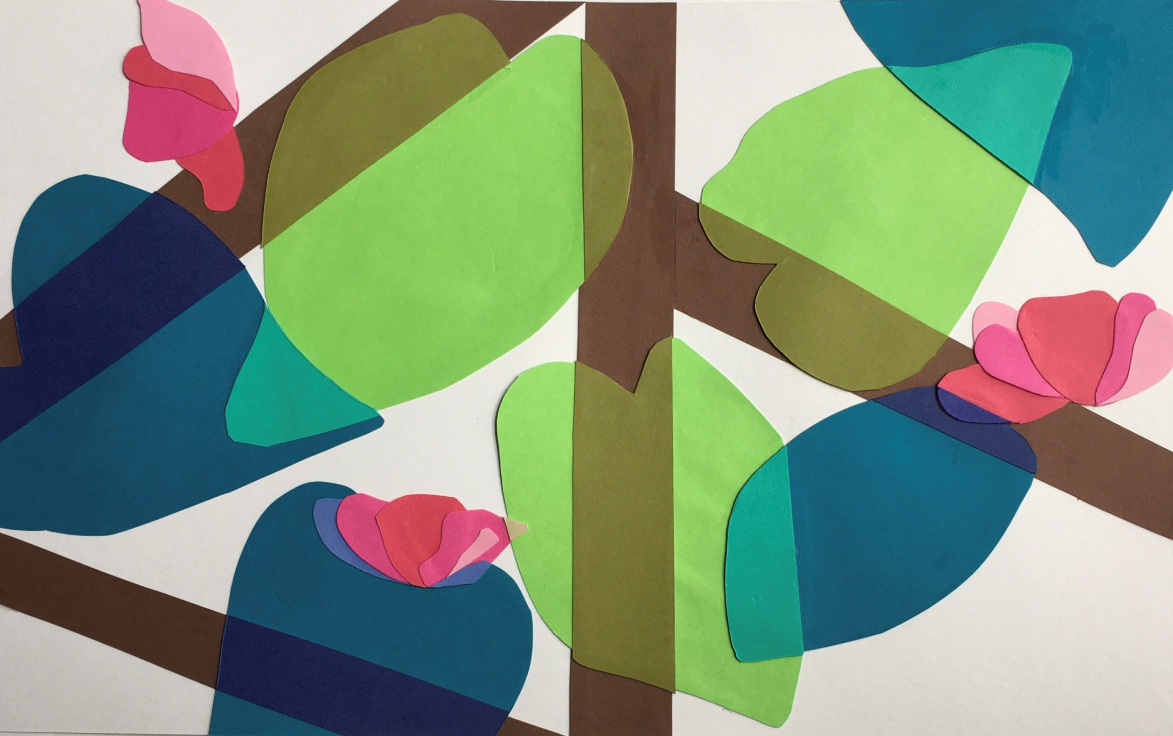

Slide 40


Slide 41
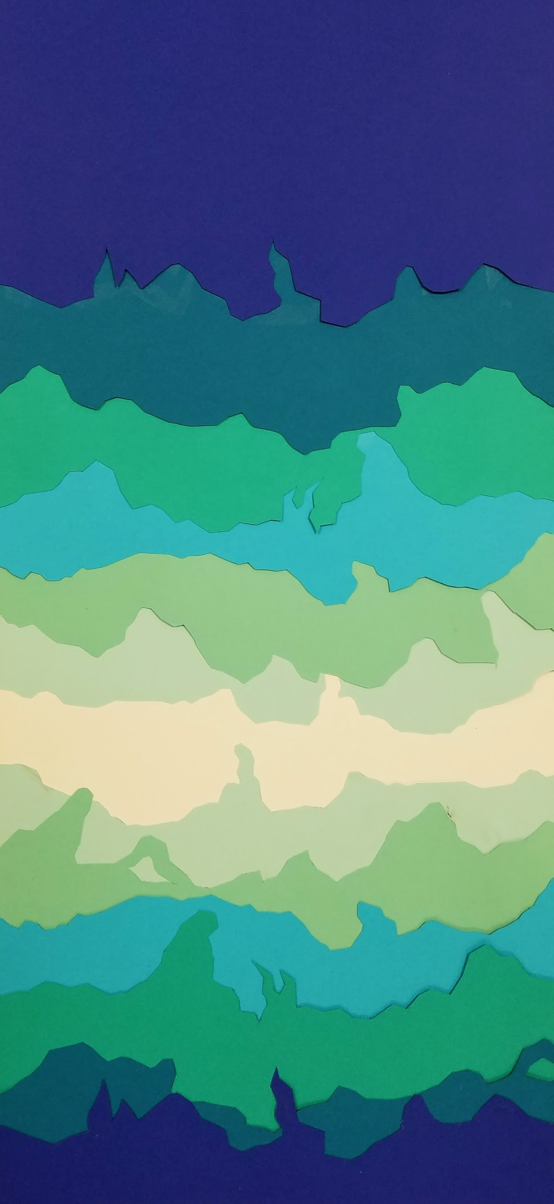
COLOR IN SPACE

Slide 42
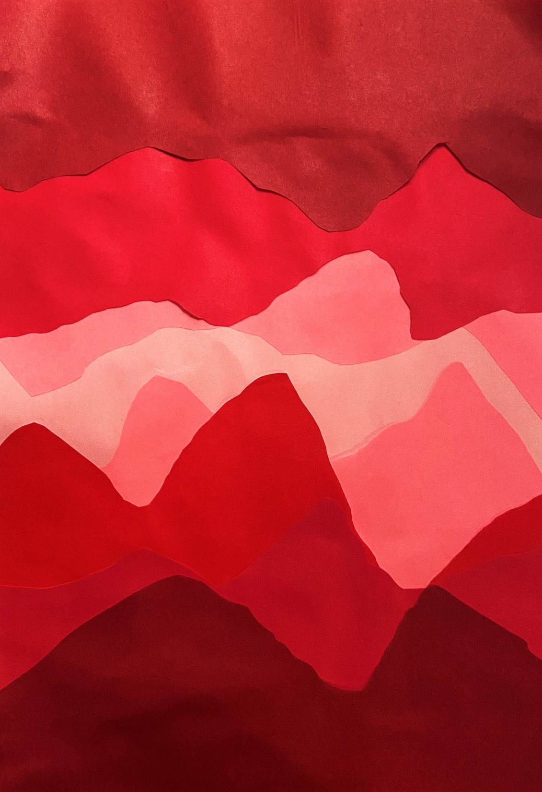

Slide 43
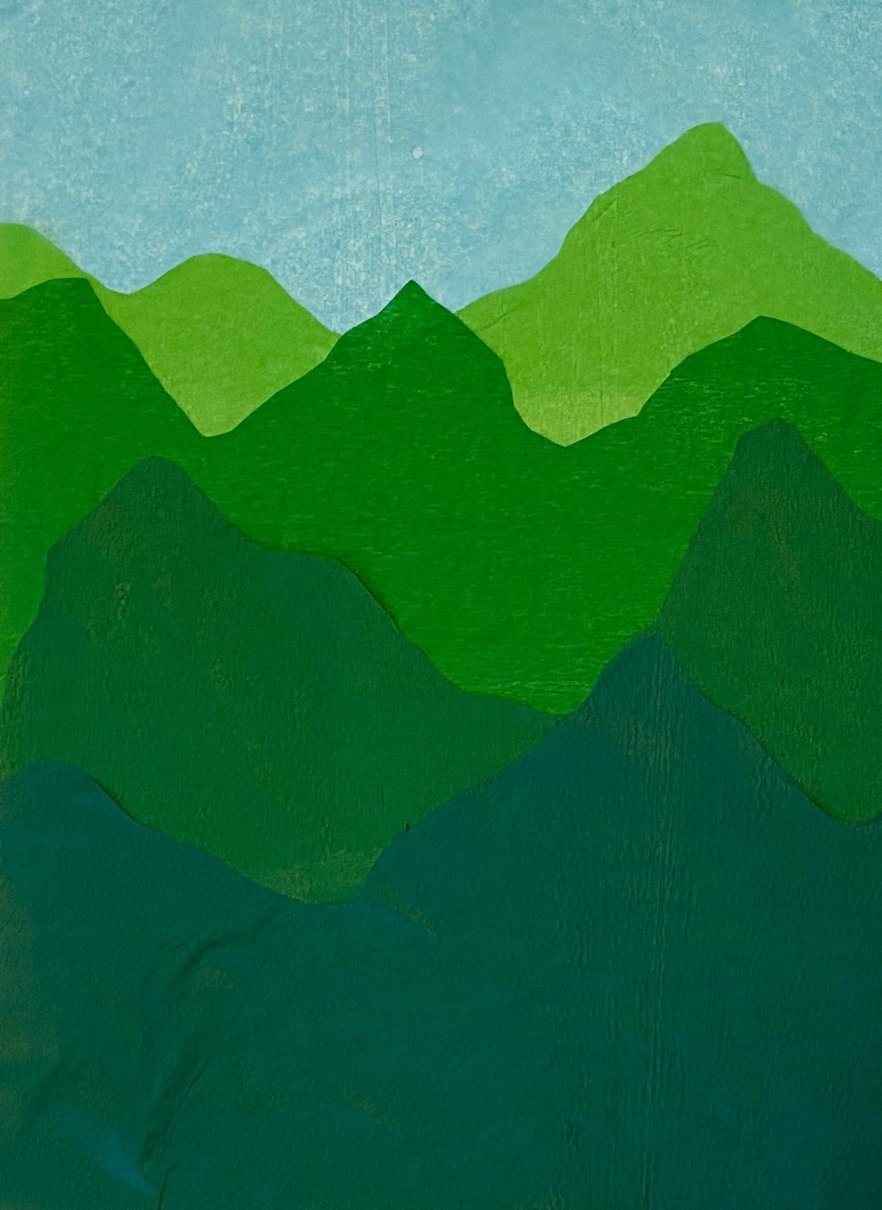

Slide 44
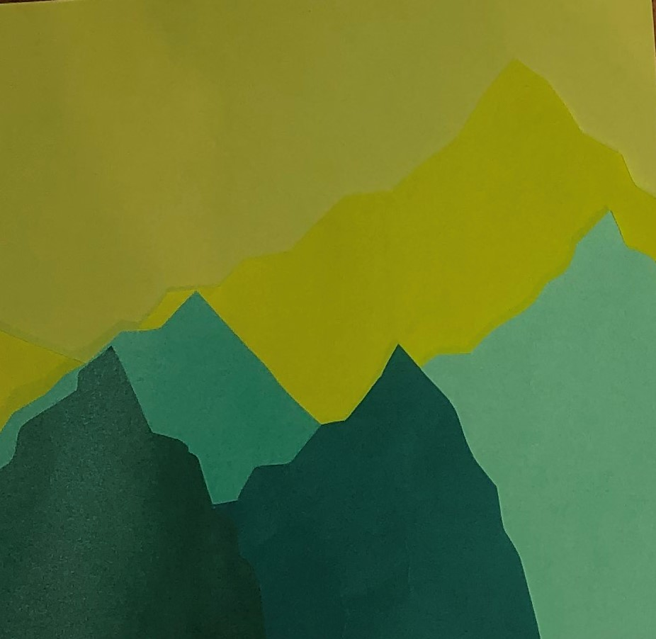

Slide 45
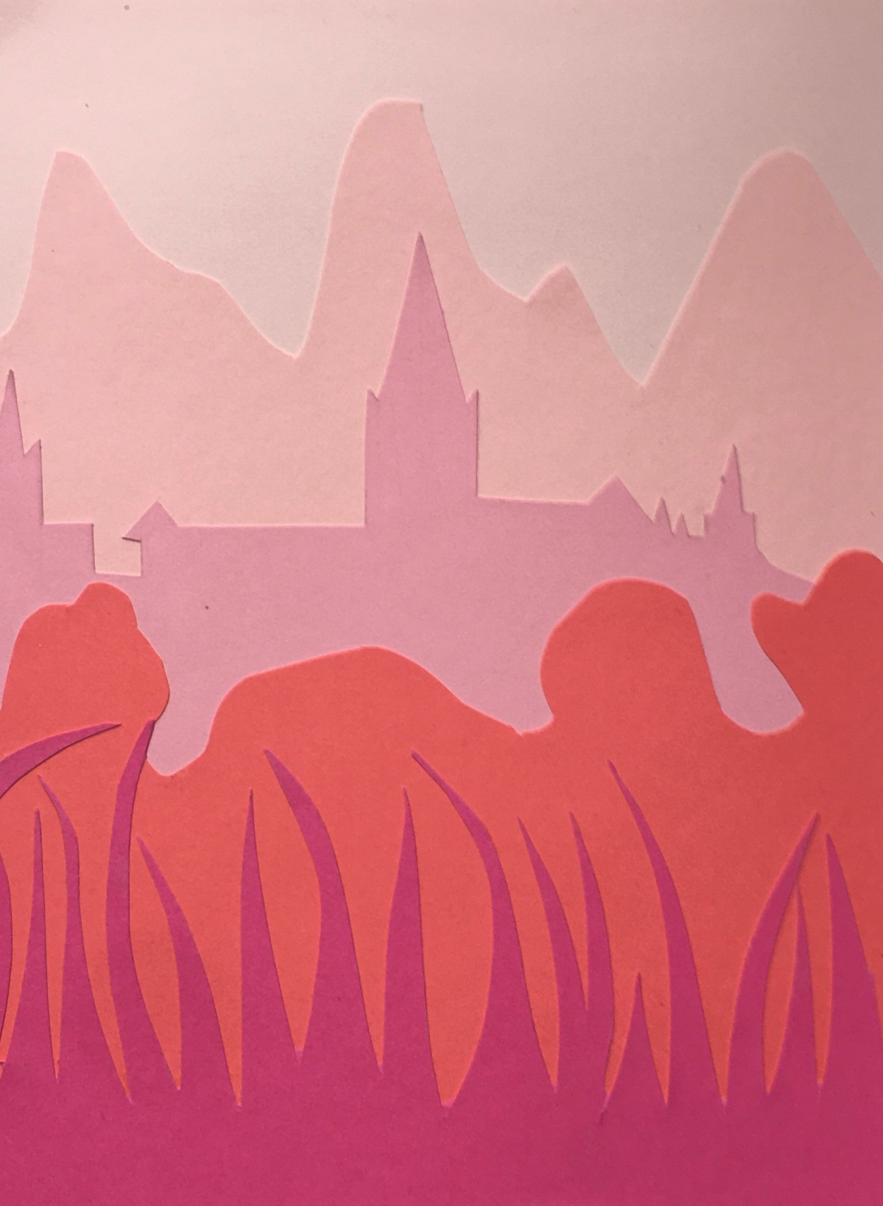

Slide 46
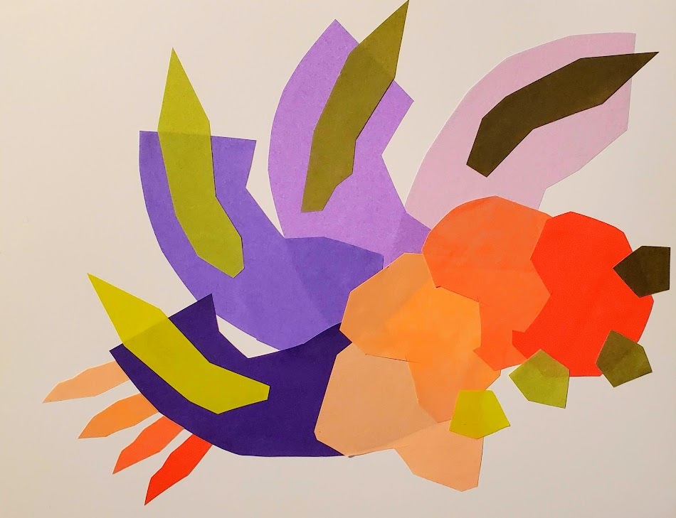
COLOR PROGRESSION

Slide 47
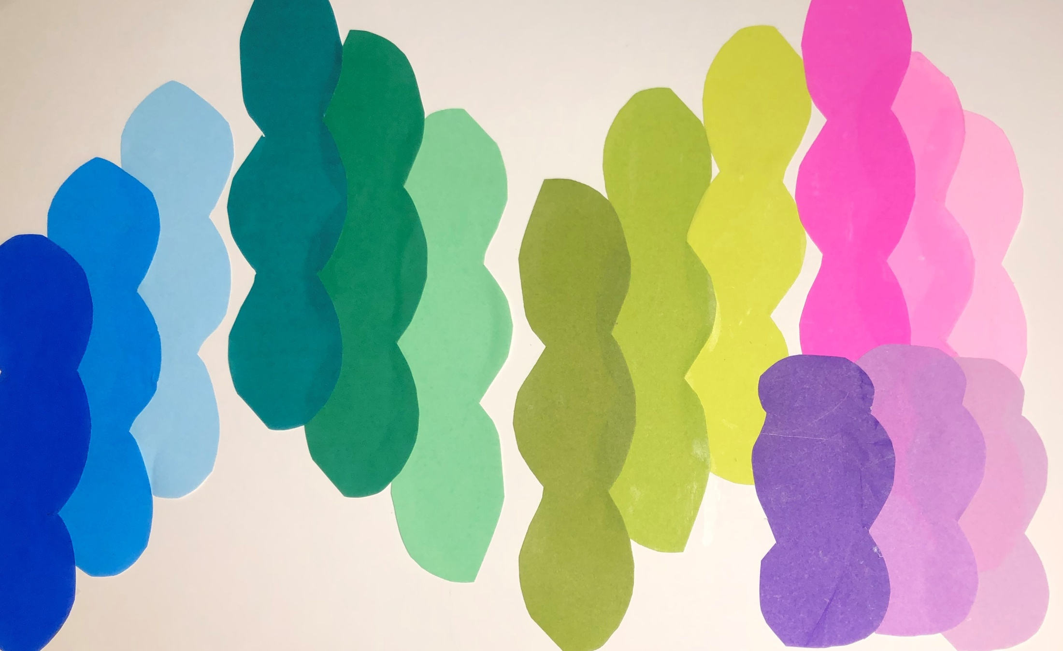

Slide 48
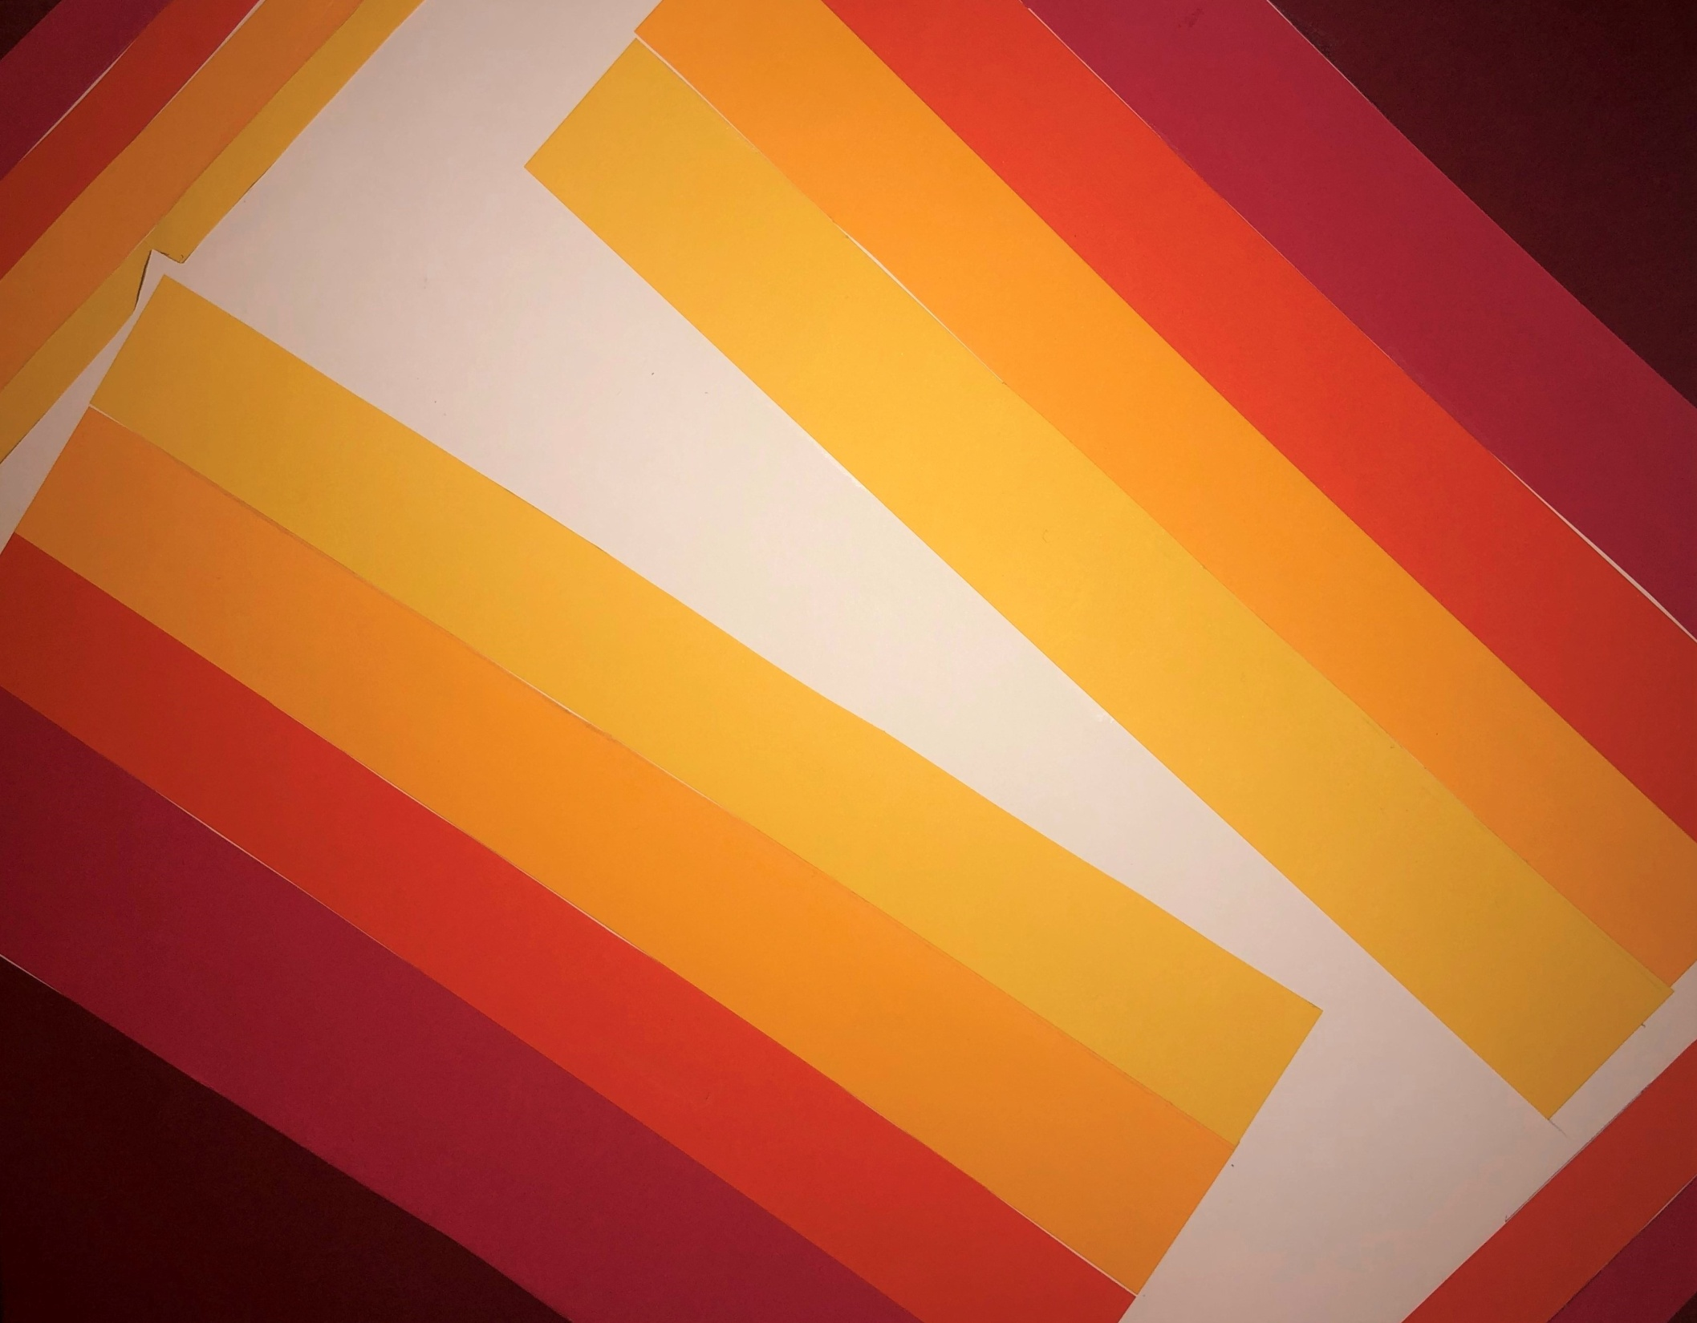

Slide 49
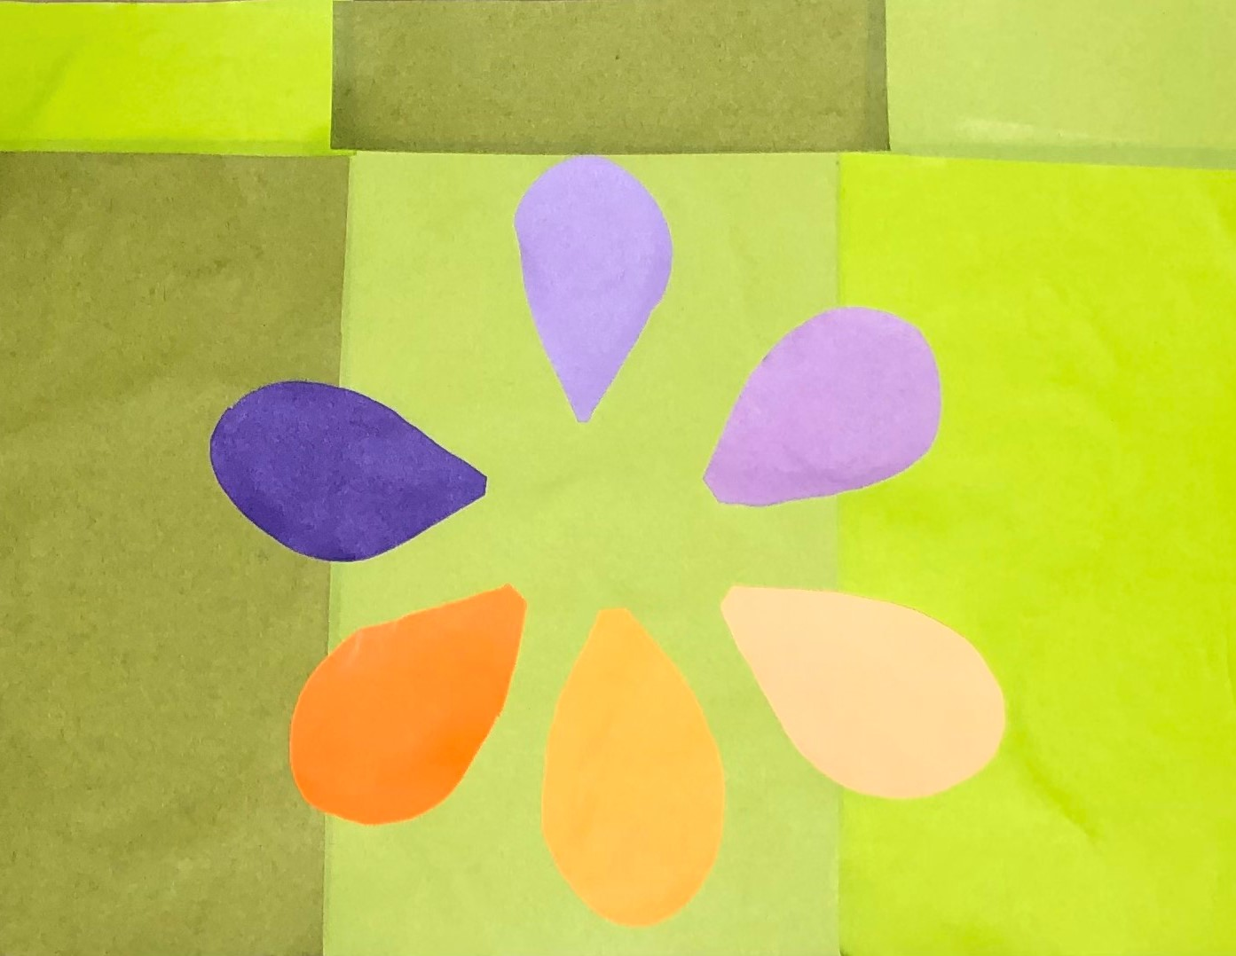

Slide 50
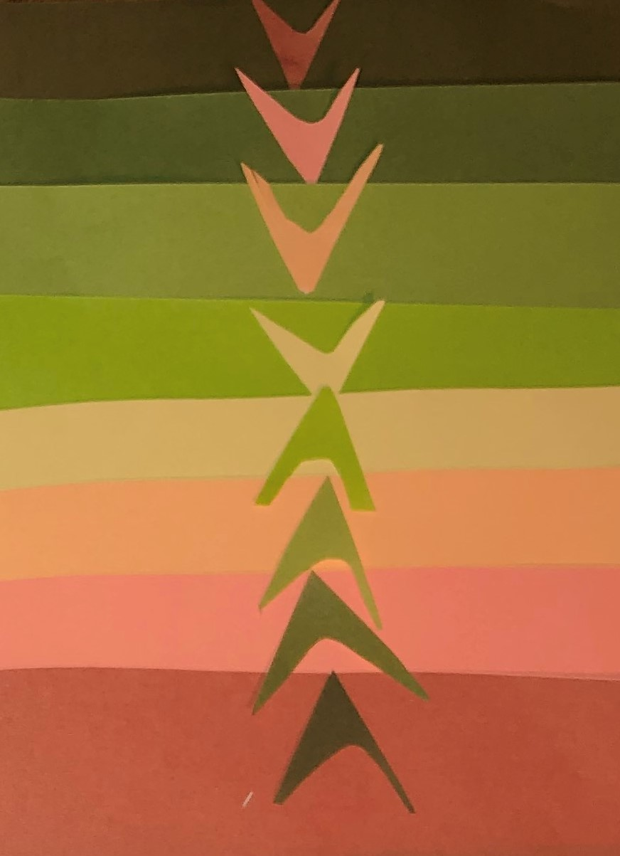

Slide 51


Slide 52


Slide 53

OP ART: Equiluminance

Slide 54


Slide 55


Slide 56


Slide 57


Slide 58


Slide 59


Slide 60


Slide 61


Slide 62


Slide 63


Slide 64


Slide 65


Slide 66


Slide 67


Slide 68


Slide 69


Slide 70


Slide 71


Slide 72


Slide 73


HARMONY + DISCORD: BOTANICAL DESIGNS

Slide 74


Slide 75



Slide 76



Slide 77



Slide 78



Slide 79



Slide 80



Slide 81



Slide 82



Slide 83


Slide 84



Slide 85



Slide 86



Slide 87



Slide 88



Slide 89



Slide 90


ALBUM COVER: Synaesthesia

Slide 91


Slide 92


Slide 93


Slide 94


Slide 95


Slide 96


Slide 97


Slide 98


Slide 99



Slide 100


Slide 101


Slide 102


Slide 103


Slide 104


Slide 105



Slide 106


Slide 107


Slide 108


